Slide 1
Genedrive MT-RNR1
Product Introduction

Slide 2
Contents
Why Pharmacogenetics
The Problem – Aminoglycosides Induced Hearing Loss
The Consequence
The Guidance
The intervention
The Impact

Slide 3
Why Pharmacogenetics
Some patients may experience reduced effectiveness of the drug. ​
Medications can work differently
for everyone
Genes can affect patient response to medication
Or an unexpected harmful response, known as an Adverse Drug Reaction (ADR)
Notes:
https://medregs.blog.gov.uk/2023/10/02/the-role-of-genetics-in-medicine-safety/
Osanlou R, Walker L, Hughes DA, et al Adverse drug reactions, multimorbidity and polypharmacy: a prospective analysis of 1 month of medical admissions BMJ Open 2022;12:e055551. doi: 10.1136/bmjopen-2021-055551
Clinical Pharmacogenetics Implementation Consortium (2020) Clinical Pharmacogenetics Implementation Consortium (CPIC) Guideline for the Use of Aminoglycosides Based on MT-RNR1 Genotype. Clinical Pharmacology & Therapeutics, 108(4), pp. 724–729.
Claims matrix reference: Rows 8 -10

Slide 4

The Problem – Aminogylcoside Induced Hearing Loss
Aminoglycosides are a class of commonly prescribed antibiotics (including gentamicin)
Around 1 in 500 people have the pathogenic variant depending on the patient cohort
A variant in the MT-RNR1 gene (m. 1555A>G) can cause irreversible hearing loss in susceptible individuals
Notes:
https://medregs.blog.gov.uk/2023/10/02/the-role-of-genetics-in-medicine-safety/
2. J. M. Barbarino, T. L. McGregor, R. B. Altman, and T. E. Klein, PharmGKB summary: very important pharmacogene information for MT-RNR1. Pharmacogene Genomics, 2016. 26(12): p. 558-567.
3. Clinical Pharmacogenetics Implementation Consortium (2020) Clinical Pharmacogenetics Implementation Consortium (CPIC) Guideline for the Use of Aminoglycosides Based on MT-RNR1 Genotype. Clinical Pharmacology & Therapeutics, 108(4), pp. 724–729.
Claims matrix reference: Rows 8 -10, 12- 13

Slide 5
The Consequence – The wrong drug
Carriers are at a greater risk of irreversible hearing loss, particularly neonates after aminoglycoside antibiotics exposure
Population Frequencies of MT-RNR1 Variants by Ethnicity
MT-RNR1 allele | Central/South Asian | East Asian | European* | Near Eastern | Sub-Saharan African
m.1555A>G | 1 in 900 | 1 in 55 | 1 in 900 | 1 in 700 | 1 in 333
*Frequency observed in the UK from routine testing ~1 in 300
Notes:
Clinical Pharmacogenetics Implementation Consortium (2020) Clinical Pharmacogenetics Implementation Consortium (CPIC) Guideline for the Use of Aminoglycosides Based on MT-RNR1 Genotype. Clinical Pharmacology & Therapeutics, 108(4), pp. 724–729.
Claims matrix reference: Rows 8 -10, 12- 13

Slide 6
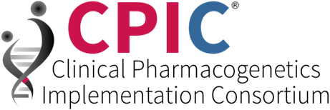
The Guidance - CPIC
Use of aminoglycosides should be avoided in individuals with an MT-RNR1 variant associated with an increased risk of aminoglycoside-induced hearing loss.
Clinical Pharmacogenetics Implementation Consortium (CPIC) guideline for the use of aminoglycosides based on MT-RNR1 genotype
Notes:
Clinical Pharmacogenetics Implementation Consortium (2020) Clinical Pharmacogenetics Implementation Consortium (CPIC) Guideline for the Use of Aminoglycosides Based on MT-RNR1 Genotype. Clinical Pharmacology & Therapeutics, 108(4), pp. 724–729.
Claims matrix reference: Rows 8 -10, 12- 13

Slide 7

The Guidance – European Medicines Agency
The EMA, CMDh, and PRAC have issued safety-related updates to the product information for systemic aminoglycosides.
there is sufficient evidence to reflect a warning between gentamicin (systemic use) and increased risk of aminoglycoside-associated ototoxicity in patients with mitochondrial mutations in the product information.
Notes:
ttps://www.ema.europa.eu/en/documents/psusa/gentamicin-systemic-use-cmdh-scientific-conclusions-grounds-variation-amendments-product-information-timetable-implementation-psusa-00009159-202303_en.pdf
European Medicines Agency (EMA),
Coordination Group for Mutual Recognition and Decentralised Procedures – Human (CMDh)
Pharmacovigilance Risk Assessment Committee (PRAC)
CMDh Scientific Conclusions
Gentamicin (systemic use) - PSUSA/00009159/202303
Tobramycin (systemic use) - PSUSA/00009318/202009
Amikacin (systemic use) - PSUSA/00000143/202206

Slide 8

The Guidance –
NICE Early Value Assessment
NICE recommend the use of the Genedrive® MT-RNR1 ID Kit
The Genedrive® MT‑RNR1 ID Kit can be used while further evidence is generated as an option for detecting the genetic variant m.1555A>G to guide antibiotic (aminoglycoside) use and prevent hearing loss in newborns.”⁷
Notes:
Overview | Genedrive MT-RNR1 ID Kit for detecting a genetic variant to guide antibiotic use and prevent hearing loss in babies: early value assessment | Guidance | NICE
NICE is a UK organisation with a remit to balance the best care with value for money across the NHS and social care, to deliver for both individuals and society as a whole.
Key recommendations:
The Genedrive® MT-RNR1 ID Kit can be used in the NHS, while further evidence is generated, as an option for detecting the genetic variant m.1555A>G to guide antibiotic (aminoglycoside) use and prevent hearing loss in newborns who are being considered for treatment with aminoglycosides.
Healthcare professionals should tell parents about the possible implications of positive test results for their baby and their family at an appropriate time and give support and information.
Positive results should be confirmed by laboratory testing.
The recommendation is conditional on further evidence being generated.
Claims matrix reference: Rows 22 / 30 / 38 / 39

Slide 9
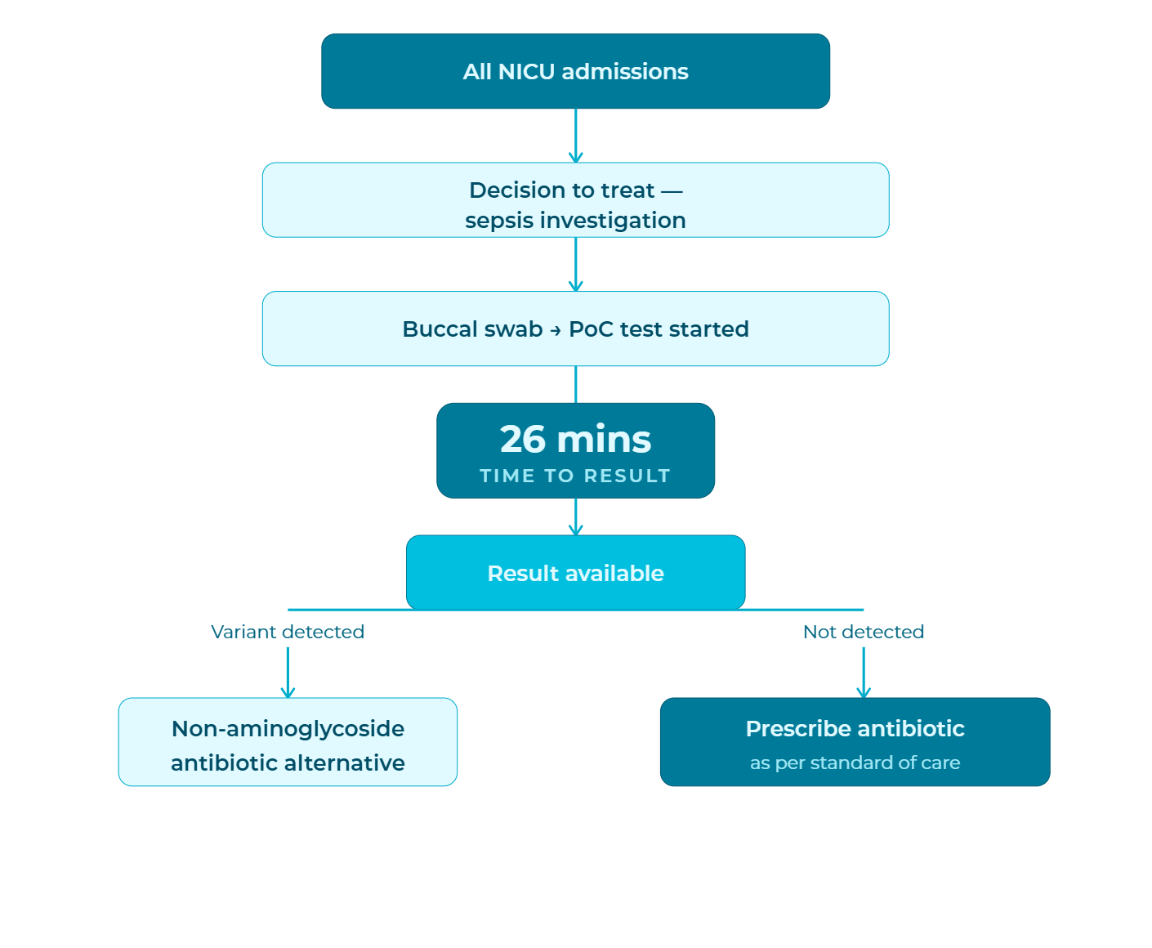

The Guidance - Scottish Health Technologies Group
SHTG provides impartial, evidence-based advice to NHS Scotland on the use of health technologies.
Key Findings:
Newborns with the MT-RNR1 gene variant, m.1555A>G, have an increased risk of permanent hearing loss if treated with aminoglycoside antibiotics.
The Genedrive® MT-RNR1 ID Kit is a point-of-care genetic test providing results in approximately 26 minutes, without delaying antibiotic treatment.
Notes:
Reference: Harbour J, Heggeland M, Bates E, Chappell J, Herbert P, Lakha F, Lee A, Nicol T. (2024). Genotype testing to guide antibiotic
use and prevent hearing loss in neonates. Glasgow/Edinburgh; NHS Healthcare Improvement Scotland.
Available at: https://shtg.scot/our-advice/genotype-testing-to-guide-antibiotic-use-and-prevent-hearing-loss-in-babies/
GPM-168 SHTG MT-RNR1 Assessment Summary

Slide 10



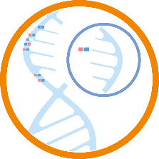
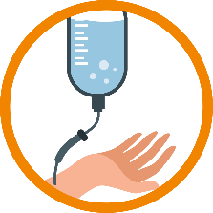


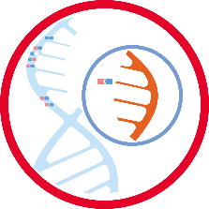
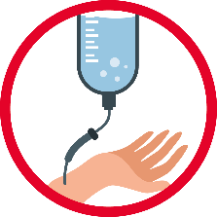

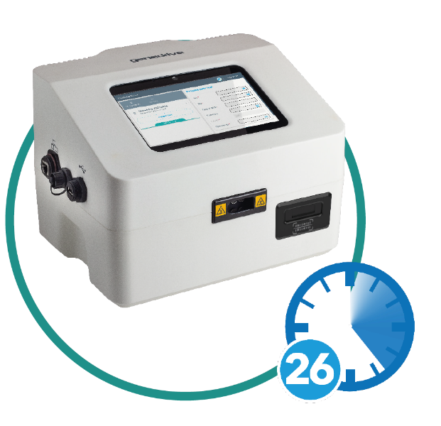




The Intervention - Genedrive
Clinician has 1 hour to administer gentamicin and benzylpenicillin
499 in 500
MT-RNR1 A variant (m.1555A)
Consider gentamicin and benzylpenicillin
Patient is at low risk of AIHL
Baby admitted to NICU
With Genedrive® System implemented
1 in 500
MT-RNR1 G variant (m.1555G)
Consider gentamicin and benzylpenicillin
Patient is at risk of AIHL
Clinician has 1 hour to administer gentamicin and benzylpenicillin
Time to result of 26 mins
1 in 500
MT-RNR1 G variant (m.1555G)
Consider an alternative antibiotic
Patient has reduced risk of AIHL
* AIHL = Aminoglycoside Induce Hearing loss
Notes:
Current Options and the SOLUTION
Golden Hour = the clinician has 1 hour to administer antibiotics from time of admission - this is based on suspicion of sepsis - as a sepsis diagnosis would take longer currently - this is in the NICE guidelines
Option 1 = how things are at the moment - 2% of population at risk of permanent hearing loss
Option 2 = not a cost-effective option, or a good idea due to concerns for antibiotic resistance, gentamicin is effective . Would contradict current NICE Guidance.
Option 3 = too long to wait, not an option
Option 4 = the solution to the clinical need, created with and for clinicians and patients in mind, the time to result ensures treatment can be administered in a clinically actionable timeframe
Innovative product
Nothing else currently on the market to meet these needs

Slide 11
The Intervention – POC vs Lab
POCT
Patient Admitted
Testing Performed
Prescription Adjusted
Blood Sample Taken
Sample Posted to GLH
Report Sent Back to HCP
Patient Admitted
DNA Extracted
Testing Performed
Report Written
Prescription Adjusted
Day 1
Day 2 - 7
Day 8 -14
Week 1
Week 2

Slide 12
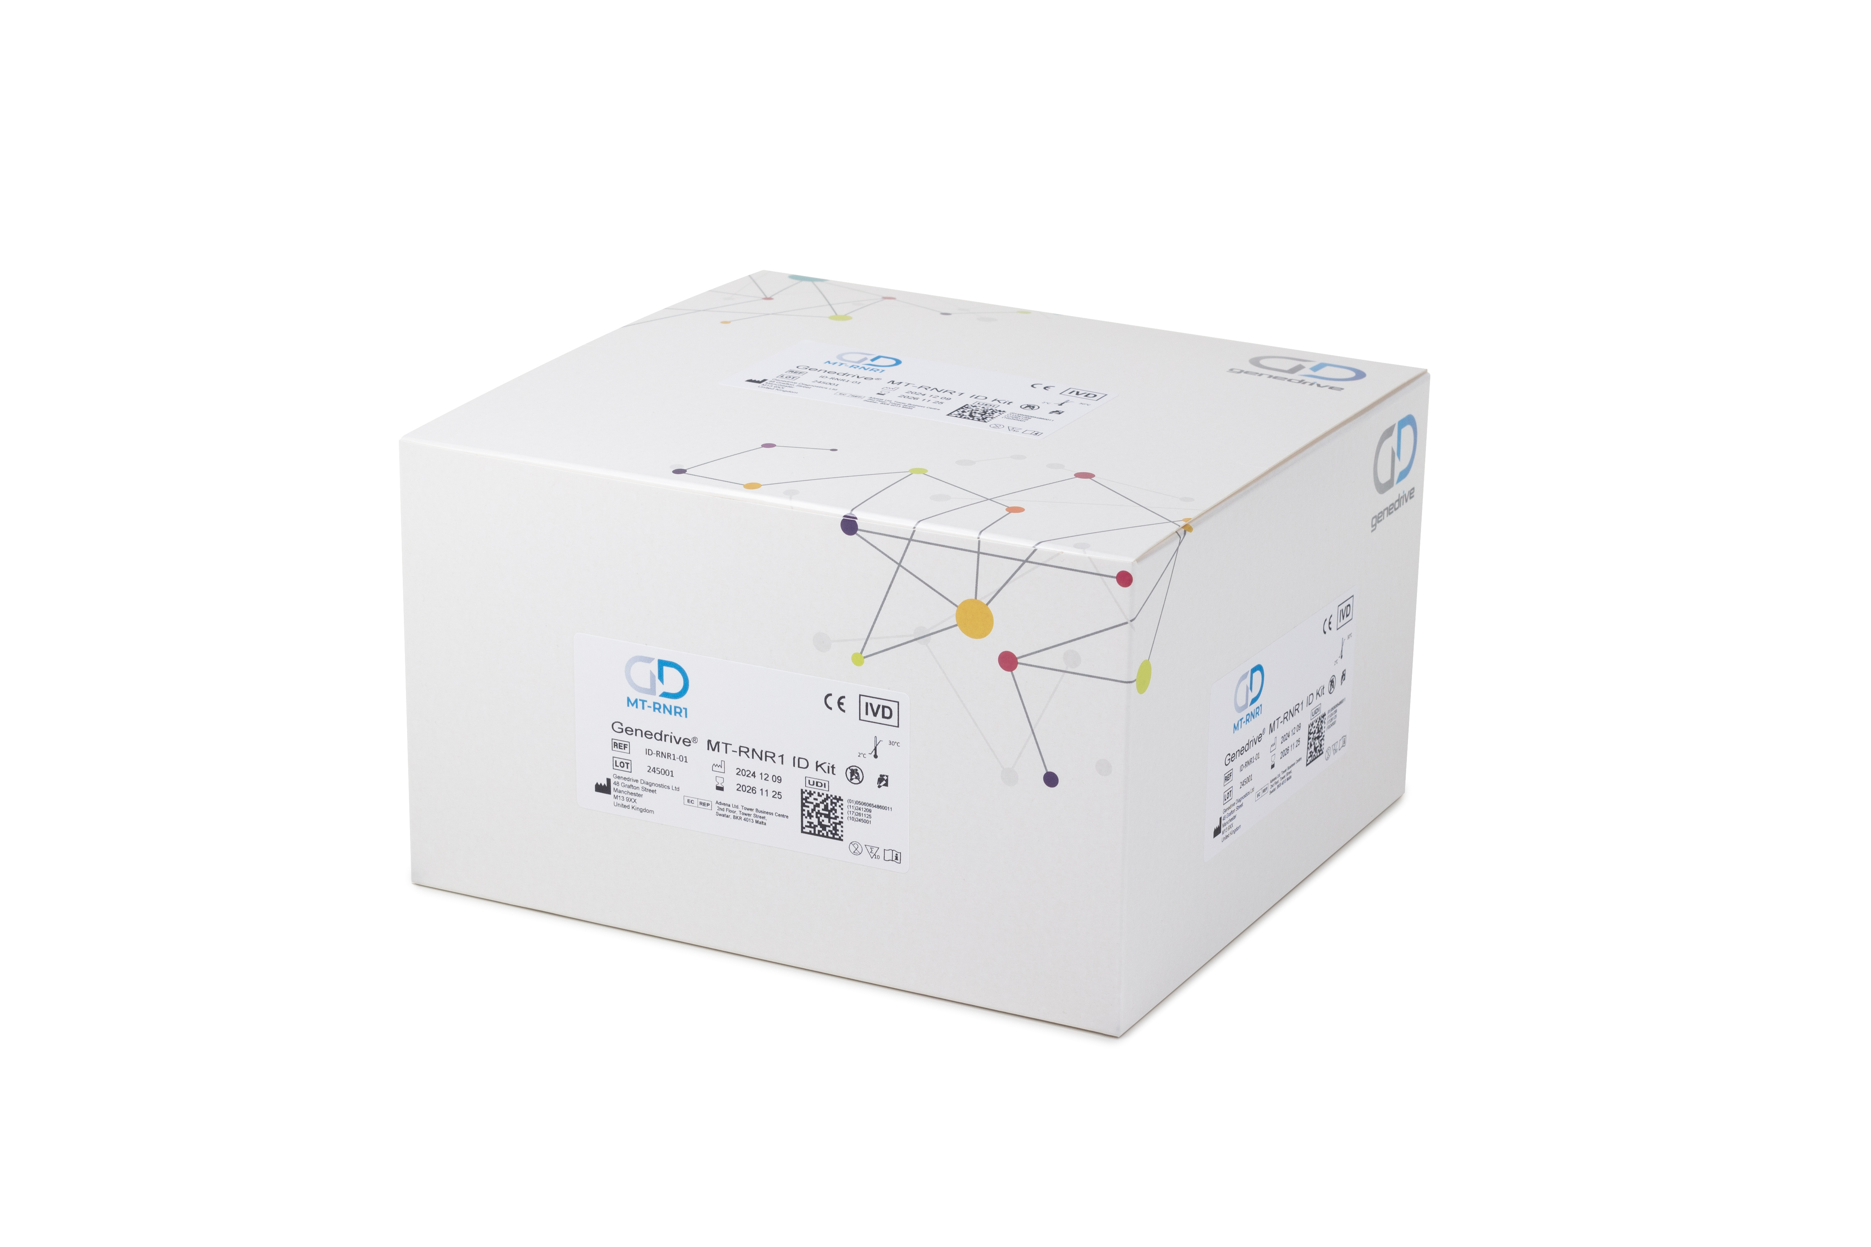
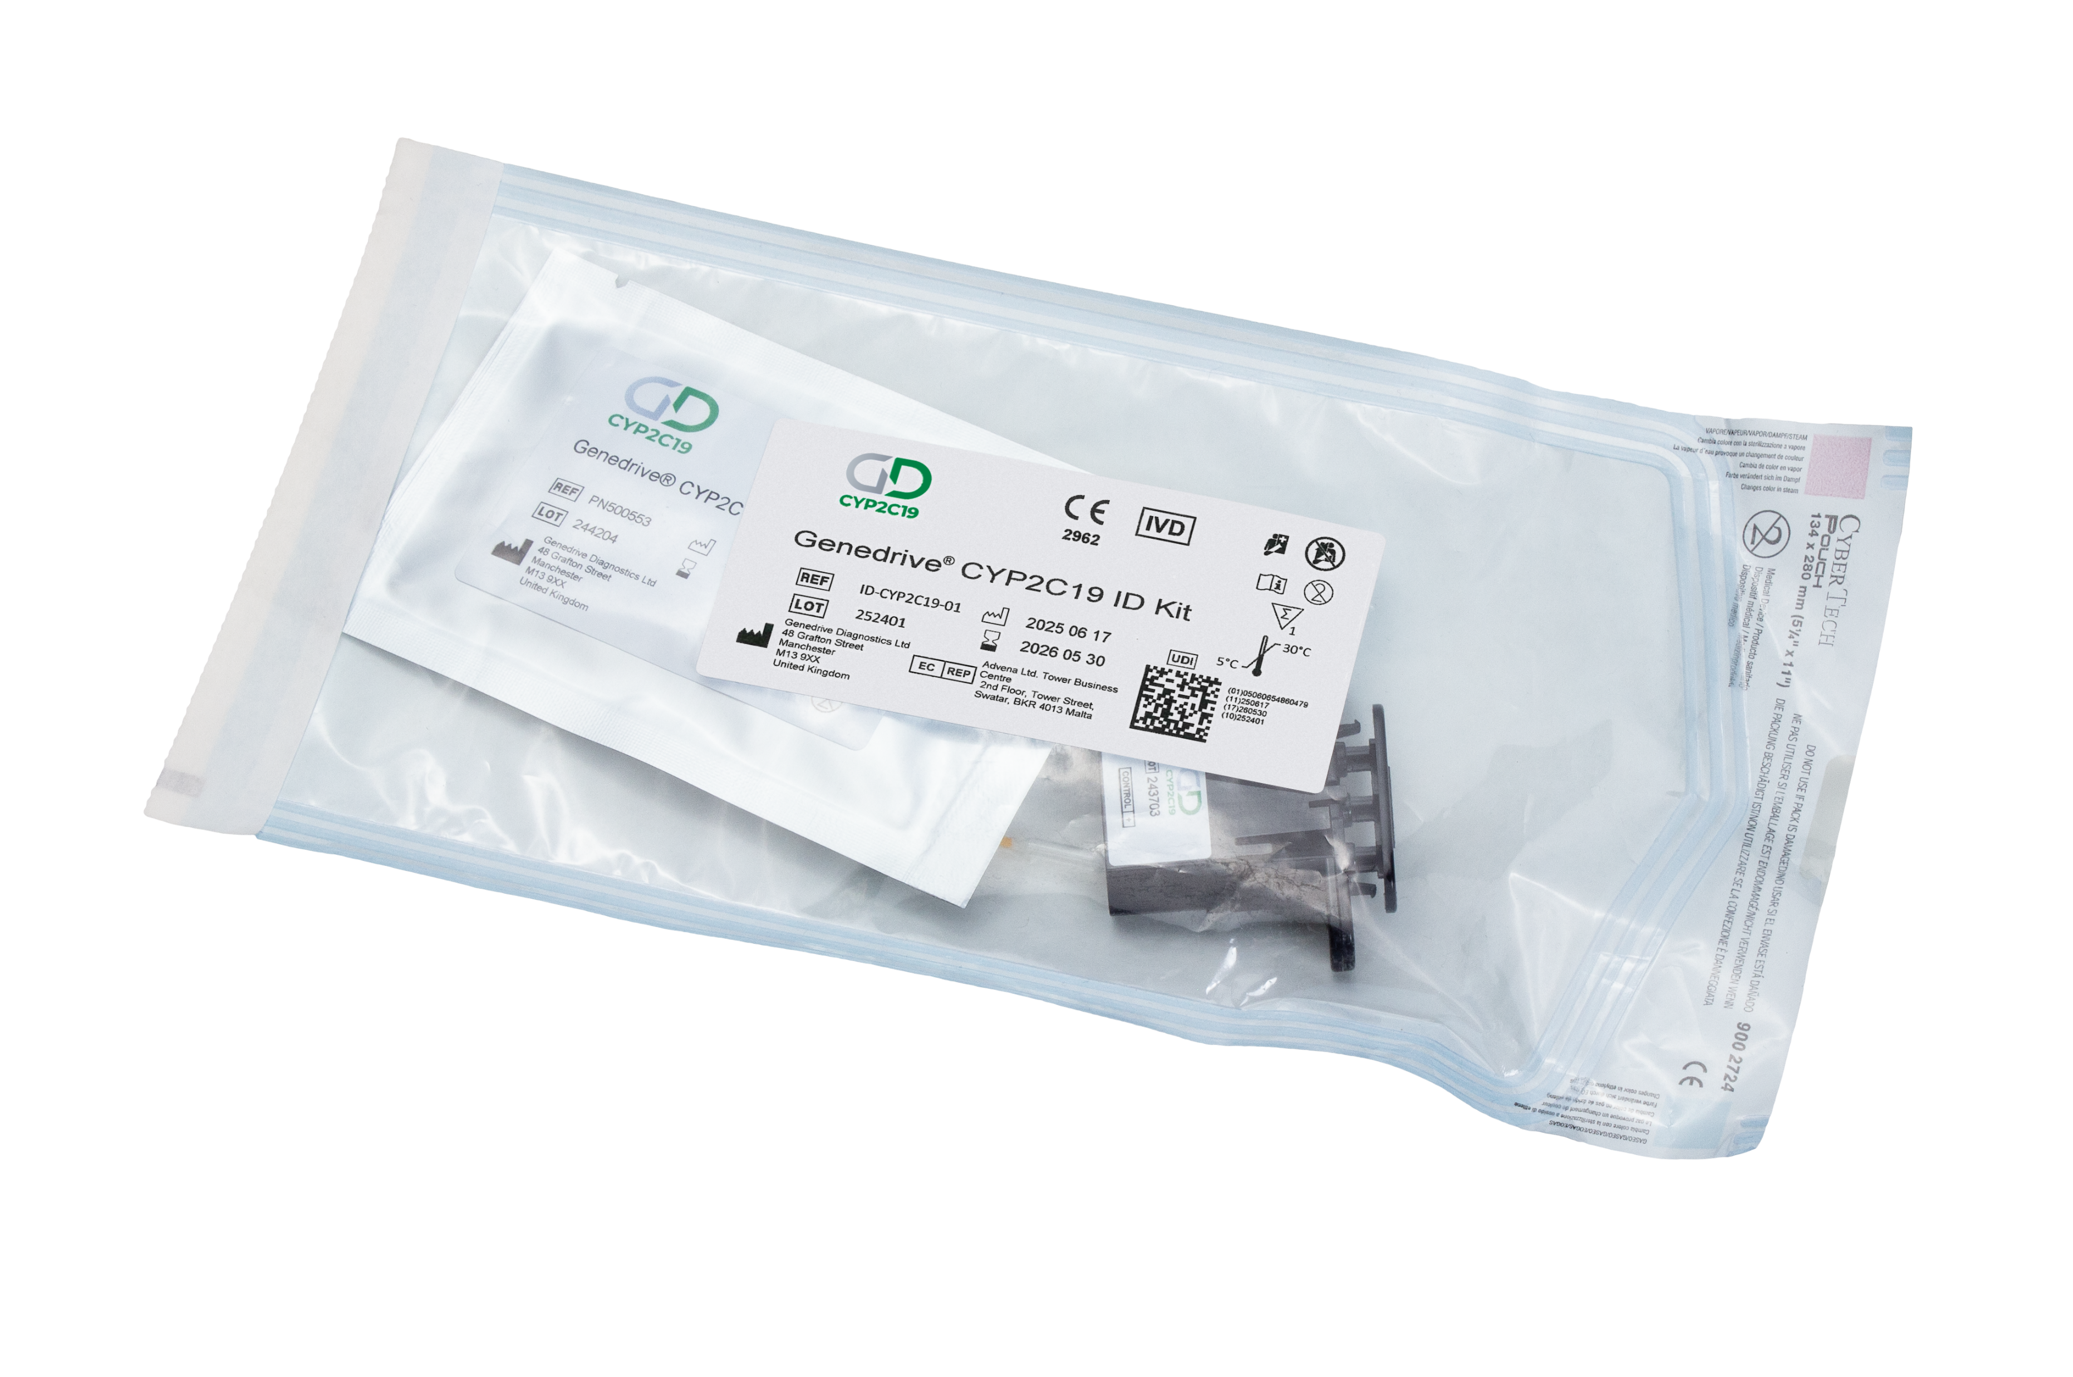
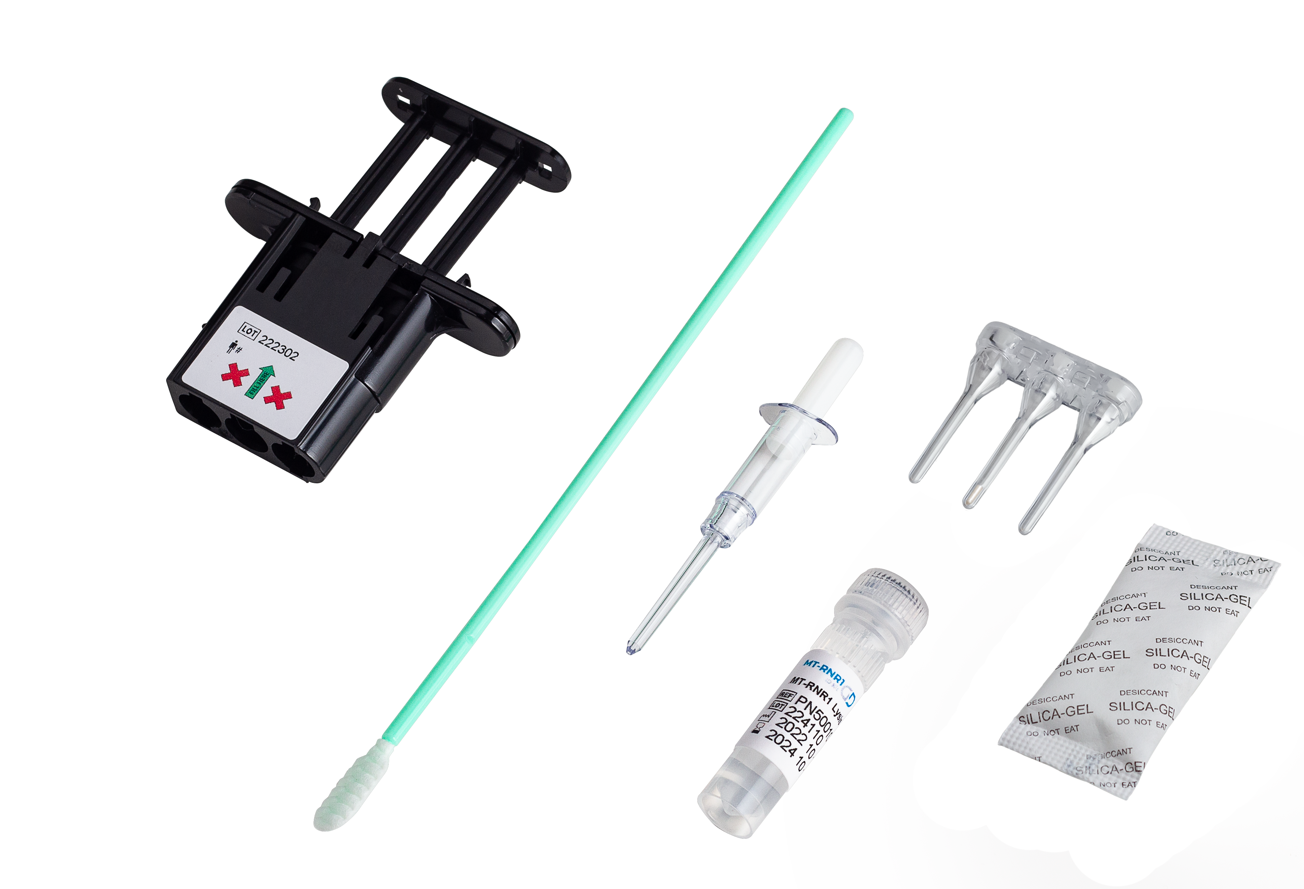
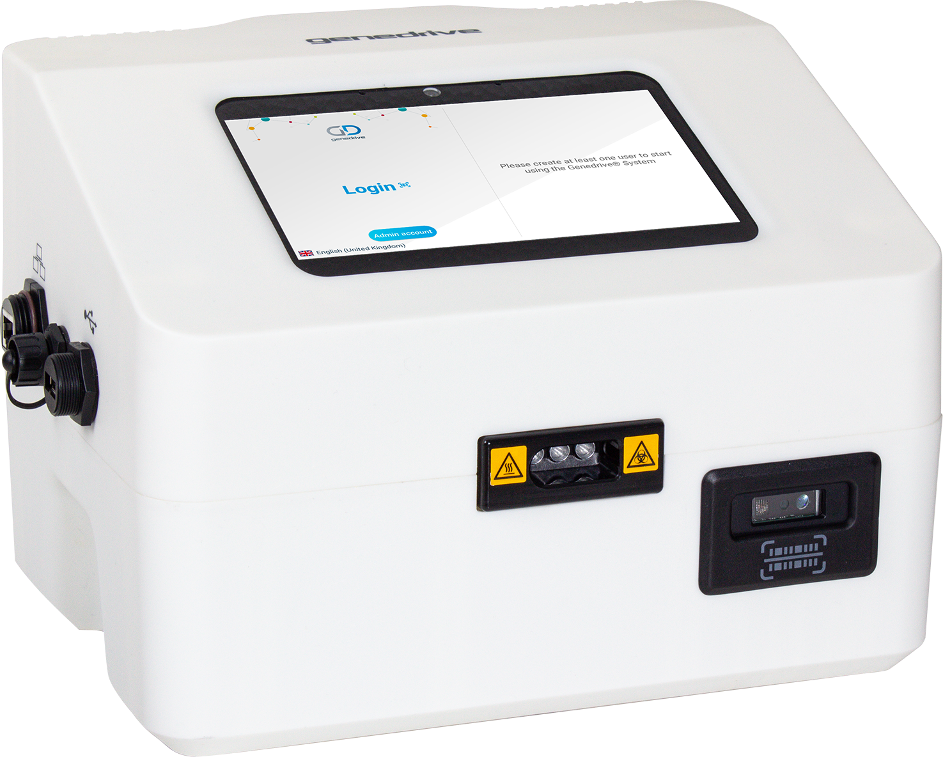
The Intervention - MT-RNR1 ID Kit
Kit Box
Test
Components
Genedrive System

Slide 13
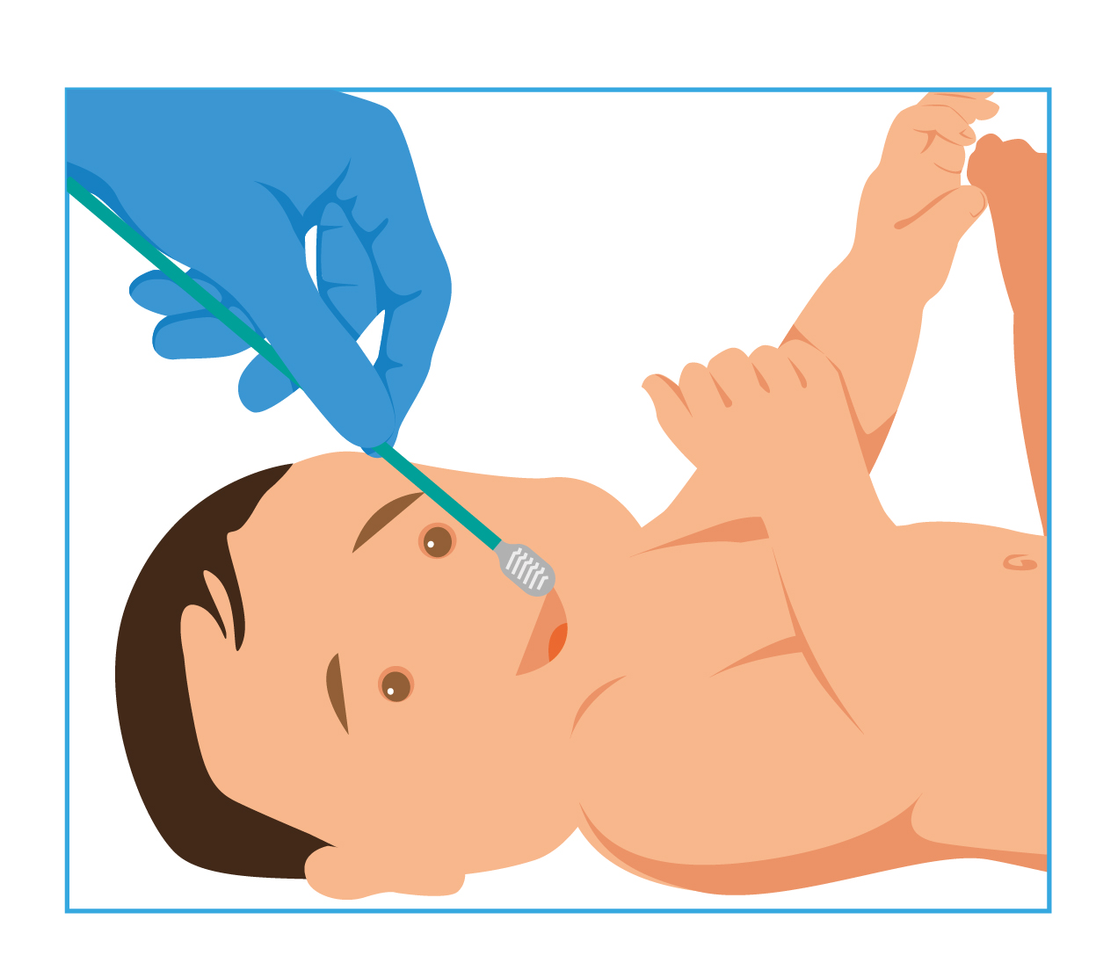
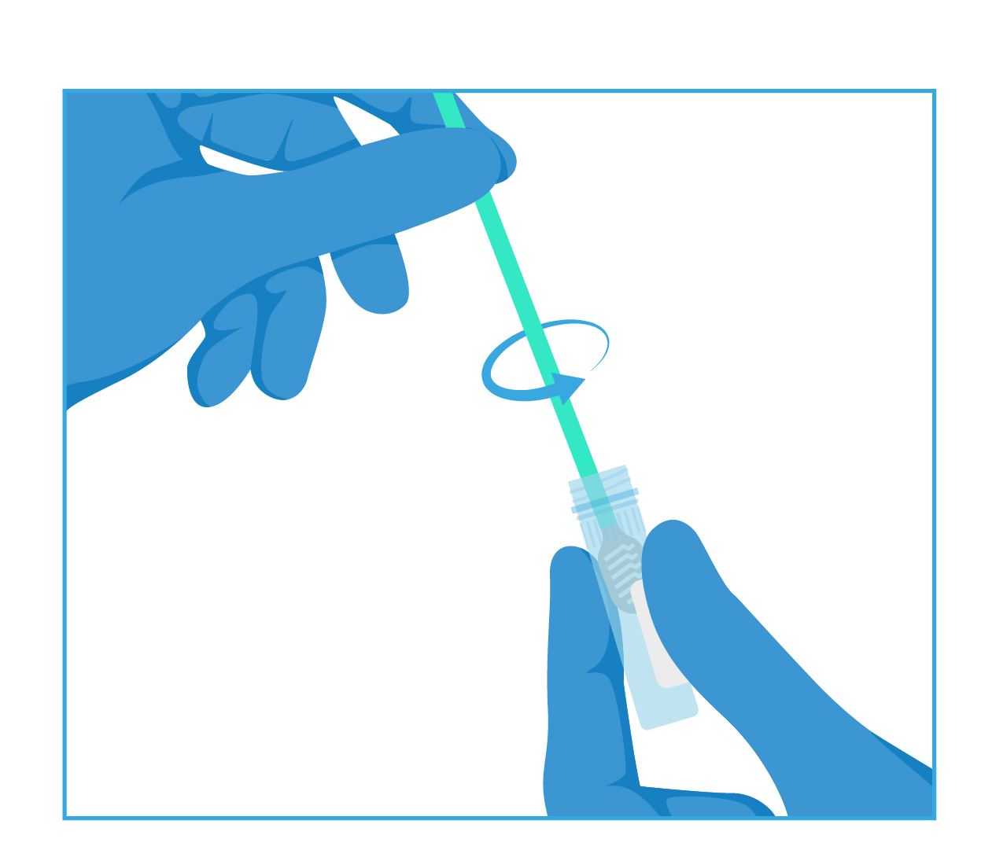
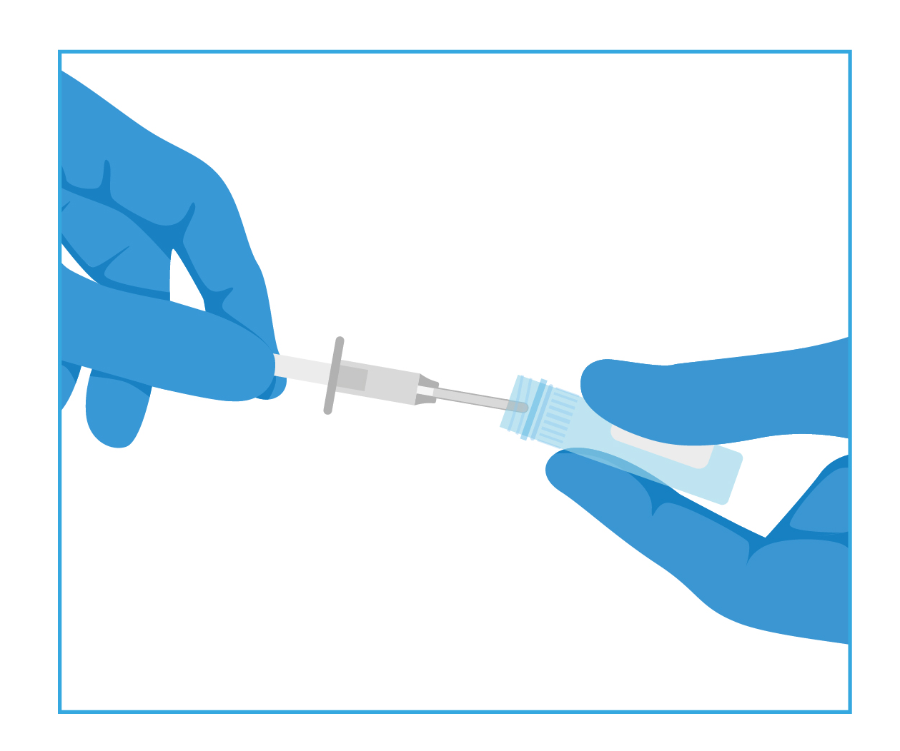
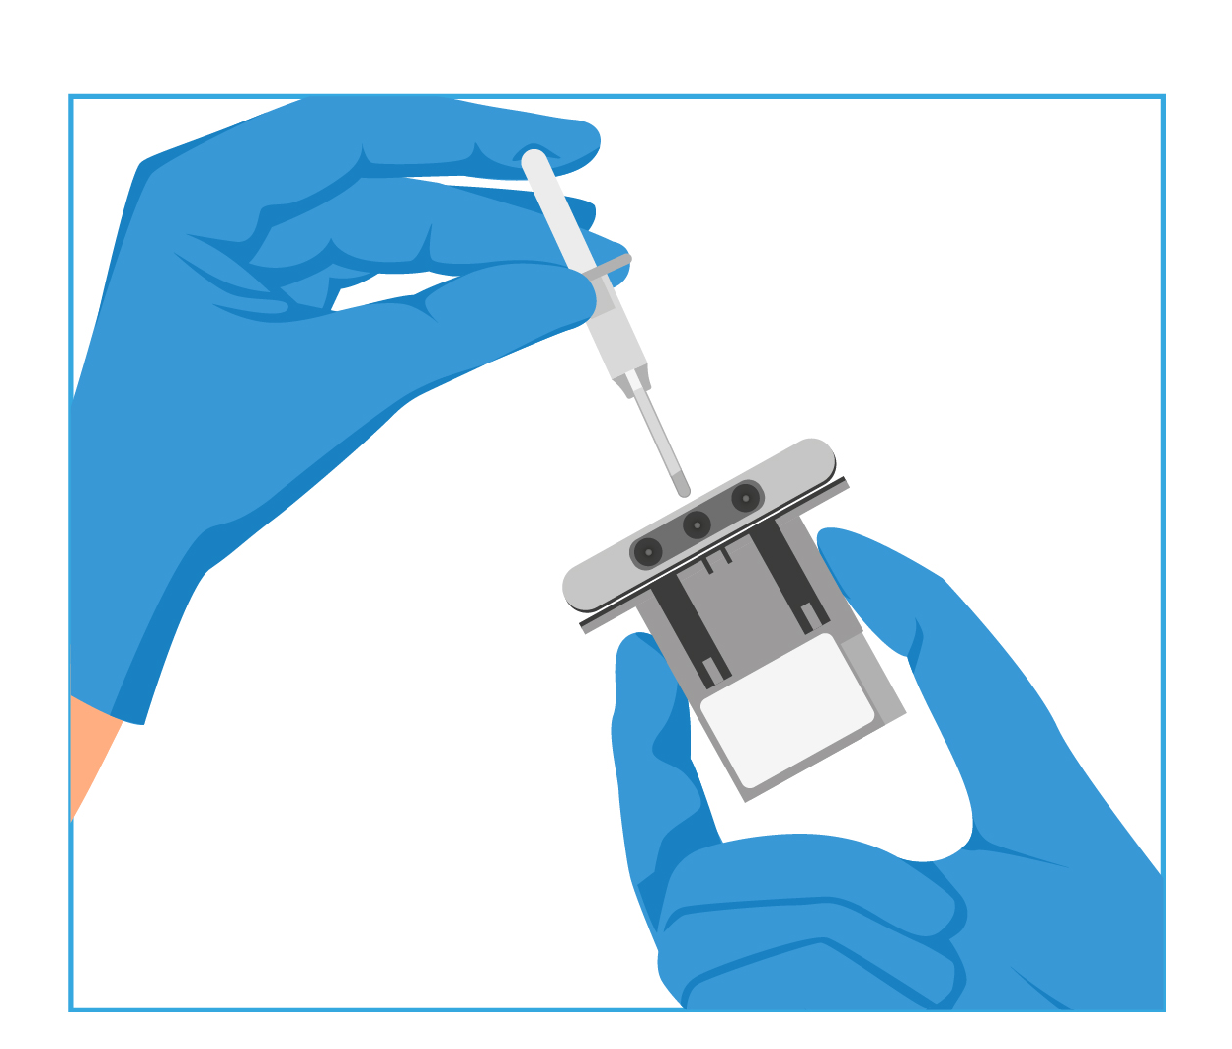
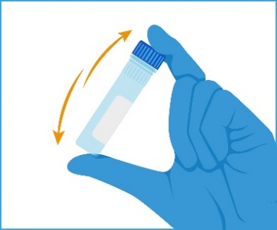
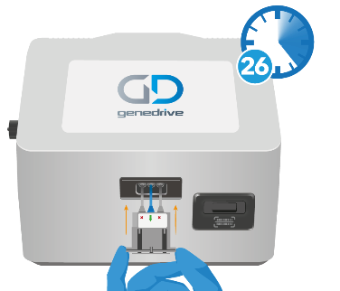

The Intervention – MT-RNR1 ID Kit Workflow
Simple workflow
Firmly swab the patient
Vigorously rotate the swab to release the DNA
Invert to mix the sample
Transfer the sample
Reconstitute assay
Start test

Slide 14
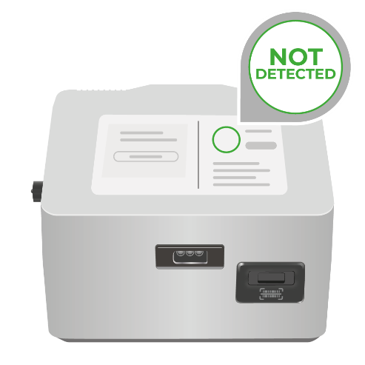
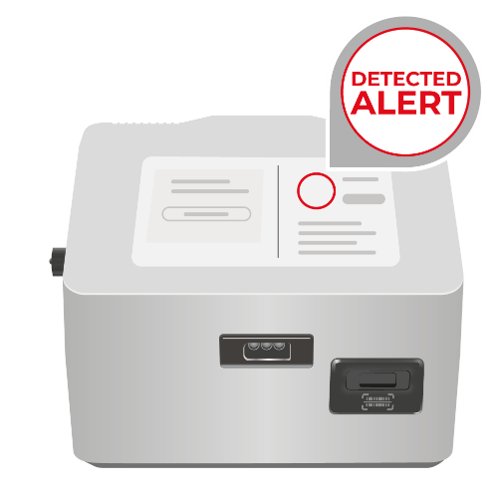
The Intervention - Results
MT-RNR1
m.1555A
Consider aminoglycoside antibiotics*
MT-RNR1
m.1555G
Consider alternative antibiotics*
Notes:
test fail that pathway is to avoid gent on test fail if no time to repeat test

Slide 15



The Impact
This equates to a variant prevalence of 1 in 300*
patients
>900
neonatal nurse users
>13,300
babies tested
40
babies protected from
risk of irreversible hearing
loss
* Observed frequency from PALOH and PALOH-UK testing (unpublished)

Slide 16


Scottish National Roll Out
£800,000 funding secured for phased national rollout
MT-RNR1 testing of newborn babies to begin October 2025
18-month phased implementation across all
regional health boards
3000+ babies per year to benefit from MT-RNR1 pharmacogenetic testing
Supported through the Accelerated National Innovation Adoption (ANIA) pathway, following technology assessments by the Scottish Health Technologies Group (SHTG)
Notes:
The Scottish Government has announced funding to support a national rollout of the Genedrive MT-RNR1 ID Kit across all regional health boards in Scotland, starting Q3 2025.
Improving health through innovation - gov.scot
gdr_news_scottish_gov_investment_pgx_cyp2c19_mt-rnr1.pdf

Slide 17
Any Questions
?
Demonstration

Slide 18
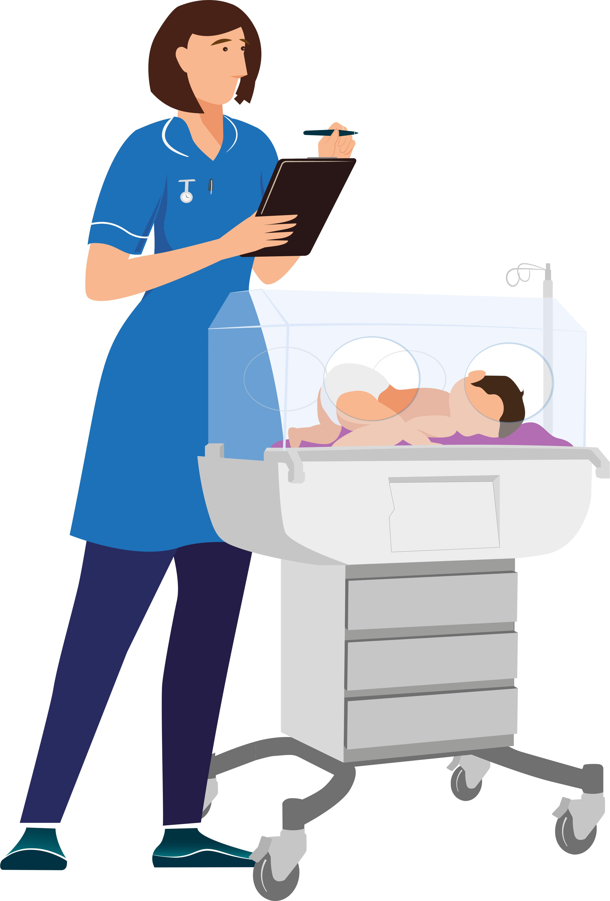
Routine Testing – UK & Ireland
Clinical Sites
St Mary’s Hospital – Manchester
North Manchester General Hospital – Manchester
Wythenshawe Hospital – Manchester
Royal Sussex County Hospital - Brighton
Royal Bolton Hospital – Greater Manchester
Tameside General Hospital – Greater Manchester
Royal Oldham Hospital – Greater Manchester
Stepping Hill Hospital – Stockport, Greater Manchester
Royal Albert Edward Infirmary – Wigan, Greater Manchester
Royal Jubilee Maternity Hospital – Belfast, Northern Ireland
Royal Hospital for Children – Glasgow, Scotland
University Hospital of Wales – Cardiff, Wales
Norfolk and Norwich University Hospital – Norwich
Betsi Cadwaladr University Health Board – Wales
Rotunda Hospital. Dublin – Ireland
Notes:
9. https://www.itv.com/news/granada/2024-11-21/new-test-to-prevent-newborn-babies-going-deaf-to-be-trialled-across-the-uk
The MT-RNR1 ID Kit is now in use at eight Greater Manchester neonatal units and has prevented the hearing loss of 11 babies across the region, with 4,000 babies tested as of October 2024.

