Slide 1
Genedrive® CYP2C19 ID Kit
Product Introduction

Slide 2
Contents
Why Pharmacogenetics
The Problem - Loss of Function
The Consequence
The Guidance
The intervention
The Impact

Slide 3
Why Pharmacogenetics
Some patients may experience reduced effectiveness of the drug. ​
Medications can work differently
for everyone
Genes can affect patient response to medication
Or an unexpected harmful response, known as an Adverse Drug Reaction (ADR)
Notes:
https://medregs.blog.gov.uk/2023/10/02/the-role-of-genetics-in-medicine-safety/
Osanlou R, Walker L, Hughes DA, et al Adverse drug reactions, multimorbidity and polypharmacy: a prospective analysis of 1 month of medical admissions BMJ Open 2022;12:e055551. doi: 10.1136/bmjopen-2021-055551

Slide 4
The Problem – Loss of Function
Clopidogrel is a recommended anti-platelet therapy
Over 25% of individuals may carry CYP2C19 LOF alleles depending on patient cohort
Variants in the CYP2C19 gene can result in loss-of-function (LOF) alleles, reducing enzyme activity and altering metaboliser status
Notes:
Lee, C.R., Luzum, J.A., Sangkuhl, K., Gammal, R.S., Sabatine, M.S., Stein, C.M., Kisor, D.F., Limdi, N.A., Lee, Y.M., Scott, S.A., Hulot, J.S., Roden, D.M., Gaedigk, A., Caudle, K.E., Klein, T.E., Johnson, J.A. and Shuldiner, A.R. (2022) ‘Clinical Pharmacogenetics Implementation Consortium guideline for CYP2C19 genotype and clopidogrel therapy: 2022 update’, Clinical Pharmacology & Therapeutics, 112(5), pp. 959–967. Available at: https://doi.org/10.1002/cpt.2526
PharmGKB, Gene-specific Information Tables for CYP2C19. <https://www.clinpgx.org/page/cyp2c19RefMaterials> (2021).
Claims matrix reference: Rows 43/ 48/ 126

Slide 5
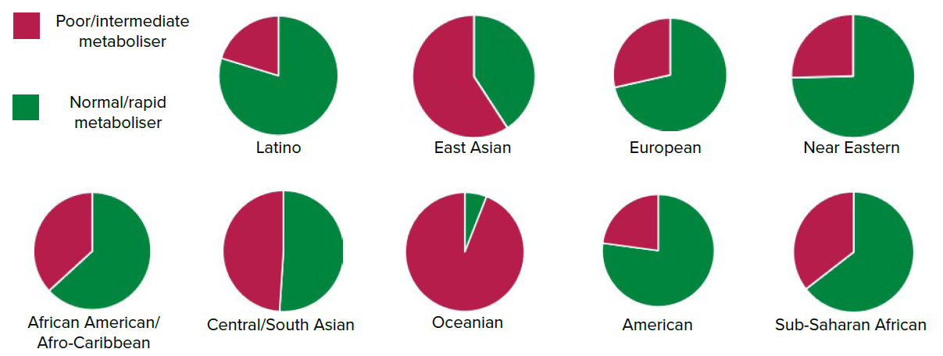
The Consequence – The wrong drug
Patients are at a greater risk of a complication in Neurology and Cardiology pathways
Healthcare inequality
Latino
East Asian
European
Near Eastern
African American/
Afro-Caribbean
Central/
South Asian
Oceanian
American
Sub-Saharan African
Notes:
Lee, C.R., Luzum, J.A., Sangkuhl, K., Gammal, R.S., Sabatine, M.S., Stein, C.M., Kisor, D.F., Limdi, N.A., Lee, Y.M., Scott, S.A., Hulot, J.S., Roden, D.M., Gaedigk, A., Caudle, K.E., Klein, T.E., Johnson, J.A. and Shuldiner, A.R. (2022) ‘Clinical Pharmacogenetics Implementation Consortium guideline for CYP2C19 genotype and clopidogrel therapy: 2022 update’, Clinical Pharmacology & Therapeutics, 112(5), pp. 959–967. Available at: https://doi.org/10.1002/cpt.2526
PharmGKB, Gene-specific Information Tables for CYP2C19. <https://www.clinpgx.org/page/cyp2c19RefMaterials> (2021).
Claims matrix reference: Rows 43/ 48/ 126

Slide 6
The Guidance - CPIC
Example Diplotype | Genotype | Metaboliser Status (Phenotype) | Impact of Clopidogrel Response
*17/*17 | Two increased function alleles | Ultarapid Metaboliser | Increased
*1/*17 | One increased function allele, one normal function allele | Rapid Metaboliser | Normal/Increased
*1/*1 | Two normal function alleles | Normal Metaboliser | Normal
*1/*3 | One no function allele, one normal function allele or one gain of function allele and no function allele | Intermediate Metaboliser | Reduced
*2/*2 | Two no function alleles | Poor Metaboliser | Significantly reduced
Patients identified as having an intermediate or poor metaboliser status should be considered for alternative antiplatelet medications.
Notes:
Lee, C.R., Luzum, J.A., Sangkuhl, K., Gammal, R.S., Sabatine, M.S., Stein, C.M., Kisor, D.F., Limdi, N.A., Lee, Y.M., Scott, S.A., Hulot, J.S., Roden, D.M., Gaedigk, A., Caudle, K.E., Klein, T.E., Johnson, J.A. and Shuldiner, A.R. (2022) ‘Clinical Pharmacogenetics Implementation Consortium guideline for CYP2C19 genotype and clopidogrel therapy: 2022 update’, Clinical Pharmacology & Therapeutics, 112(5), pp. 959–967. Available at: https://doi.org/10.1002/cpt.2526
Claims matrix reference: Row 42 (Diplotype reference)

Slide 7

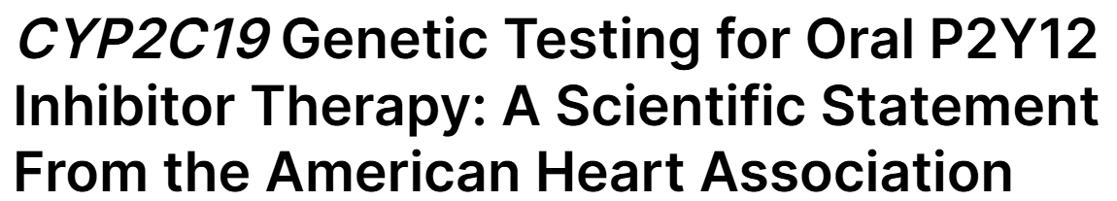
The Guidance - AHA
Carriers of reduced function CYP2C19 alleles have reduced levels of the active metabolite of clopidogrel, diminished levels of platelet inhibition, and an increased risk of major adverse cardiovascular events, including stent thrombosis.
Clopidogrel has been shown to reduce the rate of major adverse cardiovascular events among patients with ACS or undergoing PCI.
The US Food and Drug Administration issued a boxed warning for clopidogrel advising providers to consider alternatives for use in patients who carry certain CYP2C19 alleles and are poor metabolizers.
Notes:
Pereira, N.L. et al. (2024) ‘CYP2C19 genetic testing for oral P2Y12 inhibitor therapy: A scientific statement from the American Heart Association’, Circulation, June. Available at: https://doi.org/10.1161/CIR.0000000000001257

Slide 8

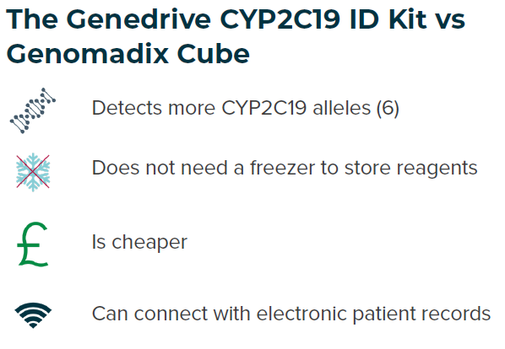
CYP2C19 Genotype Testing to Guide Clopidogrel Use After Ischaemic Stroke or Transient Ischaemic Attack
The Guidance - NICE
Laboratory based testing and point-of-care testing (POCT) are recommended.
The Genedrive CYP2C19 ID Kit should be used when laboratory-based testing is not available.
What it Means in Practice:
UK National Stroke clinical guideline recommends that dual antiplatelet therapies (such as Clopidogrel and aspirin) are administered in <24 hours of the event.
Conventional laboratory testing workflows are unlikely to turnaround actionable results in this time.
The Genedrive CYP2C19 ID Kit should be used when laboratory-based testing is not available.
Notes:
https://cks.nice.org.uk/topics/antiplatelet-treatment/
National Institute for Health and Care Excellence (2024) The problem (NICE DG59) – People with loss-of-function CYP2C19 alleles who have clopidogrel are more likely to have further strokes compared with people without loss-of-function CYP2C19 alleles. Diagnostic guidance (DG59) / HealthTech guidance (HTG724), July. Available at: https://www.nice.org.uk/guidance/htg724/chapter/1-Recommendations
Claims matrix reference: Rows 26 / 52 / 53 / GPM-152

Slide 9

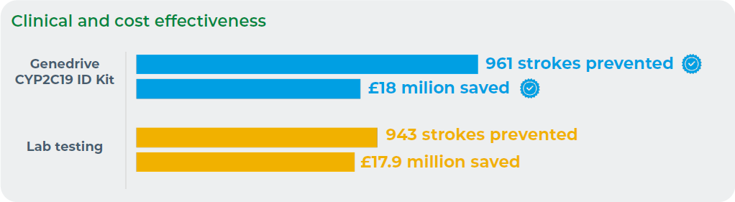
SHTG provides impartial, evidence-based advice to NHS Scotland on the use of health technologies.
The Guidance - SHTG
Key findings
Clopidogrel is prescribed to prevent recurrent strokes in patients following an ischaemic stroke or TIA. Its effectiveness is reduced by loss of function (LoF) CYP2C19 gene variants.
CYP2C19 genotype-guided therapy can reduce the risk of recurrent stroke in clopidogrel-resistant patients.
Alternative antiplatelets should be used for clopidogrel-resistant patients.
Using the Genedrive CYP2C19 ID Kit could prevent 961 recurrent strokes, saving NHS Scotland £18 million over 5 years.
Notes:
Scottish Health Technologies Group (2024) Genotype testing to guide clopidogrel use after an ischaemic stroke or transient ischaemic attack (TIA). October. Available at: https://shtg.scot/our-advice/clopidogrel-genotype-testing-after-ischaemic-stroke-or-transient-ischaemic-attack-tia/
Claims matrix reference: Rows 136 / 137 / GPM-169

Slide 10

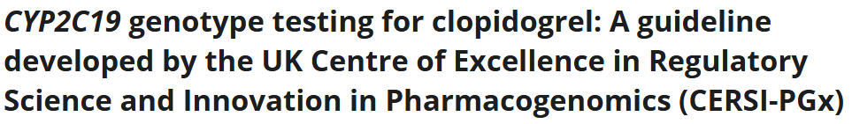
The Guidance - CERSI
Centre of Excellence in Regulatory Science and Innovation in Pharmacogenomics (CERSI-PGx)
Defines the role of point-of-care testing
States that *2, *3, *4, *8, *17* and *35 should be tested in CYP2C19 when clopidogrel therapy is being initiated.
Provides clear clinical actions based on genotype/phenotype
Notes:
Russo, G. et al. (2025) ‘CYP2C19 genotype testing for clopidogrel: A guideline developed by the UK Centre of Excellence in Regulatory Science and Innovation in Pharmacogenomics (CERSI-PGx)’, British Journal of Clinical Pharmacology, December. Available at: https://doi.org/10.1002/bcp.70370.
Claims matrix reference: Rows 117 -127

Slide 11
The Guidance - CERSI
Clinical indication | Metaboliser phenotype
 | Rapid | Normal | Intermediate | Poor
Minor ischaemic stroke or transient ischaemic attack | No PGx informed action required; manage as per usual prescribing guidelines | Clopidogrel to be prescribed at the standard dose of 75 mg/day | Consider Aspirin 75 mg/day and Dipyridamole MR 200 mg twice/day OR High-risk TIA or NIHSS ≤ 3 eligible for DAPT: | Avoid Clopidogrel - follow alternative therapy specified under intermediate metaboliser status
 |  |  | Ticagrelor: 180 mg loading, 90 mg twice/day followed by Aspirin (300 mg loading; 75 mg/day) for 30 days
Non-minor ischaemic stroke |  |  | Consider Aspirin 75 mg/day and Dipyridamole MR 200 mg twice/day
Coronary artery disease |  |  | Consider Aspirin 75 mg/day as DAPT with: Ticagrelor 90 mg twice/day or Prasugrel 10 mg/day
Peripheral arterial disease |  |  | Consider Aspirin 75 mg/day or Aspirin 75 mg/day + Rivaroxaban 2.5 mg twice/day
Recommended clinical actions for currently licensed UK indications of clopidogrel, stratified by patient metaboliser status
Notes:
Russo, G. et al. (2025) ‘CYP2C19 genotype testing for clopidogrel: A guideline developed by the UK Centre of Excellence in Regulatory Science and Innovation in Pharmacogenomics (CERSI-PGx)’, British Journal of Clinical Pharmacology, December. Available at: https://doi.org/10.1002/bcp.70370.
Claims matrix reference: Rows 117 -127

Slide 12








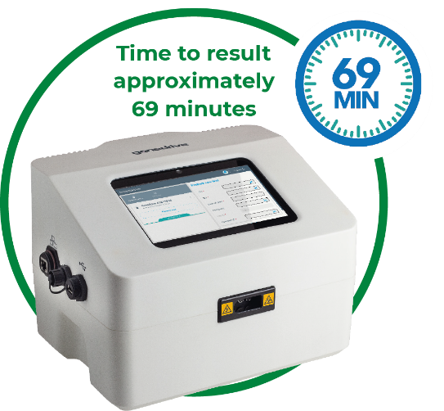




The Intervention - Genedrive
Clinician to administer treatment
Metaboliser status not known
30% of patients may not
respond to clopidogrel
PCI Patient Admitted
With Genedrive® System Implemented
Normal/Rapid/Ultrarapid Metaboliser status identified
Consider clopidogrel
Clinician to administer treatment within 24hrs
Consider alternative treatment
Intermediate/Poor Metaboliser status identified

Slide 13
The Intervention – POC vs Lab
POCT
Patient Admitted
Testing Performed
Prescription Adjusted
Blood Sample Taken
Sample Posted to GLH
Report Sent Back to HCP
Patient Admitted
DNA Extracted
Testing Performed
Report Written
Prescription Adjusted
Day 1
Day 2 - 7
Day 8 -14
Week 1
Week 2

Slide 14
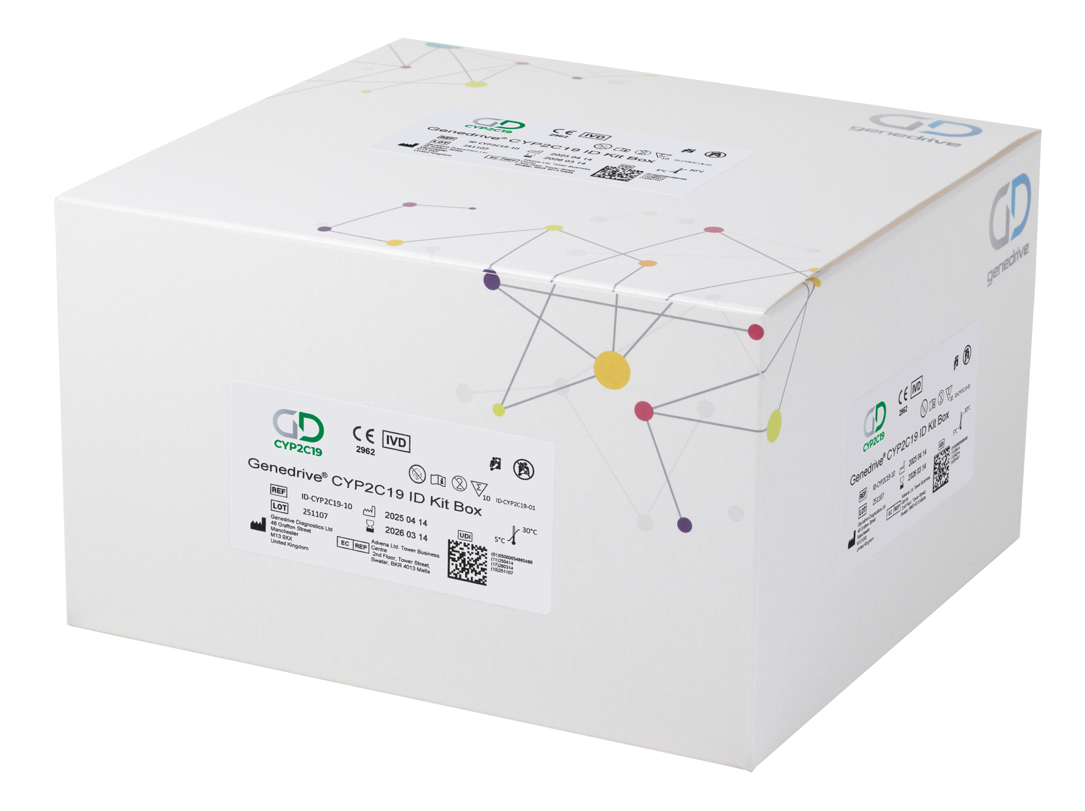
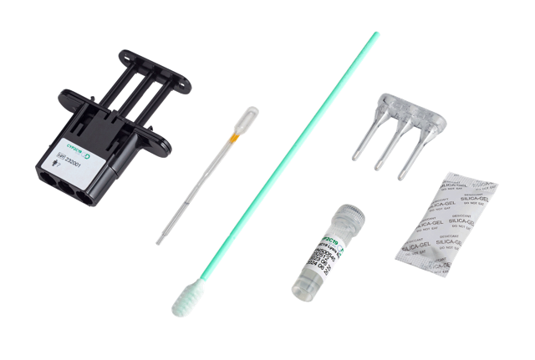
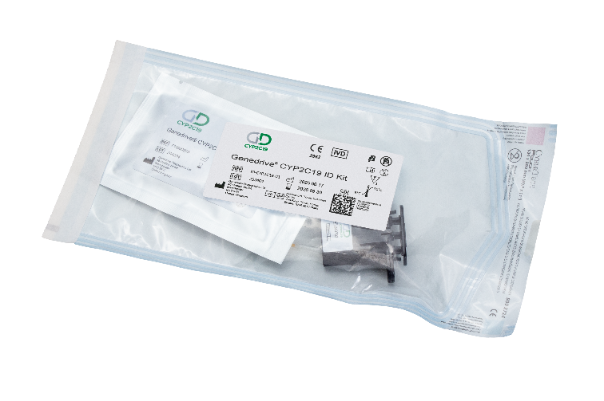

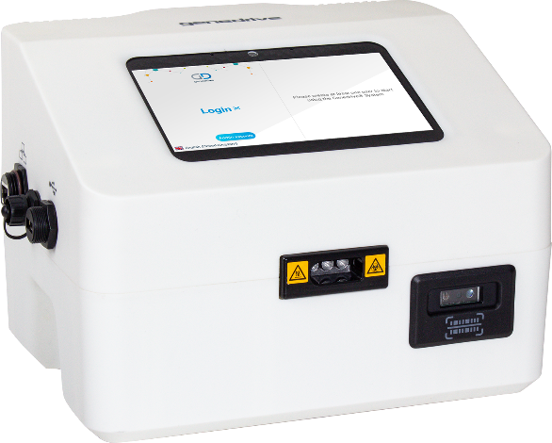
The Intervention - CYP2C19 ID Kit Test
Kit Box
Test
Components
Genedrive System

Slide 15
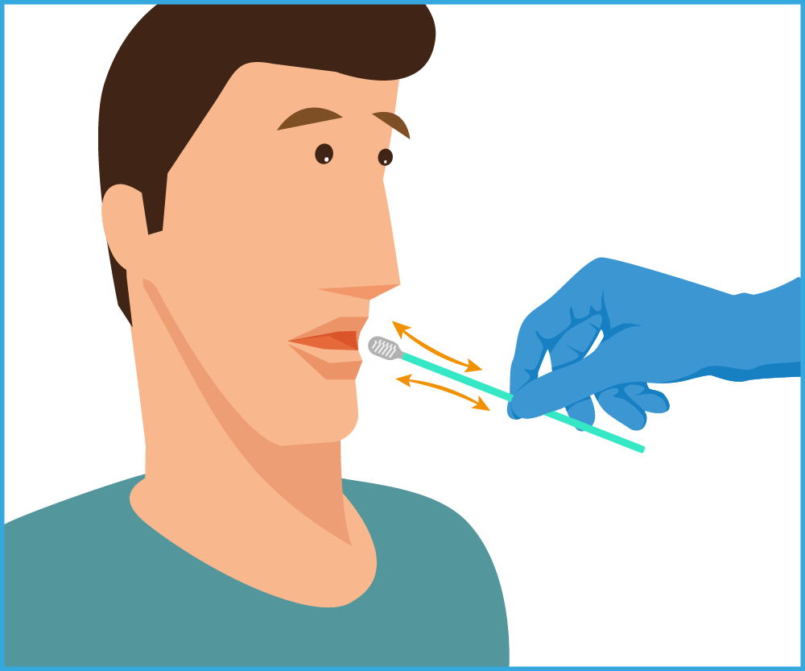

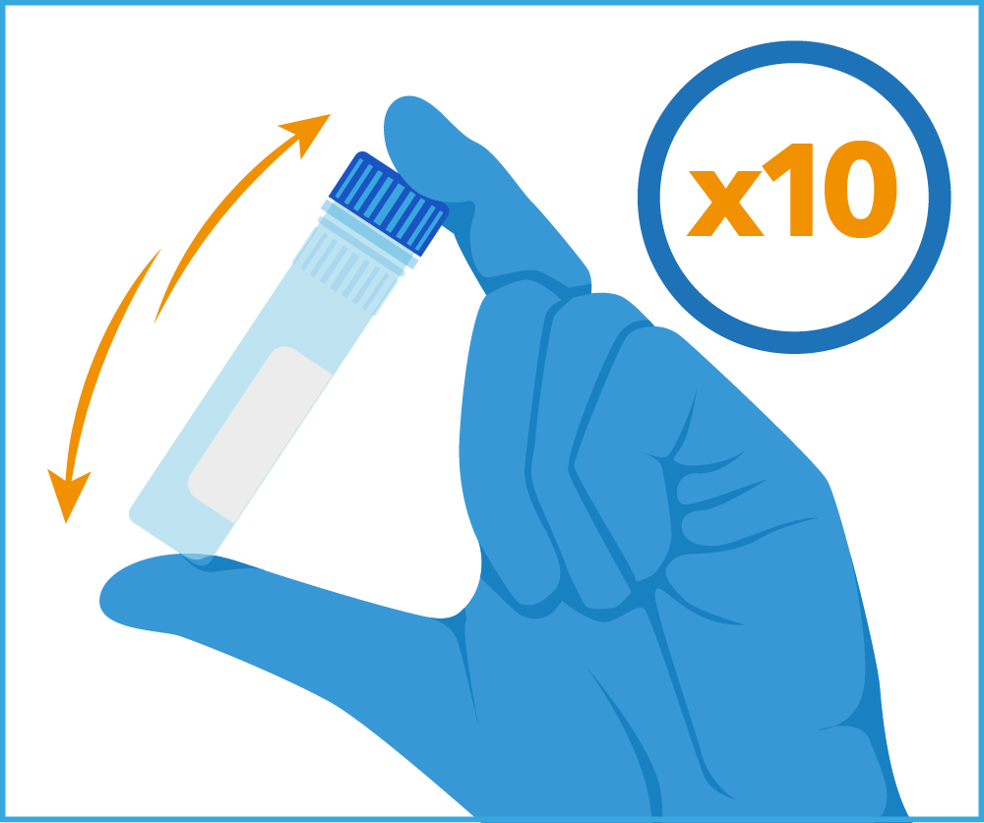

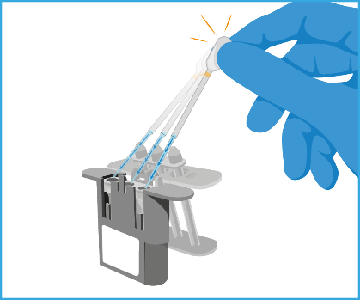
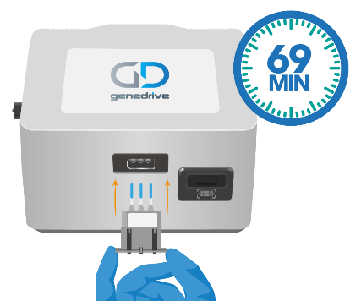
The Intervention - CYP2C19 ID Kit Workflow
Simple workflow
Firmly swab
the patient
Vigorously rotate to release the DNA
Invert to mix the sample
Transfer the sample
Reconstitute the reagents
Insert cartridge to Start test
Notes:
Technical training version

Slide 16





The Intervention - Results
Clear actionable results screens showing the diplotype identified and CPIC-coded metaboliser status
Consider clopidogrel
Consider clopidogrel
Consider clopidogrel
Consider alternative treatment
Consider alternative treatment
Therapeutic decisions should not be made solely on the results of this test

Slide 17
The Impact
Clopidogrel is a recommended anti-platelet therapy
Clinicians can optimise antiplatelet treatment
Variants in the CYP2C19 gene can cause loss of function (LOF) affecting metaboliser status
Notes:
1. https://medregs.blog.gov.uk/2023/10/02/the-role-of-genetics-in-medicine-safety/

Slide 18
Any Questions
?
Demonstration

Slide 19
References:
https://medregs.blog.gov.uk/2023/10/02/the-role-of-genetics-in-medicine-safety/
Clinical Pharmacogenetics Implementation Consortium Guideline for CYP2C19 Genotype and Clopidogrel Therapy: 2022 Update (cpicpgx.org)
https://cks.nice.org.uk/topics/antiplatelet-treatment/
*PGx = Pharmacogenetics

