Slide 1
Genedrive® MT-RNR1
How to perform a patient test
GPM-162

Slide 2
Product Demonstration How to perform a patient test
Notes:
Ideally project what is on your demo unit onto a big screen, for all to see

Slide 3
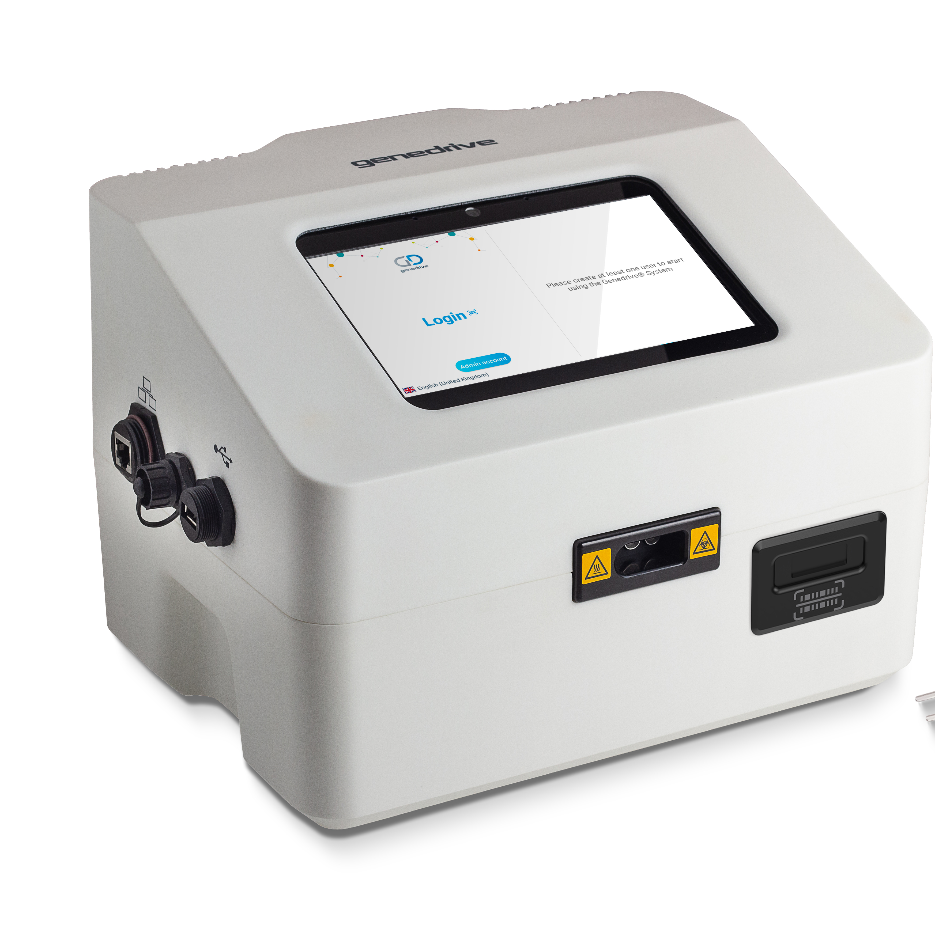
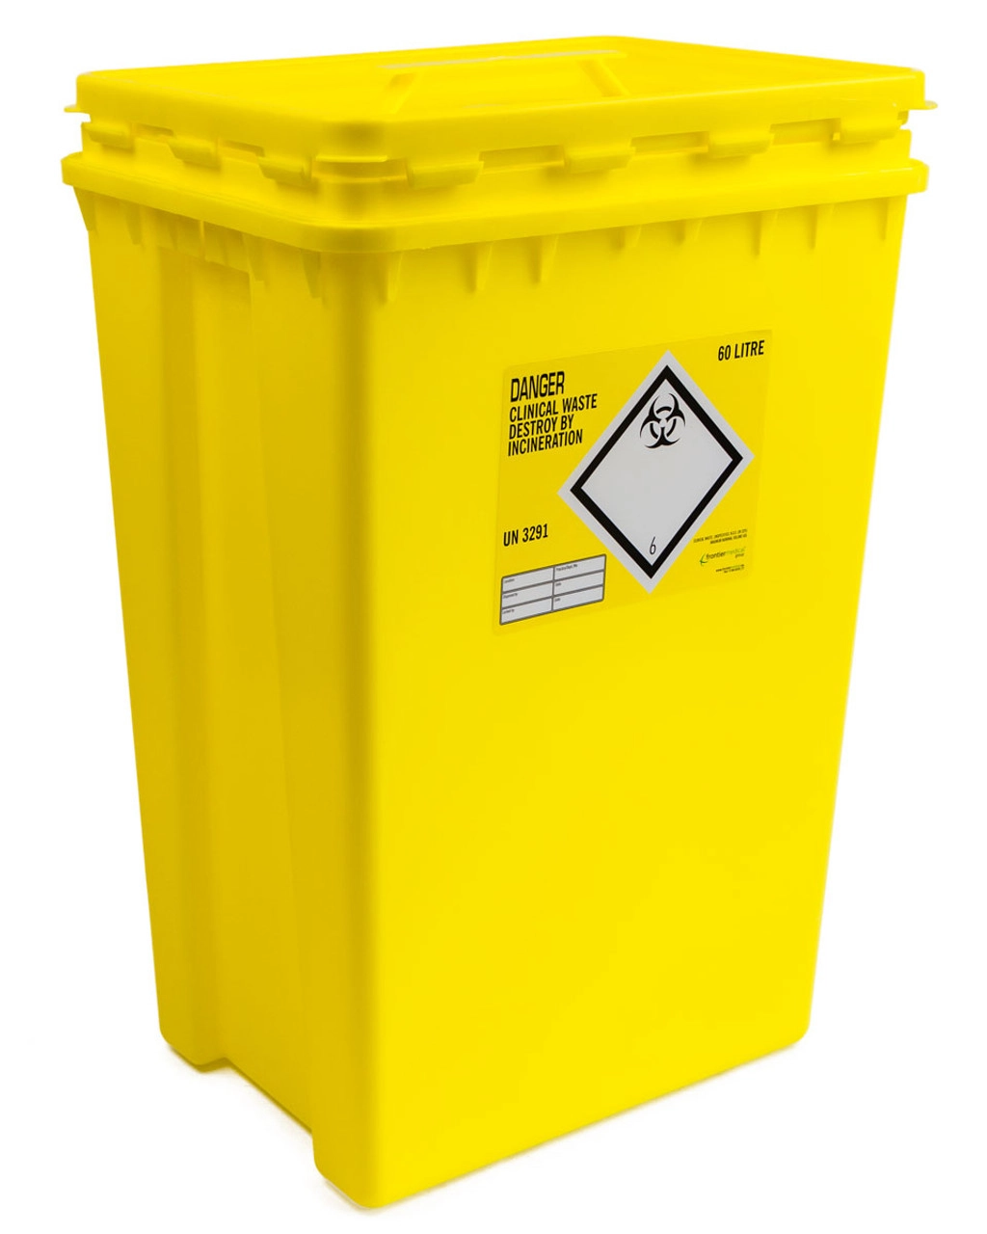
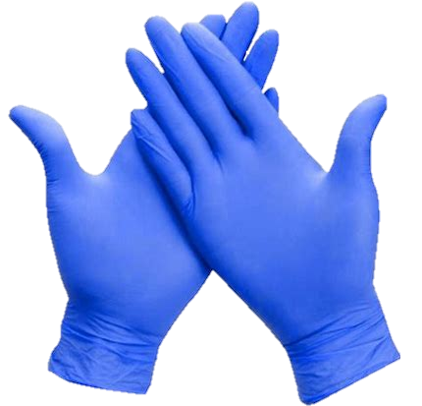
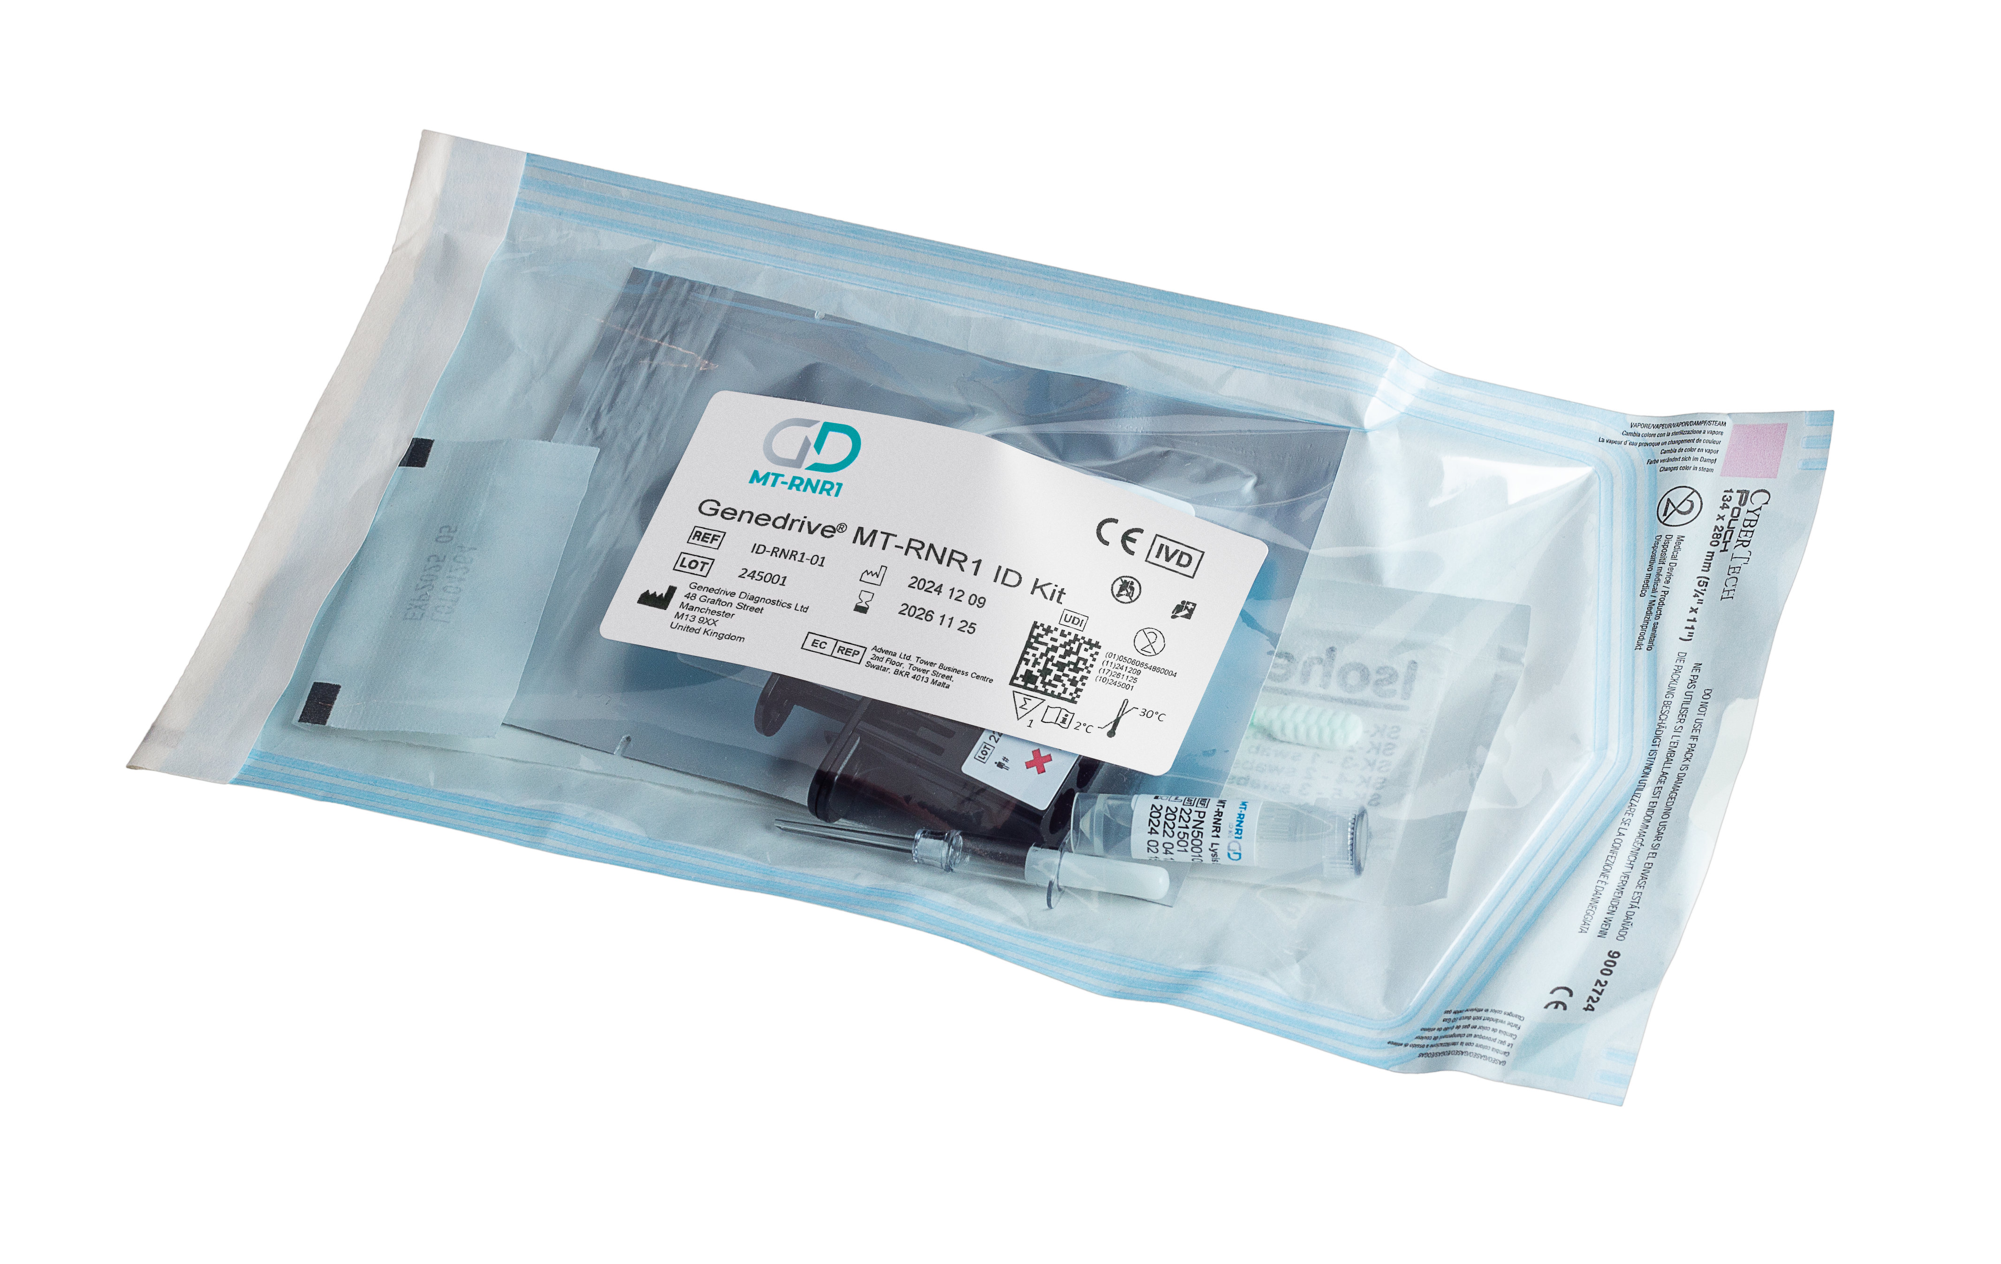
3 | TEST PROCEDURE
Performing a Patient Test
Specimen handling and preparation
You will need:​
1 x pair of powder-free disposable gloves
1 x Genedrive® MT-RNR1 KIT ID Kit (ID-RNR1-01)
Access to a clinical waste bin
Genedrive® System
GS-002
Notes:
Wear powder-free disposable gloves throughout the procedure
Before opening the RNR1 Control Kit,
check its not damaged
check the expiry date has not expired
Before opening the RNR1 ID kit
check its not damaged
check the expiry date has not expired
check the buccal swab head has not become detached from the stick – discard if it has and open a new RNR1 ID Kit

Slide 4

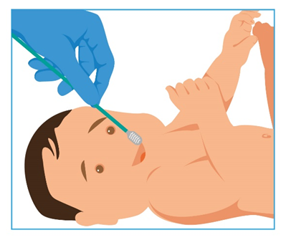
4 | TEST PROCEDURE
Performing a Patient Test
Ensure powder-free disposable gloves are worn throughout the test procedure to prevent risk of contamination with human cells/DNA​
Ensure the area is clean before starting the test
Step 1 – collect sample
1.1 If possible, request the individual to perform a mouth rinse with water prior to sample collection (e.g. for adults).
1.2 Take the swab out of the MT-RNR1 ID kit and inspect it.
1.3 FIRMLY rub the flat part of the swab across the individual’s inner cheek in a forward / backward motion for 2 strokes. Repeat using the other side of the swab on the opposite cheek for a further 2 strokes.
Notes:
Wear powder-free disposable gloves throughout the procedure
Before opening the RNR1 Control Kit,
check its not damaged
check the expiry date has not expired
Before opening the RNR1 ID kit
check its not damaged
check the expiry date has not expired
check the buccal swab head has not become detached from the stick – discard if it has and open a new RNR1 ID Kit

Slide 5
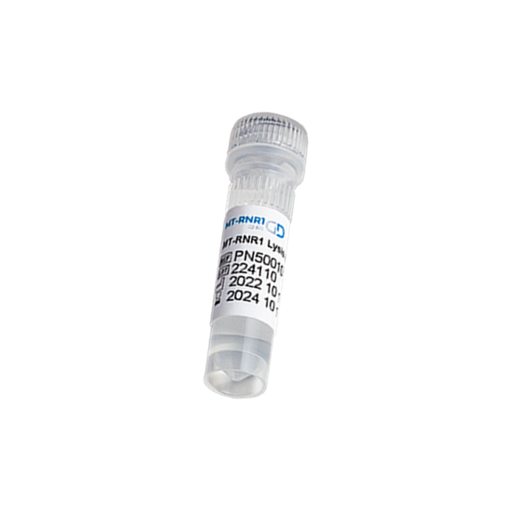

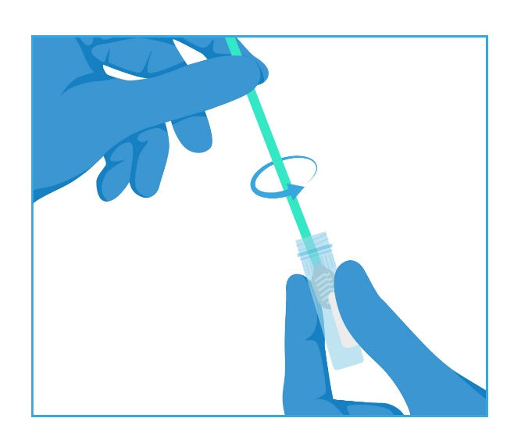
5 | TEST PROCEDURE
Performing a Patient Test
Specimen handling and preparation​
Step 2​ - Vigorously rotate
Open the sample collection tube.
Submerge the buccal swab in the Genedrive lysis buffer and VIGOROUSLY SWIRL the swab for 30 SECONDS to release the buccal cells into the solution.
Remove the buccal swab from the tube and discard.
Securely replace the sample collection tube lid.
Label the collection tube with the patient identification details.
Note: Freshly collected buccal samples are stable up to 30°C for2 hours.

Slide 6
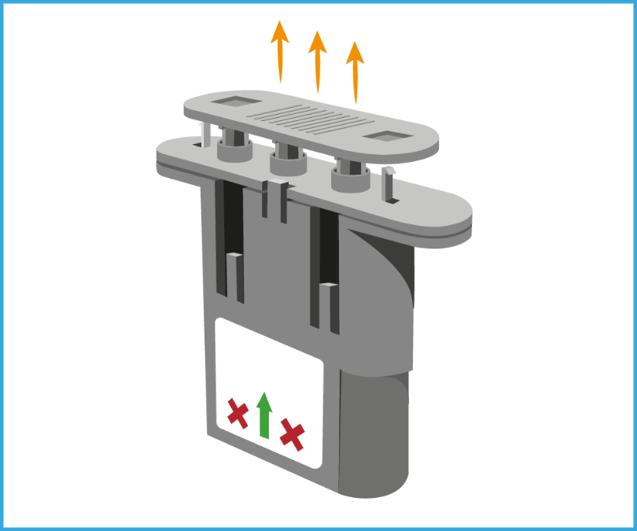
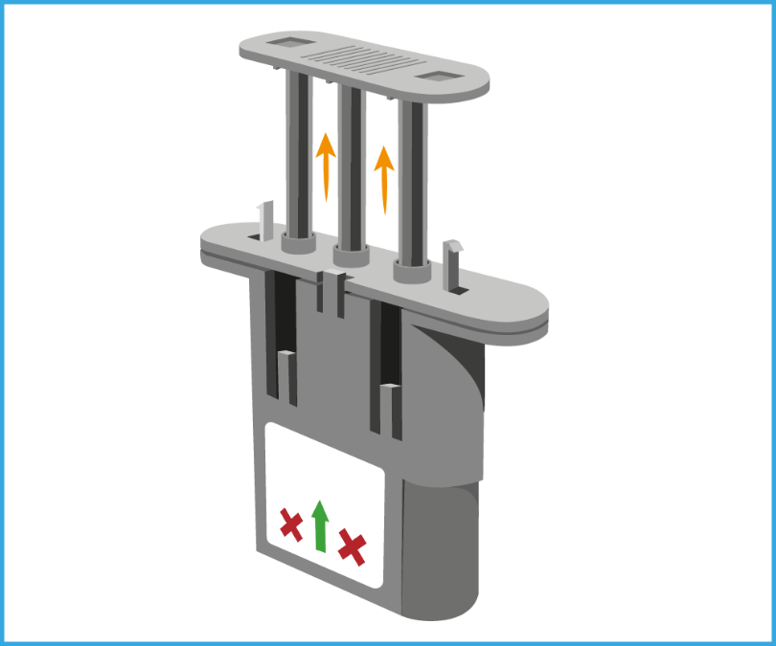
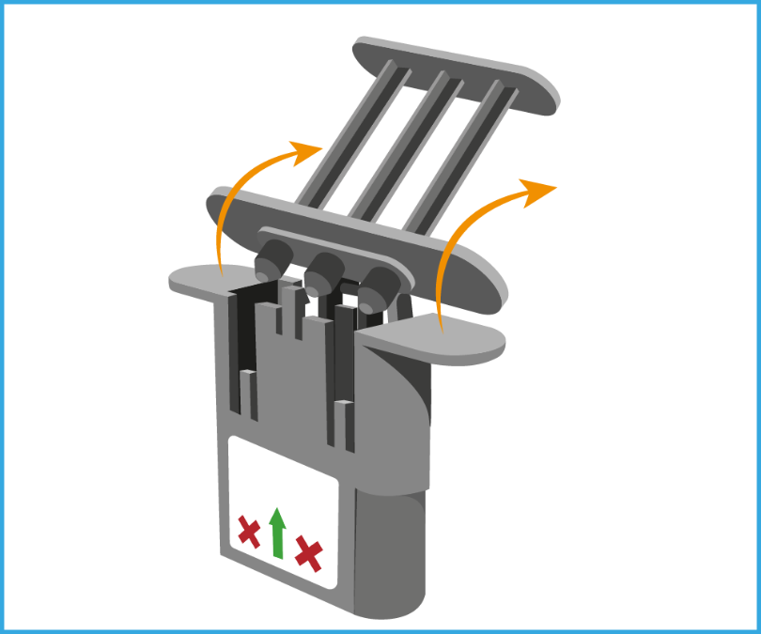
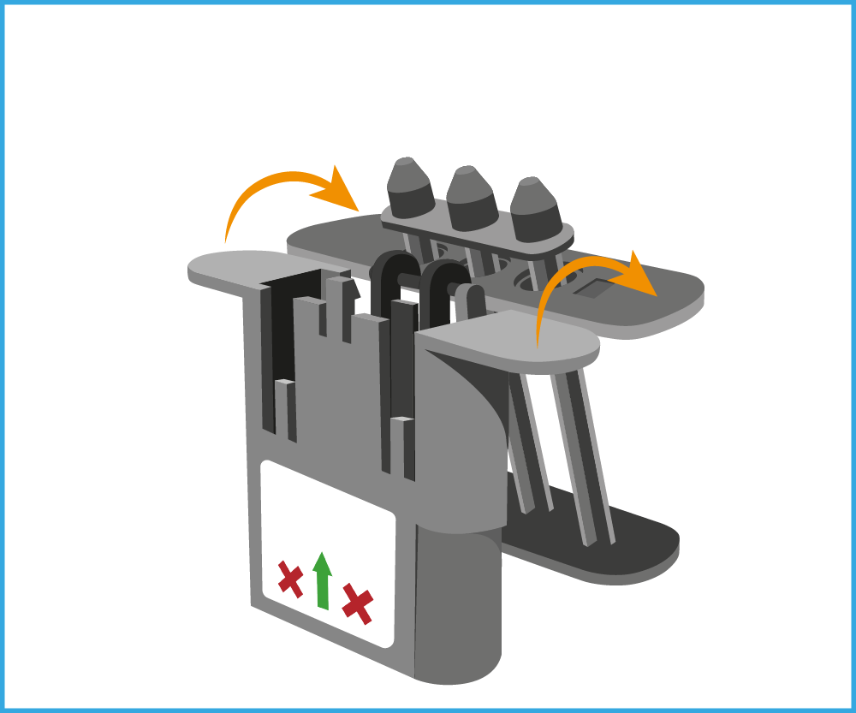
Performing a Patient Test
Step 3 – Open the cartridge lid​
Pull out the top of the cartridge and fold back upon itself (3A, 3B, 3C)​.
Once the hinge is fully open, place black cartridge lid upright and open on a flat surface (3D)​.
3A
3B
3C
3D

Slide 7
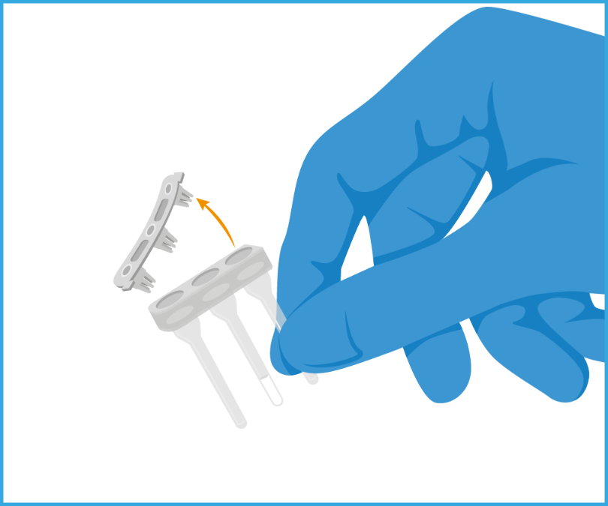
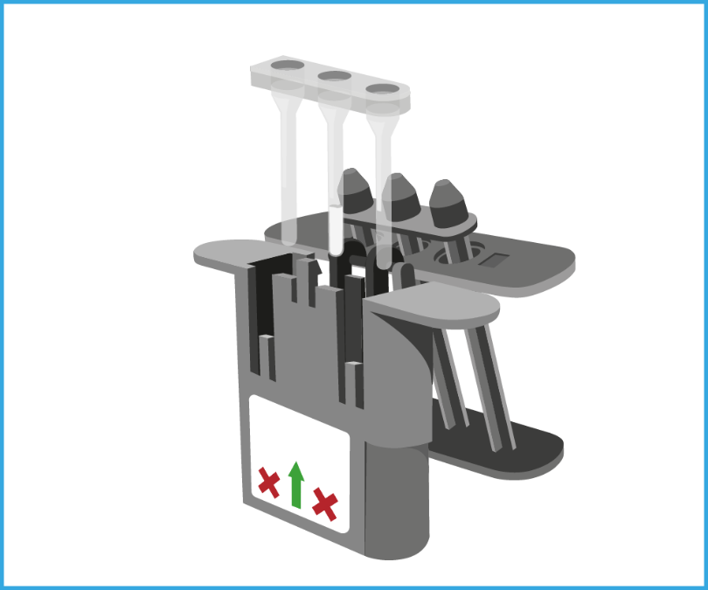
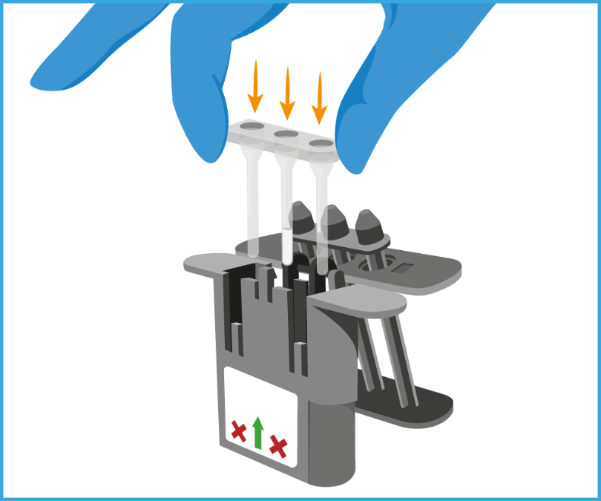
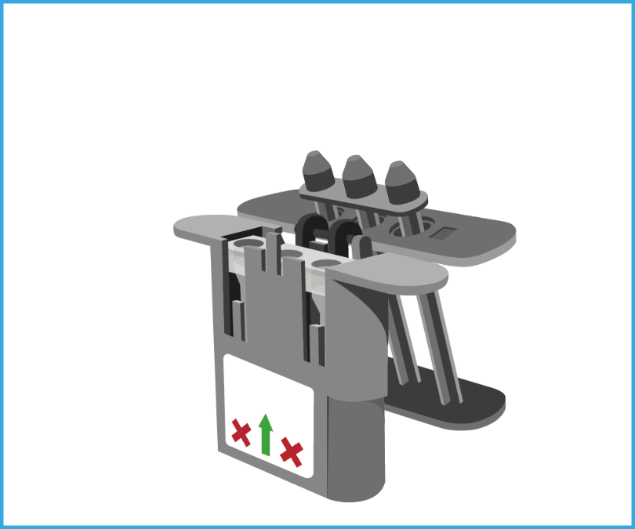
Performing a Patient Test
Step 4 – remove bung and place assay in cartridge​
Remove the strip cap (bung) from the assay cartridge and discard (4A).
Place assay cartridge into the black cartridge lid in the correct orientation (flat edges aligned, curved edges aligned) (4B,C,D)
4A
4B
4C
4D

Slide 8
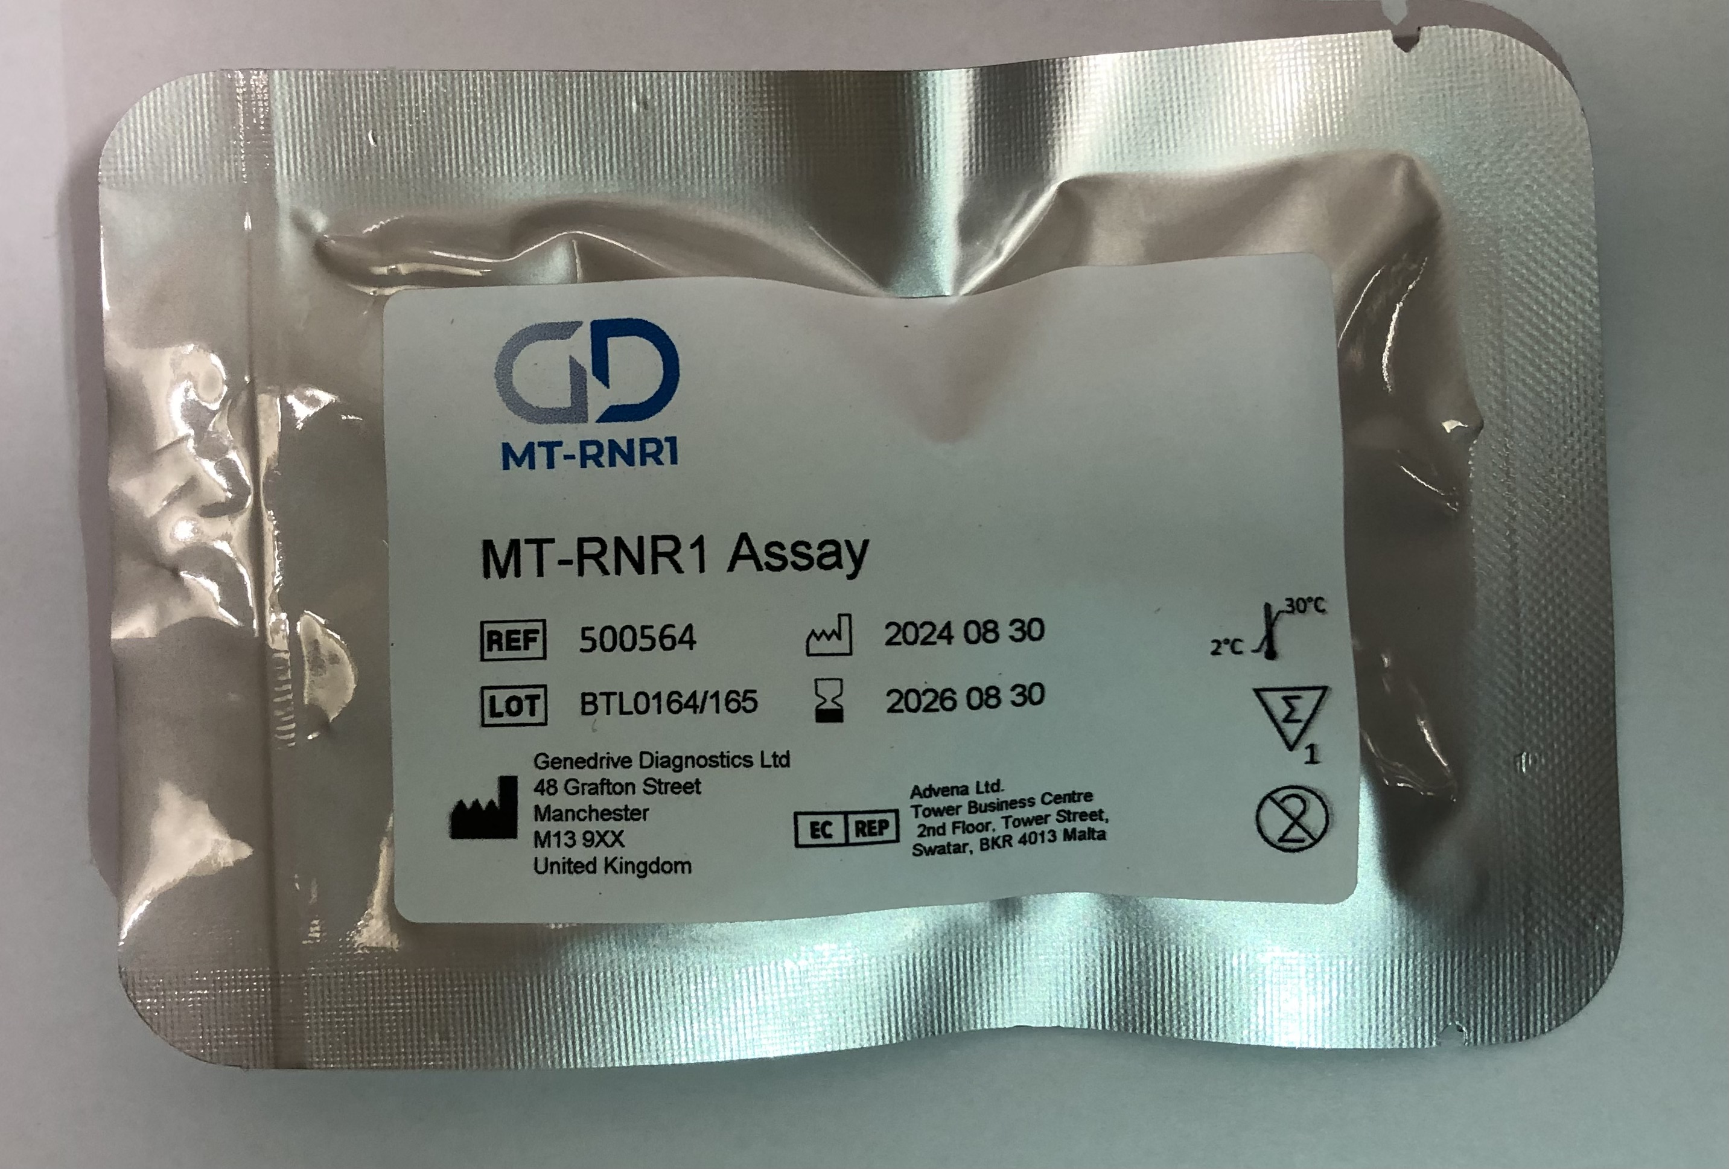
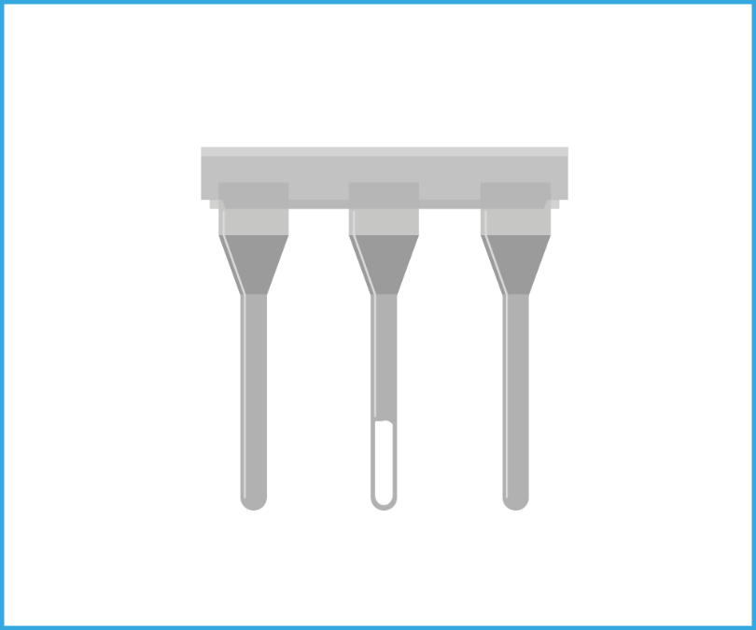
8 | TEST PROCEDURE
Performing a Patient Test
Specimen handling and preparation​
Step 5​ - Open the assay pouch
Remove the assay cartridge from its foil pouch (5A) and inspect it, ensuring that the lyophilised reagents are located at the base of the middle channel only (5B).
If the reagents are absent, discard the cartridge and open a new kit. If reagents are dislodged flick/tap to move to the bottom of the channel.
5A
5B

Slide 9
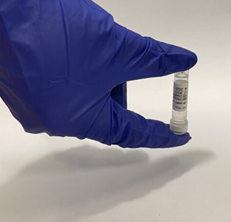
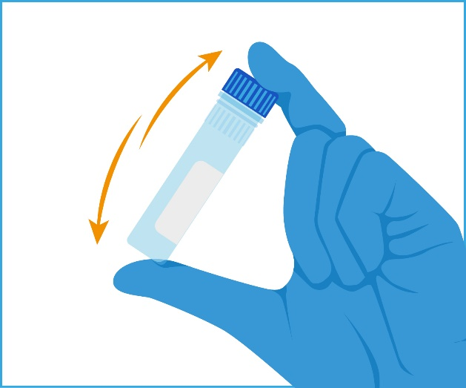
9 | TEST PROCEDURE
Performing a Patient Test
Specimen handling and preparation​
Step 6 – Invert to mix
Mix the sample collection tube containing Genedrive lysis buffer and patient sample by inverting several times.

Slide 10
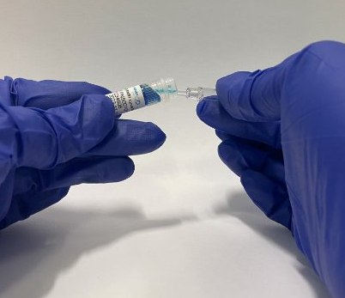
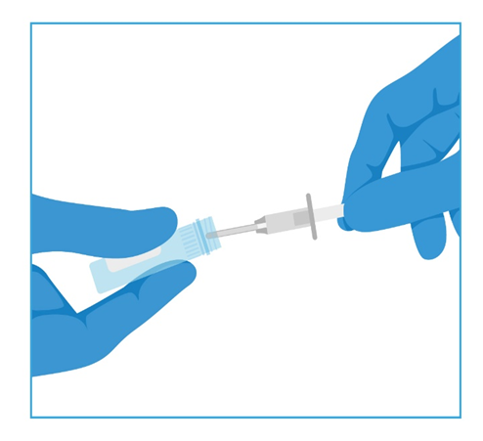
10 | TEST PROCEDURE
Performing a Patient Test
Transfer of Specimen​
Step 7 – Withdraw the sample
Prior to using the minivette ensure that the piston is not pushed down.
Hold the Minivette in a horizontal, slightly declined position, under the wings. The air ventilation hole at the end of the piston should not be covered.
Collect the sample using capillary action, by placing the Minivette under the surface of the sample
Observe the Minivette carefully during collection, to ensure the liquid fills up to the filter at the other end of the capillary tip.
Under/over fill of sample can lead to performance differences of the test.
Ensure any excess liquid present is removed by wiping the tip of the Minivette on the edge of the sample collection tube when removing.

Slide 11
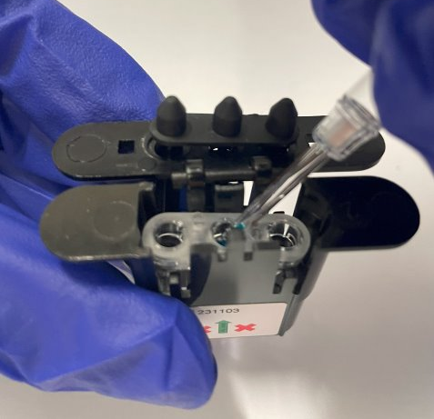
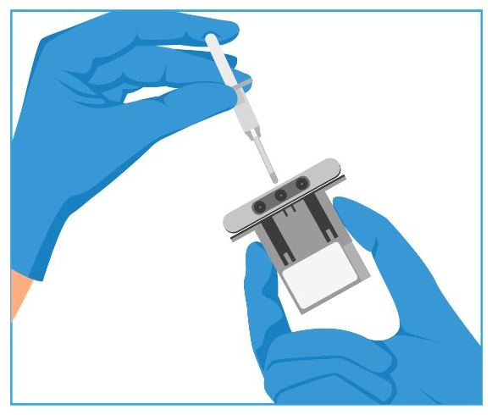
11 | TEST PROCEDURE
Performing a Patient Test
Transfer of Specimen​
Step 8 – Dispense the sample
Immediately dispense the sample into the middle channel only of the assay cartridge by slowly pressing down the piston on the Minivette.
Replace the screw cap on the sample collection tube. Discard the Minivette – the Minivette is single use only, do not refill.
Notes:
Failure to lock the lid can result in the assay tube moving when inserting into the Genedrive System which can cause test failure

Slide 12
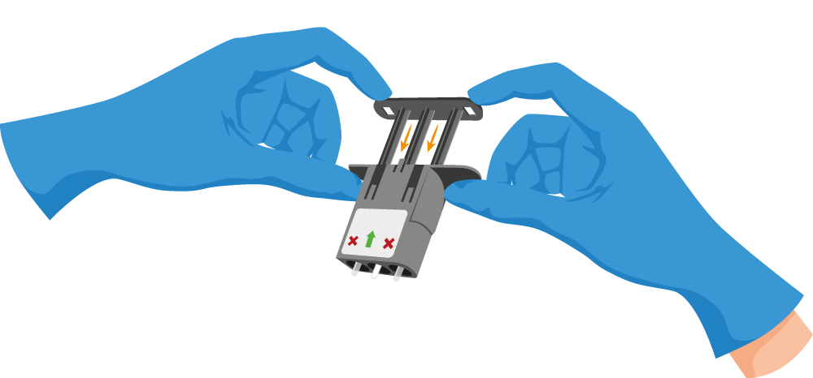
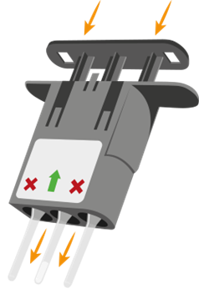
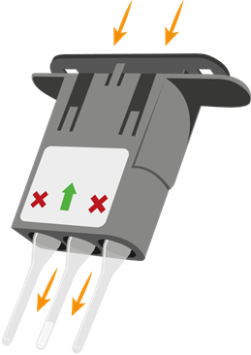
12 | TEST PROCEDURE
Performing a Patient Test
Transfer of sample​
Step 9 – Cartridge closure
Close the cartridge lid and depress the plunger to ensure the assay cartridge protrudes through the end of the cartridge lid​ (9A, 9B).
Squeeze tightly until a ‘click’ is heard, ensuring the clips at each side are fully engaged to ensure complete closure of the black cartridge lid​ (9C).
Failure to lock the lid can result in the assay tube moving when inserting into the Genedrive System which can cause test failure.
Do not attempt to open re open the assay.
9A
9B
9C
Notes:
Failure to lock the lid can result in the assay tube moving when inserting into the Genedrive System which can cause test failure

Slide 13
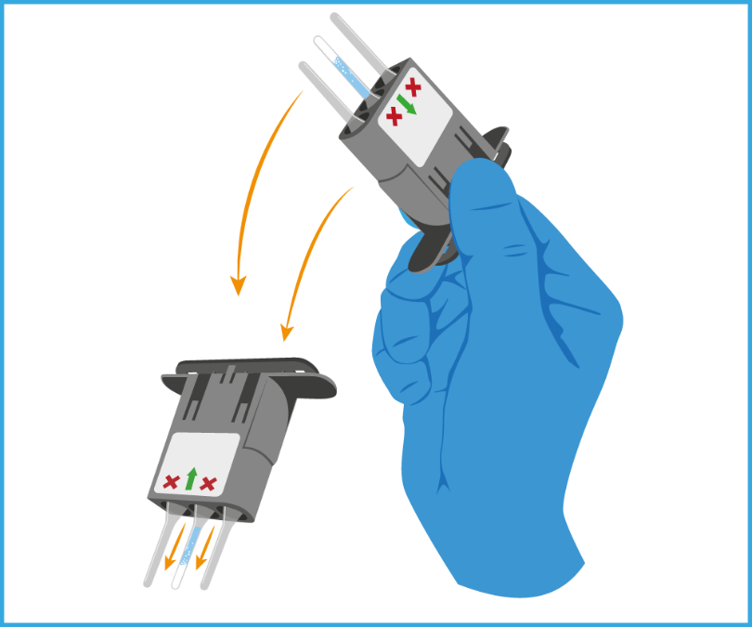
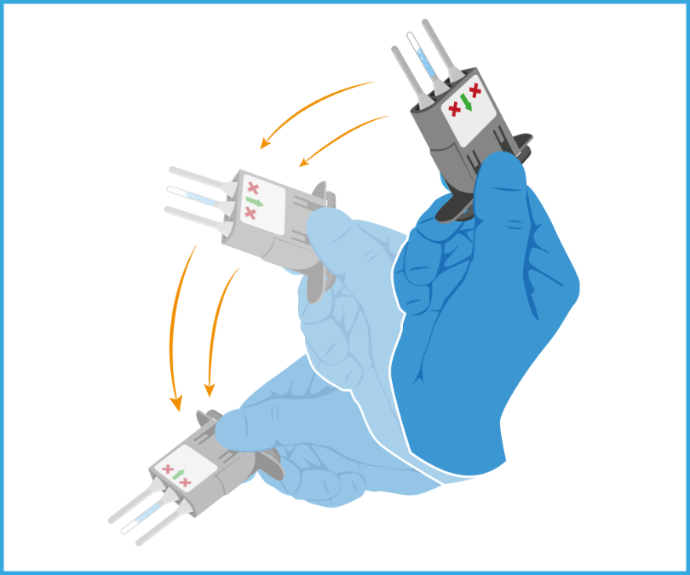
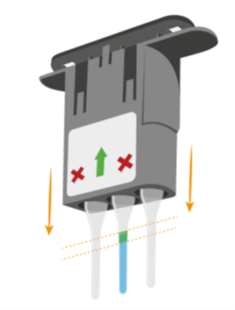
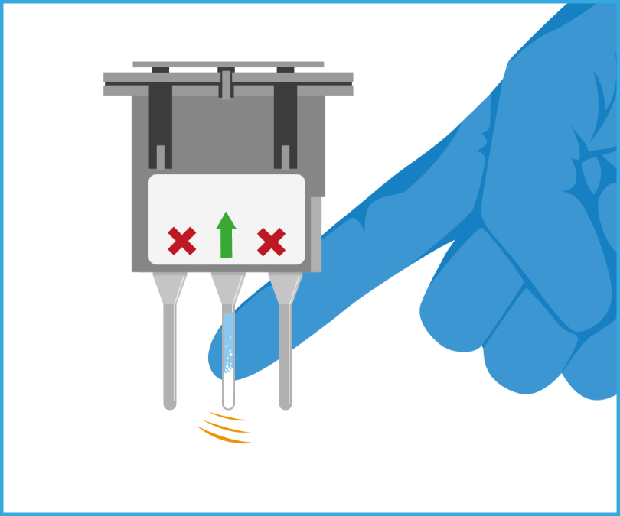
13 | TEST PROCEDURE
Performing a Patient Test
Reconstitution​
10A
10B
Step 10 – Reconstitution of lyophilised reagents
Sharply flick the cartridge downwards, forcing the liquid to the bottom of the channel (10A, 10B).
Note: It is normal to see bubbles or foam whilst the reagents mix.
Ensure liquid has moved to the base of the channel and no bubbles are present (10C).
Tap the middle channel of the assay cartridge with a finger to dislodge any bubbles and promote dissolving of the reagents (10D).
10C
10D

Slide 14
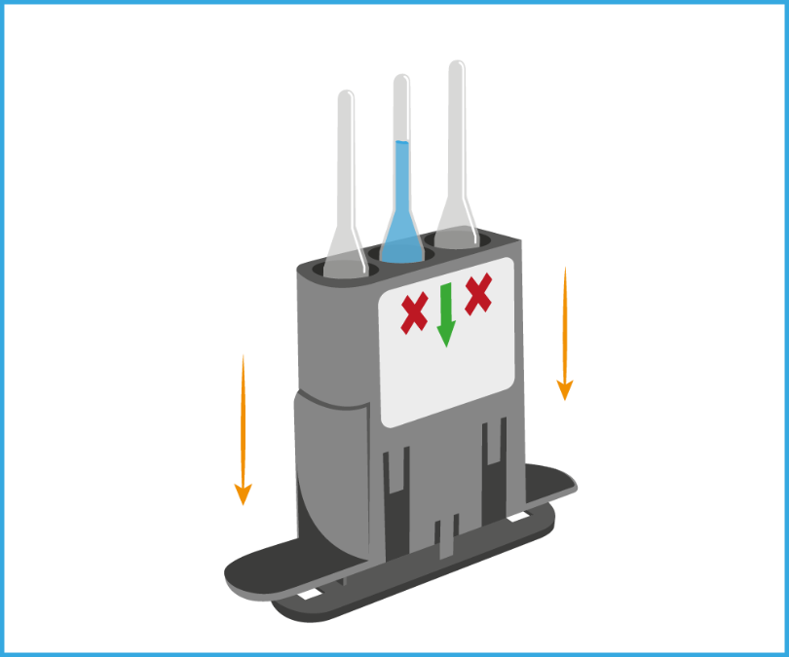
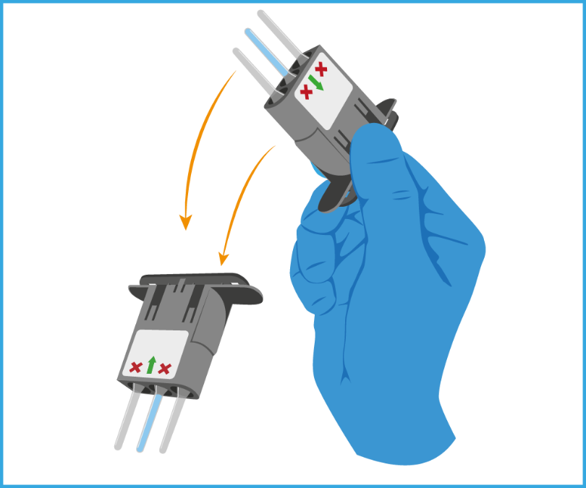


14 | TEST PROCEDURE
Performing a Patient Test
Reconstituting the Lyophilised reagents​
11A
11B
Step 11
Invert the cartridge lid on a flat surface for at least 60 seconds.
Sharply flick the cartridge downwards again, forcing the liquid to the bottom of the middle channel (11B and 11C).
Tap the middle channel with a finger to dislodge any bubbles present (11D).
11C
11D
Notes:
Tubes are made from polycarbonate and will withstand vigorous flicking.
Check that the liquid level is correct before proceeding

Slide 15
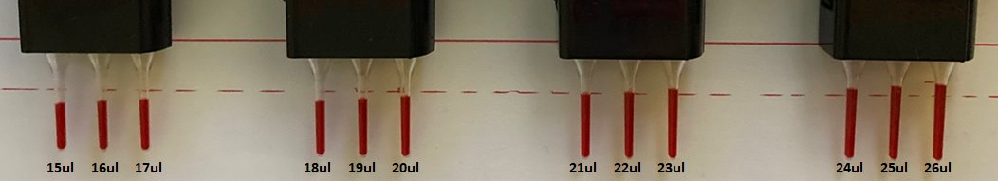
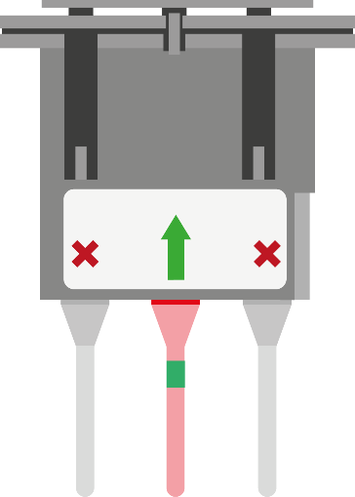
15 | TEST PROCEDURE
Performing a Patient Test
Step 12 – Check fill levels
​Visually check the assay cartridge to confirm all reagents are fully dissolved and that any bubbles move toward the top of the channel. If not, return to step 11.
Ensure the level of liquid is correct comparing it to the example image.
If the fill levels are too high or too low, then discard the assay cartridge and return to step 3.
Following successful inspection, proceed with the test immediately.
Likely to cause false results
May cause false results
Correct volume
May cause false results
Likely to cause false results

Slide 16
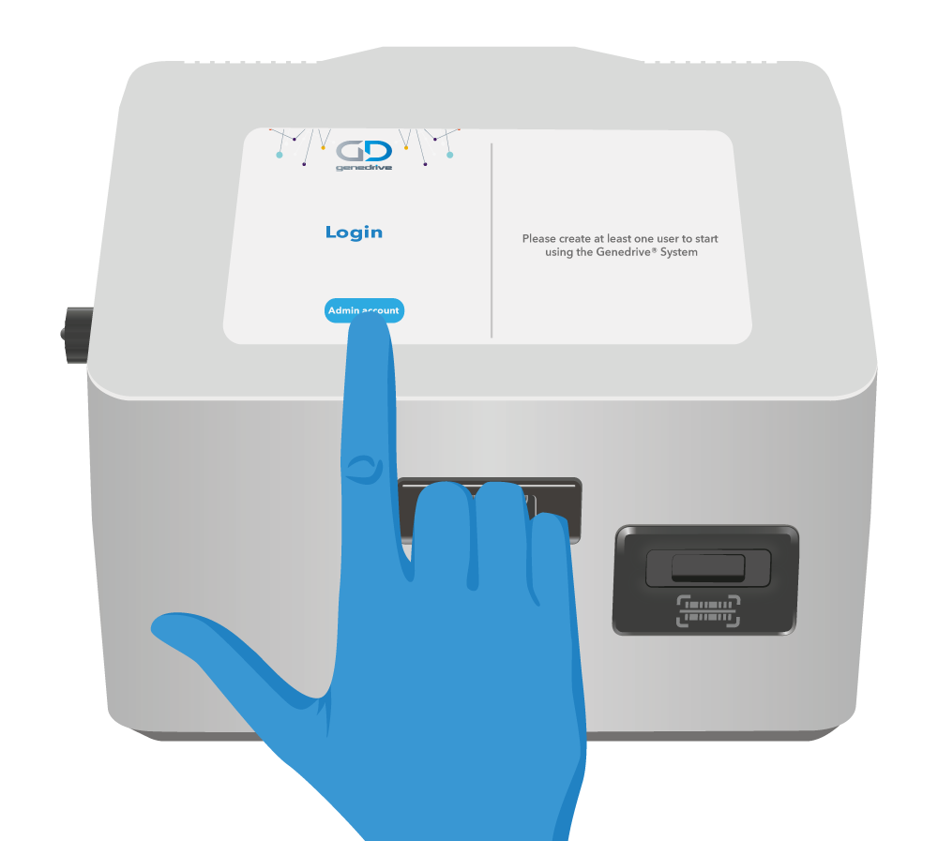
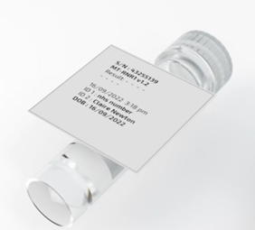
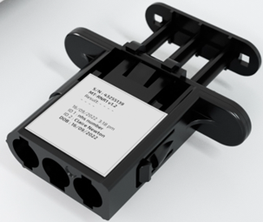
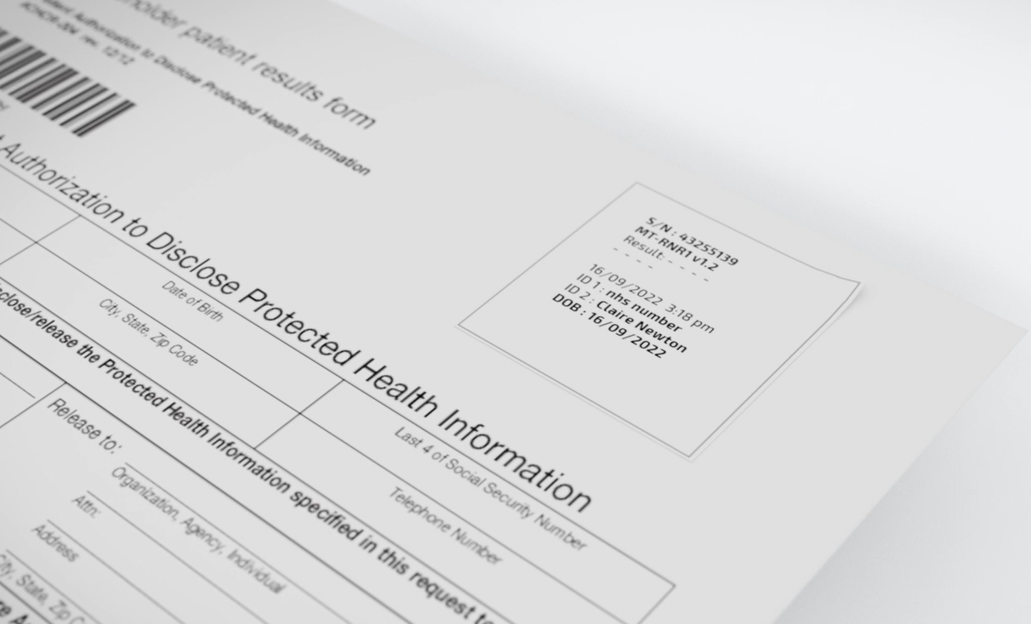
16 | TEST PROCEDURE
Performing a Patient Test
Step 13 – starting the test
Log onto the Genedrive System
Select “Patient Test” and input the patient data as required. Press “Ok” and confirm the data is correct before pressing “Ok” again.
If using the printer, print off 3 labels and attach to
sample collection tube
cartridge lid
paper patient record

Slide 17
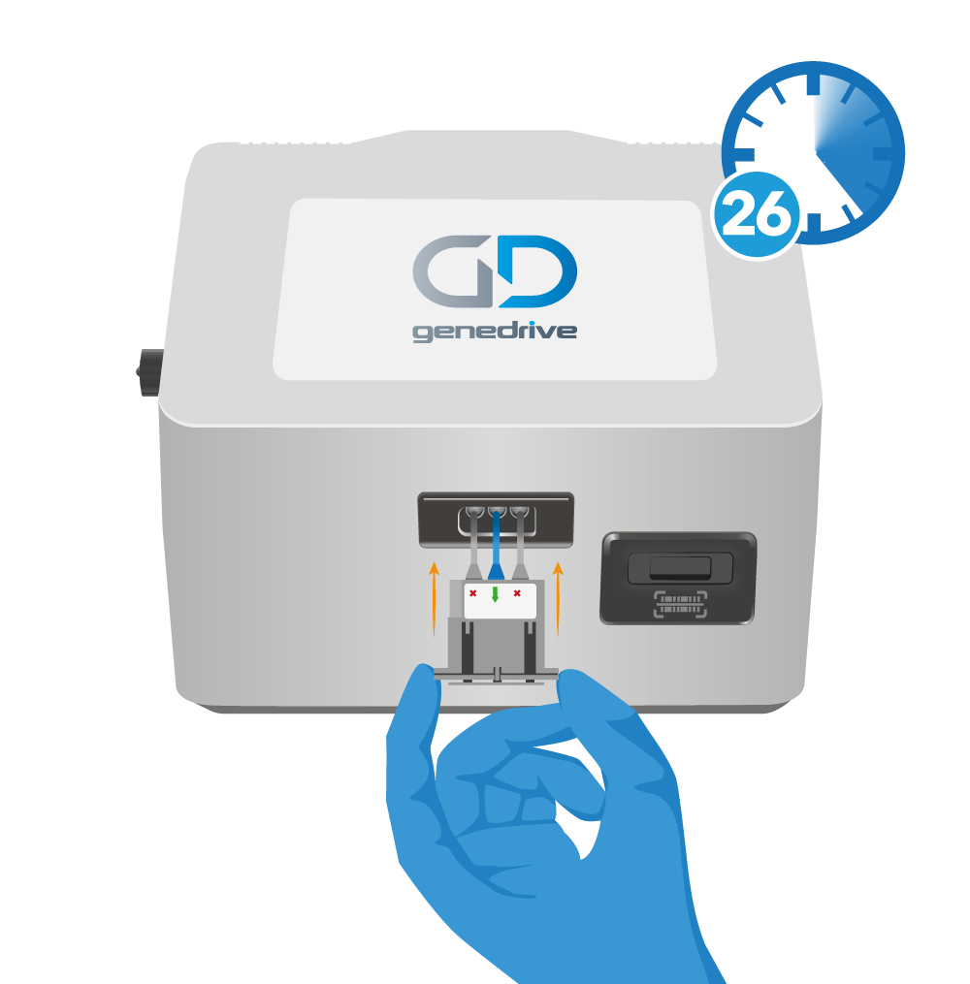
17 | TEST PROCEDURE
Performing a Patient Test
Step 14 – insert cartridge and start test
Immediately insert the assay cartridge into the Genedrive® System.
Push firmly until a ‘click’ is heard and a single ‘beep’ tone.
The assay cartridge will only insert into the Genedrive® System baffle in one orientation (with curve and flat side aligned).
Press ‘Start Test’ on the touchscreen.
Notes:
The assay cartridge will only insert in one orientation
If a valid cartridge is inserted you will hear a beep tone to confirm
DO NOT disturb or move the Genedrive® System when a test is running
Never try to take the cartridge out of the black cartridge lid

Slide 18
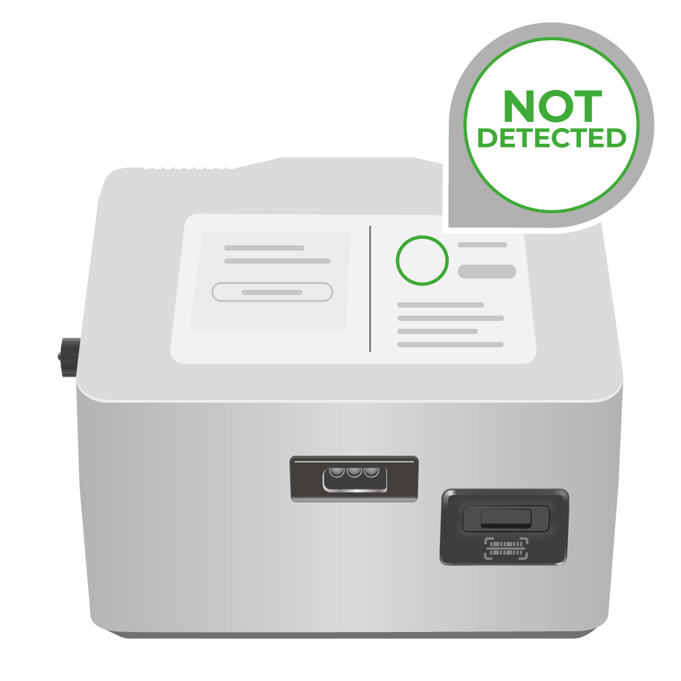
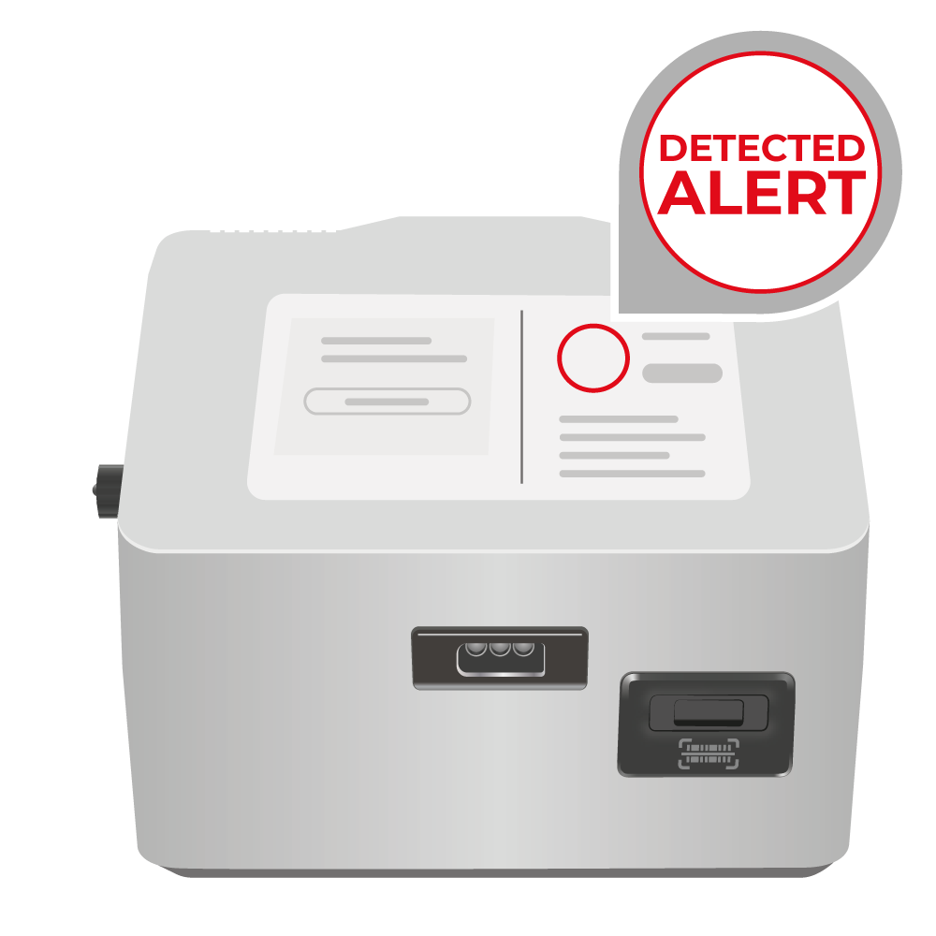
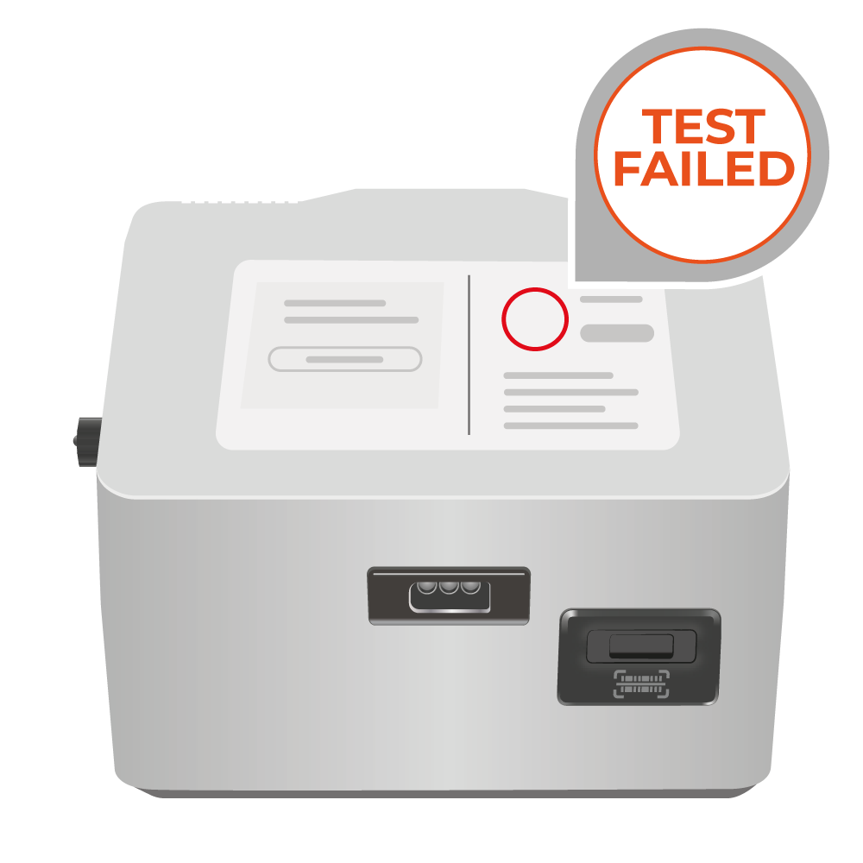

18 | TEST PROCEDURE
Post Test
Step 15 – Results
Note: In some scenarios a short automatic re analysis step (around 11 minutes) will be performed after a standard test, allow this to finish before continuing.
Upon completion of the test, the result will be displayed on the screen:
Not Detected Detected Alert Test Failed
Record the result and print labels if required
Test Failed means that the test has failed due to the quality metrics not being met.
Notes:
Detected Alert means that MT-RNR1 variant has been detected and the patient is positive for the m.1555A>G variant
Not Detected means that MT-RNR1 variant has not been detected and the patient is negative for the m.1555A>G variant

Slide 19
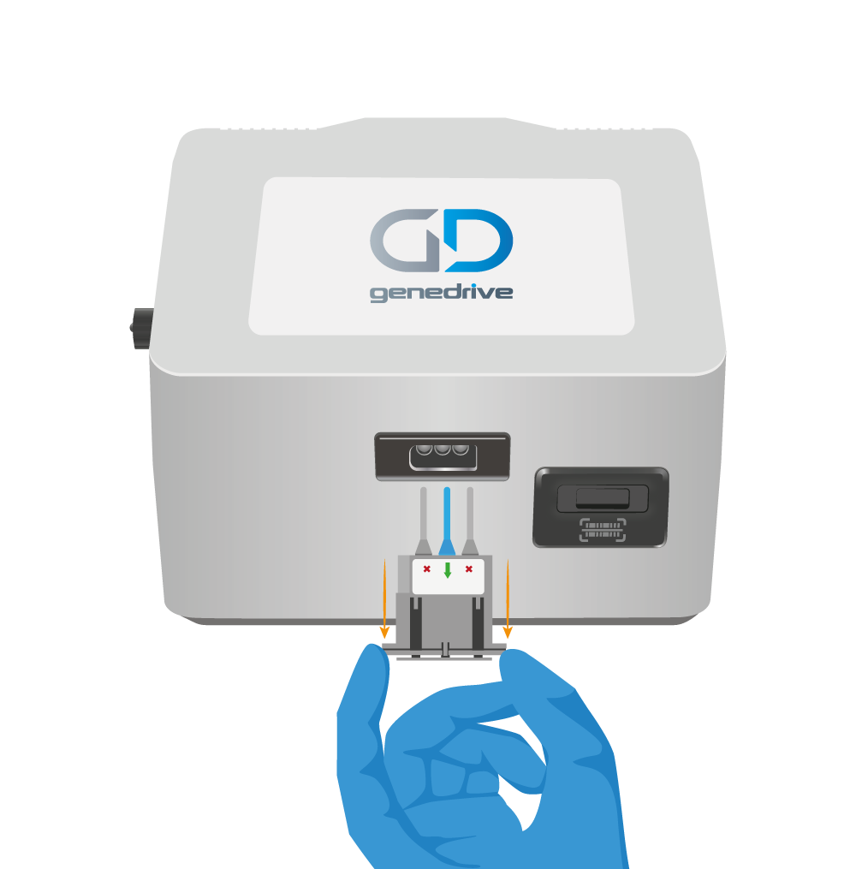
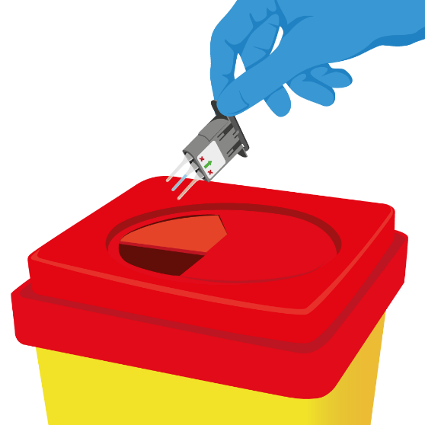
19 | TEST PROCEDURE
Performing a Patient Test
Step 16 - Remove cartridge and dispose
Remove the cartridge by pressing down on the button on the side of the cartridge and withdrawing.
All test components should be disposed of as clinical waste.
Never open the cartridge lid before disposal.
Notes:
The assay cartridge will only insert in one orientation
If a valid cartridge is inserted you will hear a beep tone to confirm
DO NOT disturb or move the Genedrive® System when a test is running
Never try to take the cartridge out of the black cartridge lid

Slide 20
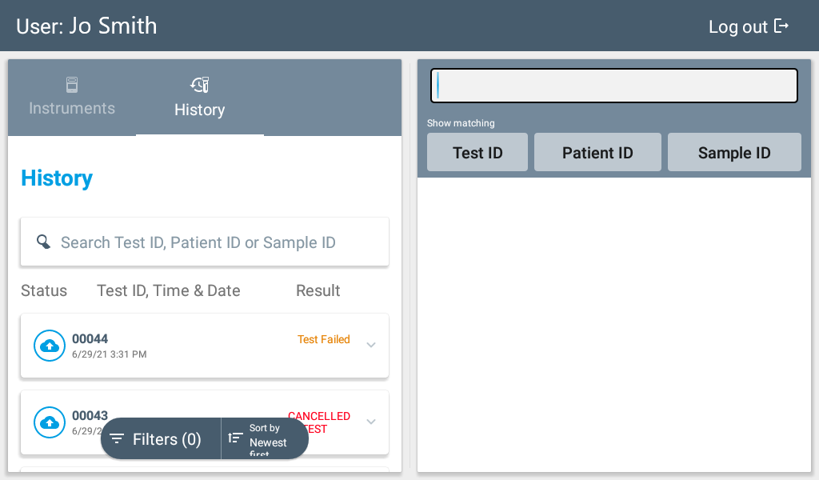
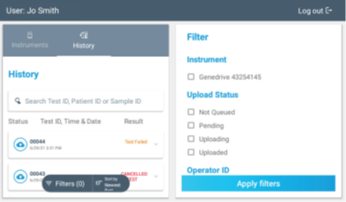
20 | TEST PROCEDURE
Post Test
Search test results by Test, Patient or Sample ID
Results​
Check past test results
Check results from any test using the ‘History’ tab
Clicking ‘search’ brings up a dialogue box to search by:
Test ID
ID 1
ID 2
Once selected, the full test details can be viewed on the right of the screen
Tests can be filtered and sorted oldest or newest first
Filter test results from oldest to newest
Notes:
Detected Alert means that MT-RNR1 variant has been detected and the patient is positive for the m.1555A>G variant
Not Detected means that MT-RNR1 variant has not been detected and the patient is negative for the m.1555A>G variant

Slide 21

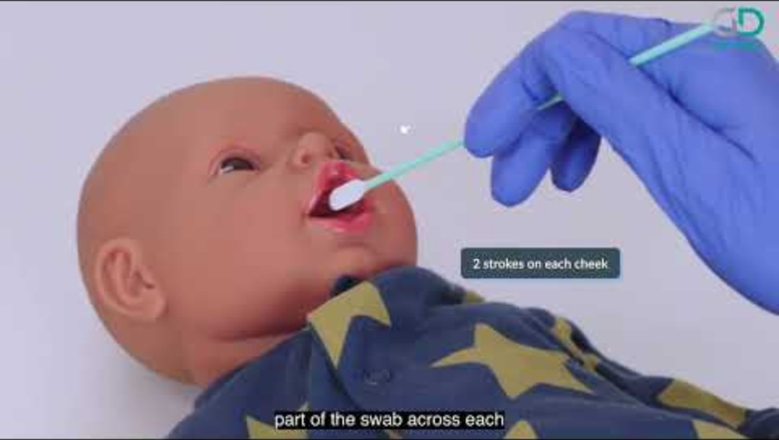
21 | OUR PRODUCTS
Genedrive® MT-RNR1 ID Kit
Technical Training Video
How to Use the Genedrive® MT-RNR1 ID Kit | Step-by-Step for Healthcare Professionals
Notes:
Take a closer look at the control kit
GET THEM TO OPEN THE KIT
Put to the side for now

Slide 22
Product Demonstration How to perform a quality control test
Notes:
Ideally project what is on your demo unit onto a big screen, for all to see

Slide 23
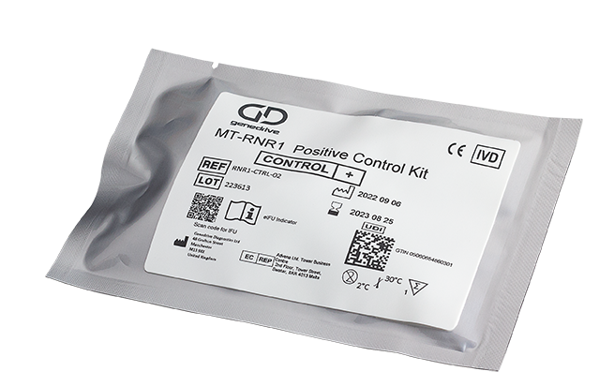
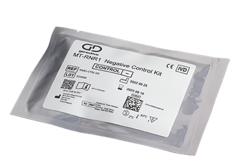
23 | TEST PROCEDURE
Performing a QC Test
Specimen handling and preparation
You will need:​
2 x pairs of powder-free disposable gloves
1 x Genedrive®
MT-RNR1 Positive Control Kit
(RNR1-CTRL-02)
1 x Genedrive®
MT-RNR1 Negative Control Kit
(RNR1-CTRL-03)
2 x Genedrive®
MT-RNR1 ID Kit
(ID-RNR1-01)
Access to a clinical waste bin
Genedrive System
GS-002 V6.0
Notes:
Wear powder-free disposable gloves throughout the procedure
Before opening the RNR1 Control Kit,
check its not damaged
check the expiry date has not expired
Before opening the RNR1 ID kit
check its not damaged
check the expiry date has not expired
check the buccal swab head has not become detached from the stick – discard if it has and open a new RNR1 ID Kit

Slide 24
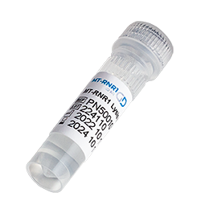


24 | TEST PROCEDURE
Performing a QC Test
Wear powder free disposable gloves throughout
Step 1
Take the Lysis buffer tube from the Genedrive® MT-RNR1-ID Kit
Take one Dual Bulb Pastette® from the Genedrive® MT-RNR1 Positive Control Kit
Take the red capped positive control tube from the Genedrive® MT-RNR1 Positive Control Kit
Notes:
Use for Text for IFU . Images not required in IFU. Use for presentation.

Slide 25

25 | TEST PROCEDURE
Performing a QC Test
Step 2
Using the dual bulb pastette® measure 200μl of the lysis buffer sample.
Squeeze and release the upper bulb to aspirate your sample.
The pipette will fill up with liquid, and the excess will overflow into the lower bulb,
Then dispense into the red capped positive control tube.
To dispense squeeze the upper bulb. The air displaces the measured sample leaving the overspill in the lower bulb.
Then discard the Dual Bulb Pastette® as per clinical waste.

Slide 26

26 | TEST PROCEDURE
Performing a QC Test
Step 3
Firmly reattach the red cap onto the positive control tube and leave to stand for 5 minutes at 18-30°C.
Note: Due to the small amount of control sample required, the tube may appear empty.

Slide 27
Performing a QC Test
Step 4 – Open the cartridge lid​
Pull out the top of the cartridge and fold back upon itself (4A, 4B, 4C).​
Once the hinge is fully open, place cartridge lid upright and open on a flat surface (4D)​.
4A
4B
4C
4D

Slide 28
28 | TEST PROCEDURE
Performing a QC Test
Specimen handling and preparation​
Step 5​ - Open the assay pouch
Remove the assay cartridge from its foil pouch (5A) and inspect it, ensuring that the lyophilised reagents are located at the base of the middle channel only (5B).
If the reagents are absent, discard the cartridge and open a new kit. If reagents are dislodged flick/tap to move to the bottom of the channel.
5A
5B

Slide 29
Performing a QC Test
Step 6– remove bung and place assay in cartridge​
Remove the strip cap (bung) from the assay cartridge and discard (6A).
Place assay cartridge into the cartridge lid in the correct orientation (flat edges aligned, curved edges aligned) (6B,C,D).
6A
6B
6C
6D

Slide 30

30 | TEST PROCEDURE
Performing a QC Test
Step 7
Mix the lysis buffer and positive control sample by vigorously shaking the tube up and down ten times.
Flick the tube, ensuring the volume has reached the base of the red capped positive tube.

Slide 31
31 | TEST PROCEDURE
Performing a QC Test
Transfer of Specimen​
Step 8 – Withdraw the sample
Prior to using the minivette ensure that the piston is not pushed down.
Hold the Minivette in a horizontal, slightly declined position, under the wings. The air ventilation hole at the end of the piston should not be covered.
Collect the sample using capillary action, by placing the Minivette under the surface of the sample.
Observe the Minivette carefully during collection, to ensure the liquid fills up to the filter at the other end of the capillary tip.
Under/over fill of sample can lead to performance differences of the test.
Ensure any excess liquid present is removed by wiping the tip of the Minivette on the edge of the sample collection tube when removing.

Slide 32
32 | TEST PROCEDURE
Performing a QC Test
Transfer of Specimen​
Step 9 – Dispense the sample
Immediately dispense the sample into the middle channel only of the assay cartridge by slowly pressing down the piston on the Minivette.
Replace the screw cap on the sample collection tube. Discard the Minivette – the Minivette is single use only, do not refill.
Notes:
Failure to lock the lid can result in the assay tube moving when inserting into the Genedrive System which can cause test failure

Slide 33
33 | TEST PROCEDURE
Performing a QC Test
Transfer of Control​
Step 10 – Close cartridge Lid
Close the black cartridge lid and depress the plunger to ensure the assay cartridge protrudes through the end of the cartridge lid​ (10A, 10B).
Squeeze tightly until a ‘click’ is heard, ensuring the clips at each side are fully engaged to ensure complete closure of the cartridge lid​ (10C).
Failure to lock the lid can result in the assay tube moving when inserting into the Genedrive System which can cause test failure.
Do not attempt to open re open the assay.
10A
10B
10C
Notes:
Failure to lock the lid can result in the assay tube moving when inserting into the Genedrive System which can cause test failure

Slide 34
34 | TEST PROCEDURE
Performing a QC Test
Reconstitution​
11A
11B
Step 11 – Reconstitution of lyophilised reagents
Sharply flick the cartridge downwards, forcing the liquid to the bottom of the channel (11A, 11B).
Note: It is normal to see bubbles or foam whilst the reagents mix.
Ensure liquid has moved to the base of the channel and no bubbles are present (11C).
Tap the middle channel of the assay cartridge with a finger to dislodge any bubbles and promote dissolving of the reagents (11D).
11C
11D

Slide 35
35 | TEST PROCEDURE
Performing a QC Test
Reconstituting the Lyophilised reagents​
11A
11B
Step 12
Invert the cartridge lid on a flat surface for at least 60 seconds.
Sharply flick the cartridge downwards again, forcing the liquid to the bottom of the middle channel (11B and 11C).
Tap the middle channel with a finger to dislodge any bubbles present (11D).
11C
11D
Notes:
Tubes are made from polycarbonate and will withstand vigorous flicking.
Check that the liquid level is correct before proceeding

Slide 36
36 | TEST PROCEDURE
Performing a Patient Test
Step 13 – Check fill levels
​Visually check the assay cartridge to confirm all reagents are fully dissolved and that any bubbles move toward the top of the channel. If not, return to step 11.
Ensure the level of liquid is correct comparing it to the example image.
If the fill levels are too high or too low, then discard the assay cartridge and return to step 3.
Following successful inspection, proceed with the test immediately.
Likely to cause false results
May cause false results
Correct volume
May cause false results
Likely to cause false results

Slide 37

37 | TEST PROCEDURE
Performing a QC Test
Data entry​
Step 14
Log onto the Genedrive System. Select “Control test” or “non-scheduled control test” (by the 3 dots).
Enter the control data by scanning the product barcode on the tube label.
Press “Ok” and confirm the data is correct before pressing “Ok” again
Print off the labels via the Bluetooth label printer and attach to control tube and the cartridge lid.

Slide 38
38 | TEST PROCEDURE
Performing a QC Test
Start test​
Step 15
Immediately insert the assay cartridge into the Genedrive® System in the correct orientation.
Push firmly until a ‘click’ is heard and a ‘beep’ tone
Press the ‘Start Test’ button on the Genedrive® System screen.
Notes:
The assay cartridge will only insert in one orientation
If a valid cartridge is inserted you will hear a beep tone to confirm
DO NOT disturb or move the Genedrive® System when a test is running
Never try to take the cartridge out of the black cartridge lid

Slide 39


39 | TEST PROCEDURE
Performing a QC Test
Step 16 - Results
Upon completion of a successful control test the Genedrive® System will display Control Pass. If quality metrics were not met the Genedrive® System will display Control Fail.
If required print off the results labels via the Bluetooth label printer to attach to records.
If QC controls are set up as scheduled on the Genedrive® system, QC failure will prevent patient testing being conducted until QC pass is achieved. Repeat QC test if QC fail is determined, and If QC fails more than twice, please contact Genedrive Diagnostics Ltd, or your local distributor.

Slide 40
40 | TEST PROCEDURE
Performing a QC Test
​Results
Step 17 Remove cartridge and dispose
Remove the cartridge by pressing down on the button on the side of the cartridge and withdrawing.
All test components should be disposed of as clinical waste.
Never open the cartridge lid before disposal.
Notes:
The assay cartridge will only insert in one orientation
If a valid cartridge is inserted you will hear a beep tone to confirm
DO NOT disturb or move the Genedrive® System when a test is running
Never try to take the cartridge out of the black cartridge lid

Slide 41


41 | TEST PROCEDURE
Performing a QC Test
When performing a negative control test, repeat steps 1 to 15. Substituting the red capped positive control tube with the green capped negative control tube. Use the second dual bulb pastette® and a fresh pair of powder free gloves.
Negative MT-RNR1 Control Kit
Positive MT-RNR1 Control Kit

Slide 42
Supporting information
GUM-7 Genedrive System User Manual
ID-RNR1-IFU Genedrive MT-RNR1 ID Kit Instructions for Use
GPM-15 Genedrive MT-RNR1 ID Kit Quick Reference Guide
GPM-149 Genedrive MT-RNR1 ID Kit Critical Steps Guide
RNR1-CTRL-IFU Genedrive MT-RNR1 Control Kit Instructions for Use
GPM-101 Genedrive MT-RNR1 Control Kit Quick Reference Guide

Slide 43

Thank You

