Slide 1
Genedrive MT-RNR1
GPM-99 Product Overview

Slide 2
CONTENTS
Contents
03 | About Us
07 | Why Pharmacogenetics
13 | The Clinical Need
25 | Our Solution
33 | System Evolution & PALOH
35 | Product Range
41 | Demonstration
42 | Guidance & Recommendation

Slide 3
ABOUT US
Our Why
We want to improve patient outcomes by enabling healthcare professionals to deliver personalised treatment.
Our Vision
To become the leading company globally in pharmacogenetic testing.
Our Mission
To design and develop easy-to-use pharmacogenetic tests that directly improve clinical outcomes.
Notes:
Merge Vision & Mission

Slide 4

ABOUT US
Our Core Competencies
Proven Track Record
of achieving
CE-IVD status on several products
Regulatory Expertise
ISO 13485 certification
Flexible
technology uses different methods, for a broad assay portfolio
Unique
position in POC PGx* testing and a world’s first product
Experienced hardware, software and reagent development teams
Growing Network
of accredited distributors and partners
Notes:
Pharmacogenetics

Slide 5
ABOUT US
Our Network
Health innovation Networks
Manchester
SHTG
ANIA
NICE
NIHR
OLS
BIVDA
NHS Partnerships
Manchester Foundation Trust
NHS Scotland
Genomic Laboratory Hubs
7 in England
1 in Wales
4 in Scotland
Academic Partnerships
University of Manchester
POCT
Innovators
POCT for Scotland
Notes:
Strong Partnerships with academic institutions and healthcare providers and clinical governance organisations
England
Central and South Genomic Laboratory Hub led by Birmingham Women’s and Children NHS Foundation Trust
East Genomic Laboratory Hub led by Cambridge University Hospitals NHS Foundation Trust
North West Genomic Laboratory Hub led by Manchester University NHS Foundation Trust
North Thames Genomic Laboratory Hub led by Great Ormond Street Hospital for Children NHS Foundation Trust
South East Genomic Laboratory Hub led by Guy’s and St Thomas’ NHS Foundation Trust
South West Genomic Laboratory Hub led by North Bristol NHS Trust
North East and Yorkshire Genomic Laboratory Hub led by The Newcastle upon Tyne Hospitals NHS Foundation Trust
Scotland
Scottish Strategic Network for Genomic Medicine (SSNGM) Aberdeen, Dundee, Edinburgh and Glasgow
SHTG Scottish Healthcare Technology Group
ANIA Accelerated National Innovation Adoption

Slide 6
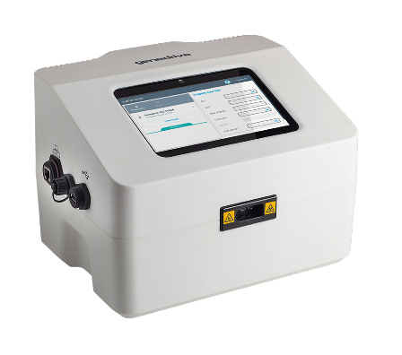
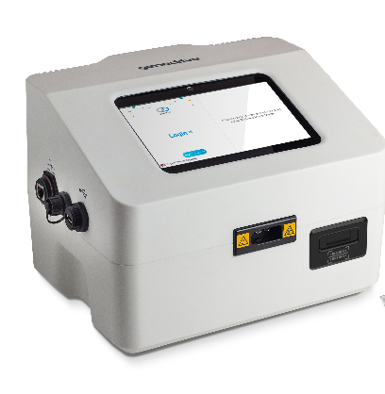
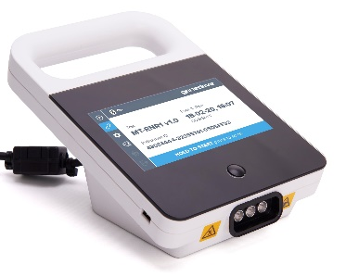
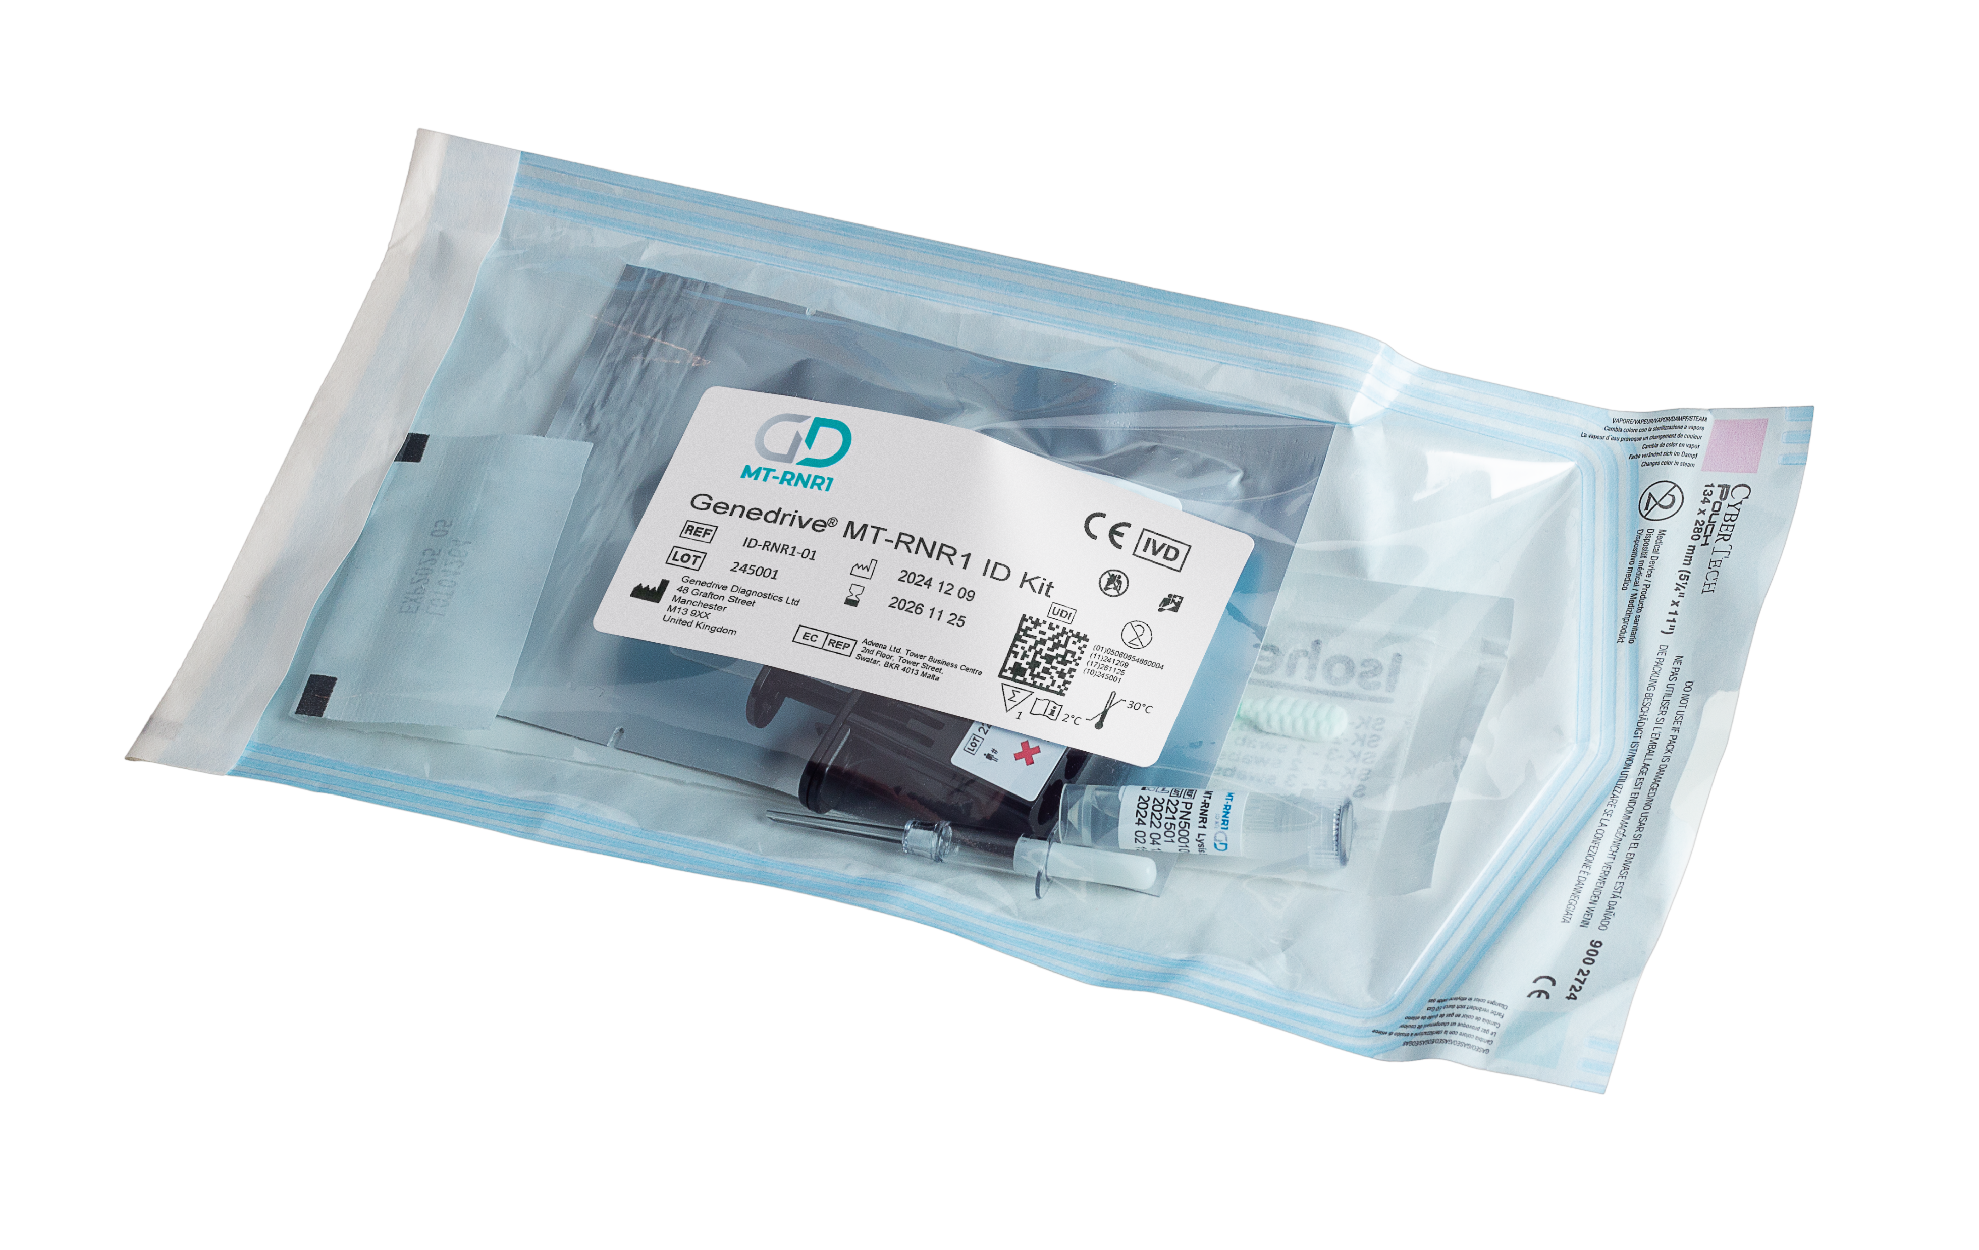

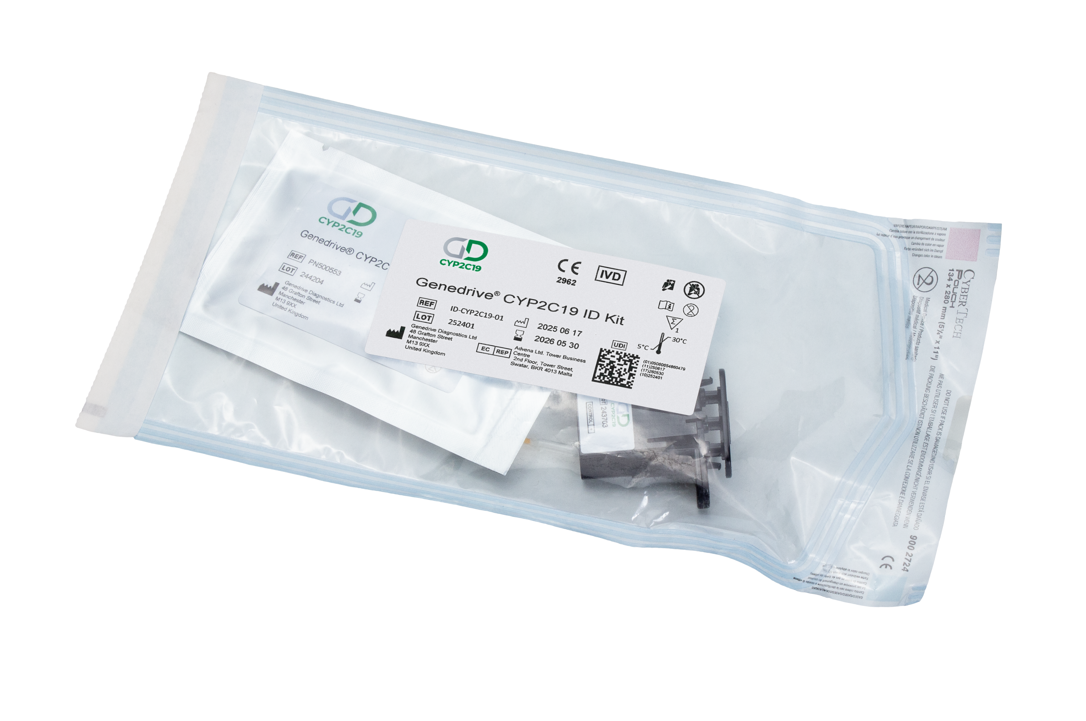
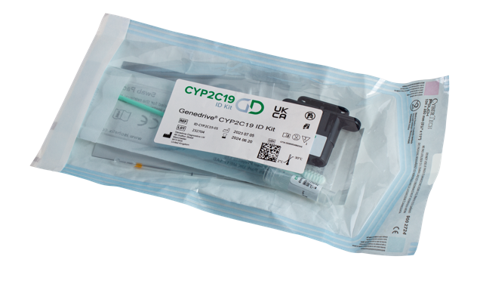
Our Company Product Timeline
April 2018
Nov
2019
Sept
2021
July
2022
Sept
2023
July
2024
Sept
2024
May
2025
Genedrive
Instrument
CE-IVD marked
Genedrive
MT-RNR1 ID Kit
CE-IVD
marked
Genedrive
System
CE-IVD marked
Strategic Direction
Away from infectious diseases to PGx testing
Genedrive
CYP2C19 ID Kit
UKCA
marked
Genedrive
MT-RNR1 ID Kit
FDA breakthrough
Genedrive
System
V6 launched
Genedrive
CYP2C19 ID Kit
CE-IVD marked (IVDR)
Genedrive CYP2C19 Collection kit launched
Notes:
Genedrive are based in Manchester, UK in a building shared with the University of Manchester
Genedrive Diagnostics Ltd is part of genedrive plc; formed in 2016, previously part of Epistem Holdings
We are a molecular diagnostic company Over 12 Years of experience in point-of-care molecular diagnostics
Initially focused on infectious diseases, now primarily focused on rapid, point-of-care tests used to stratify patients to guide treatment decisions in time-critical situations
An ISO 13485 accredited company

Slide 7
Why Pharmacogenetics?

Slide 8






WHY PHARMACOGENETICS
Why Pharmacogenetics
ADRs are responsible for 6.5% of hospital admissions ²
Some patients may experience reduced effectiveness of the drug
Or an unexpected harmful response, known as an Adverse Drug Reaction (ADR)
Medications can work differently
for everyone
PGx could prevent up to
30% ADRs ¹
8,000 beds occupied due to ADRs in the NHS ²
ADRs estimated to cost the NHS over £2 billion annually ²
Genes can affect patient response to medication
Using pharmacogenetics can improve patient safety by quickly testing for genes known to cause ADRs
Notes:
https://medregs.blog.gov.uk/2023/10/02/the-role-of-genetics-in-medicine-safety/
Osanlou R, Walker L, Hughes DA, et al Adverse drug reactions, multimorbidity and polypharmacy: a prospective analysis of 1 month of medical admissions BMJ Open 2022;12:e055551. doi: 10.1136/bmjopen-2021-055551

Slide 9





WHY PHARMACOGENETICS
Why MT-RNR1
Aminoglycosides are a class of commonly prescribed antibiotics (including gentamicin)
Around 1 in 500 people³ have the variant (m.1555A>G), which causes profound, irreversible hearing loss when given aminoglycosides
PGx could prevent up to
30% ADRs ¹
A variant in the MT-RNR1 gene causes an adverse drug reaction (ADR) to aminoglycoside antibiotics
Pharmacogenetic testing with the Genedrive MT-RNR1 ID Kit guides antibiotic prescription to avoid hearing loss in susceptible patients
Notes:
https://medregs.blog.gov.uk/2023/10/02/the-role-of-genetics-in-medicine-safety/
3. J. M. Barbarino, T. L. McGregor, R. B. Altman, and T. E. Klein, PharmGKB summary: very important pharmacogene information for MT-RNR1. Pharmacogene Genomics, 2016. 26(12): p. 558-567.

Slide 10
WHY PHARMACOGENETICS
MT-RNR1 gene
The mitochondrial region of the gene
The nucleotide that has been substituted from A to G
MT-RNR1 m.1555 A > G
Short for Mitochondrial
The gene
Nucleotide position on the genome

Slide 11
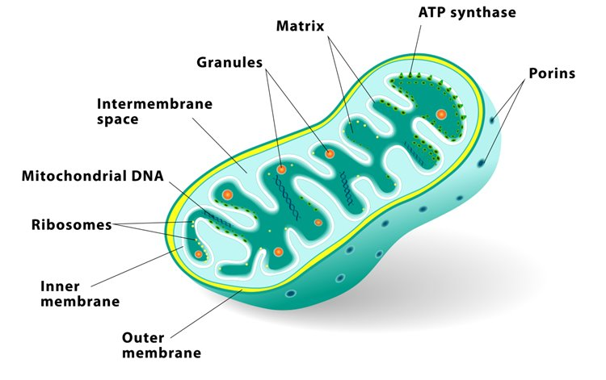
WHY PHARMACOGENETICS
What is MT-RNR1
It’s a gene located on the mitochondrial genome
The gene codes for a molecule that is important for protein production within a cell

Slide 12



WHY PHARMACOGENETICS
What is the m.1555A>G gene variant
SNP (single nucleotide polymorphism) - Small mutation on mitochondrial DNA within a cell.
Causes a slight change of the structure of a protein involved in protein synthesis.
This structural change can cause the protein to “look” like a bacterial cell
Certain antibiotics i.e., gentamicin can mistake these altered proteins as bacteria and attack them
Certain antibiotics i.e., gentamicin can mistake these altered proteins as bacteria and attack them

Slide 13


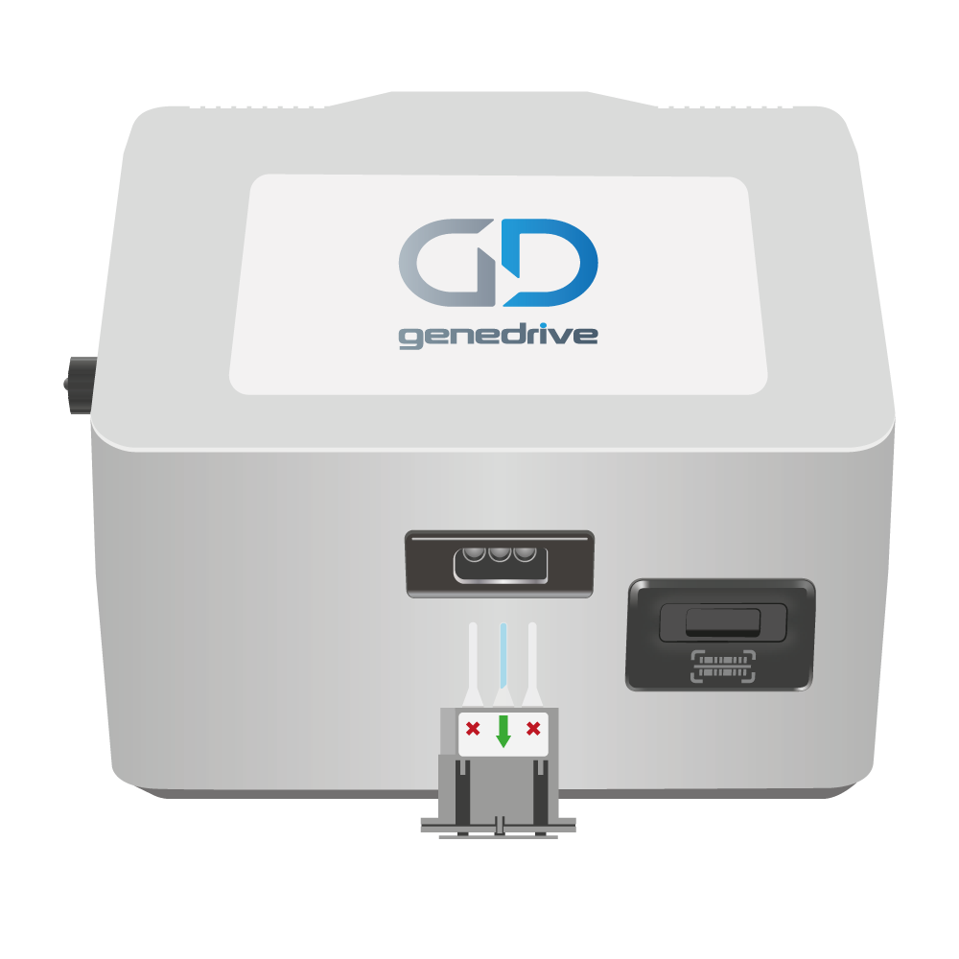

WHY PHARMACOGENETICS
What is the m.1555A>G gene variant
The m.1555A>G gene variant is the most common mitochondrial DNA variant; estimated prevalence of 0.2% in the general population
The m1555G variant is associated with deafness
The gene is maternally inherited and can affect anyone with the variant at any point in their life
The Genedrive® MT-RNR1 ID Kit is a qualitative in vitro diagnostic (IVD) molecular test for the detection of the m.1555A>G gene variant
1
500

Slide 14




WHY PHARMACOGENETICS
MT-RNR1 Inheritance
The MT-RNR1 gene is inherited maternally which means only a mother can pass the gene on to her children and only a daughter can pass it on to her children
Female with m.1555G
Male with m.1555G
Female with m.1555A
Male with m.1555A

Slide 15
THE CLINICAL NEED

Slide 16



THE CLINICAL NEED
The Background
The idea came from leading clinical genetic scientists from the University of Manchester
m.1555A>G is a known gene variant of clinical interest (since 1993) and is inherited from the mother via maternal mitochondria
Individuals with the m.1555A>G gene variant, are at high risk of developing profound irreversible hearing loss if exposed to aminoglycoside antibiotics

Slide 17





THE CLINICAL NEED
The Problem: Neonatal Sepsis
UK NICE Guidelines: suspected sepsis in newborns should be treated within the “golden hour” using the aminoglycoside antibiotic, gentamicin⁴
Affordable
Broad-spectrum antibiotic
Low risk of antibiotic resistance
90,000
Annual UK NICU admissions for
suspected sepsis⁵
Existing laboratory methods cannot test for the MT-RNR1 variant status within the golden hour

Slide 18
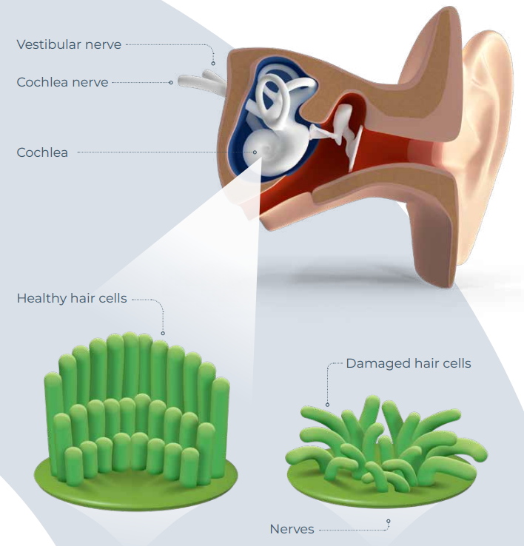
THE CLINICAL NEED
Effect of aminoglycoside antibiotics on individuals with m.1555A>G gene variant
Gene variant causes the hair cell molecule to “look” similar to a bacteria molecule
The aminoglycoside antibiotic (i.e., gentamicin), mistakes the hair cell molecules for bacteria molecules and inhibits protein synthesis
This causes the hair cells to die
Resulting in vestibular/cochlear damage, vertigo, disequilibrium, tinnitus and profound irreversible hearing loss
This is known as Ototoxicity
Annual UK NICU admissions for
suspected sepsis⁵

Slide 19
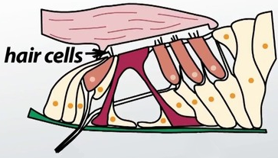
THE CLINICAL NEED
Effect of aminoglycoside antibiotics on individuals with m.1555A>G gene variant
m.1555A Wild type molecule
(12s ribosomal RNA subunit)
m.1555G variant type molecule (12s ribosomal RNA subunit)
Annual UK NICU admissions for
suspected sepsis⁵
Aminoglycoside
Aminoglycoside
Bacterial molecule
(16S ribosomal RNA subunit)

Slide 20
THE CLINICAL NEED
Effect of aminoglycoside antibiotics on individuals with m.1555A>G gene variant
m.1555G variant type molecule
(12s ribosomal RNA subunit)
Aminoglycoside
Annual UK NICU admissions for
suspected sepsis⁵
Aminoglycoside
Bacterial molecule
(16S ribosomal RNA subunit)

Slide 21
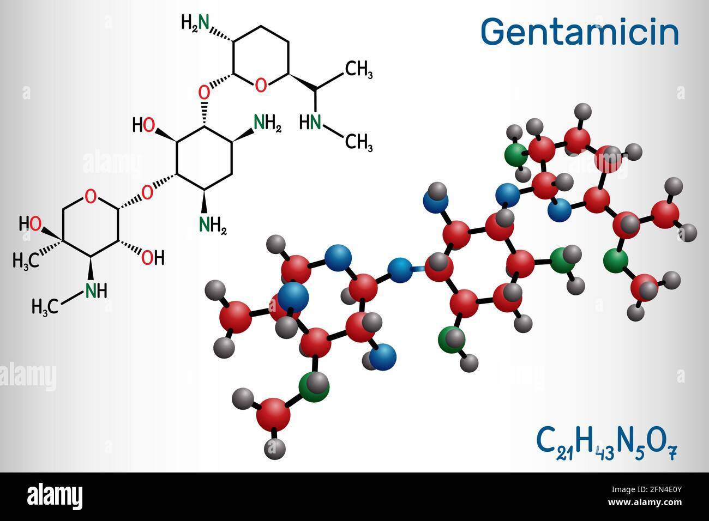
THE CLINICAL NEED
Aminoglycoside antibiotics use
Only administered via IV
Only used for gram negative Aerobic Bacteria (e.g., Sepsis)
Usually administered in combination with other antibiotics (e.g., benzylpenicillin)
Dose and duration of aminoglycoside treatment (e.g., gentamycin) must be carefully monitored due to known risks in causing hearing disorders
Designed to target bacterial ribosomes, by inhibiting translation of the mRNA by binding to the bacterial 30S ribosomal subunit
The irreversible binding of the aminoglycoside to the 30S ribosome subunit, causes the misreading of the codons along the mRNA
This misreading of the codons causes an error in the proofreading process of translation leading to improper protein expression leading to bacterial cell death
Annual UK NICU admissions for
suspected sepsis⁵

Slide 22



Why gentamicin monitoring alone isn’t enough: two pathways to ototoxicity
Dose-Dependent Ototoxicity
(General Population)
Cumulative Risk
Gentamicin monitoring helps manage dose-dependent ototoxicity, which correlates with cumulative exposure
Dose-Independent Ototoxicity
(MT-RNR1 Variant Carriers)
Genetic Risk
Can cause irreversible hearing loss even after a single, standard dose of gentamicin
MT-RNR1 variant m.1555A>G
Standard gentamicin dose
Risk of AIHL
Notes:
(1) Gentamicin monitoring to reduce adverse effects such as ototoxicity: https://www.nnuh.nhs.uk/publication/download/gentamicin-prescribing-v9/
(2) Individuals with MT-RNR1 variants are at increased risk of AIHL, even at standard dosages: https://cpicpgx.org/guidelines/guideline-for-aminoglycosides-and-mt-rnr1/

Slide 23
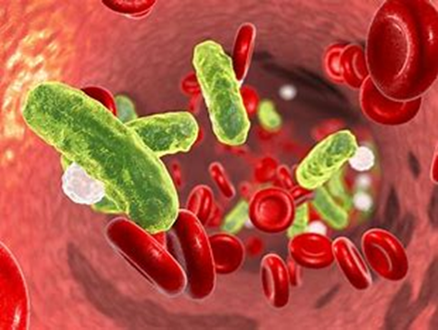
Sepsis is the body’s extreme response to infection
THE CLINICAL NEED
What is Sepsis?
It is a life-threatening medical emergency
It happens when your immune system overreacts to an infection and starts to damage your body's own tissues and organs
Without timely treatment, sepsis can rapidly lead to tissue damage, multiple organ failure, and death
Frequently caused by 4 bacteria5
Staphylococcus Aureus
Pseudomonas species
Escherichia Coli (E. Coli)
Group B streptococcus
Annual UK NICU admissions for
suspected sepsis⁵

Slide 24










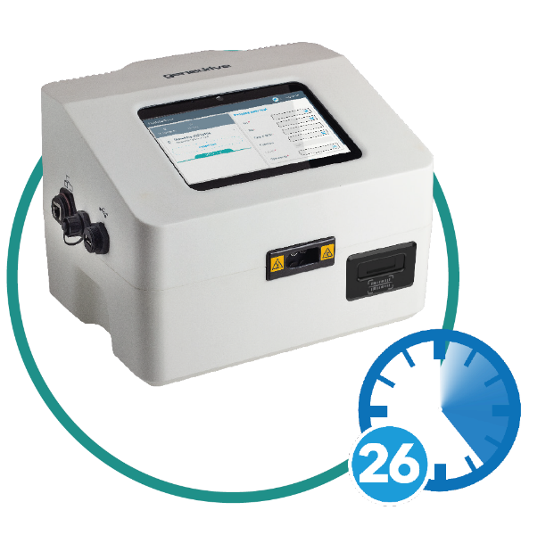




OUR SOLUTION
Current situation
Clinician has 1 hour to administer gentamicin and benzylpenicillin
499 in 500
MT-RNR1 A variant (m.1555A)
Consider gentamicin and benzylpenicillin
Patient is at low risk of AIHL
Baby admitted to NICU
With Genedrive® System implemented
1 in 500
MT-RNR1 G variant (m.1555G)
Consider gentamicin and benzylpenicillin
Patient is at risk of AIHL
Clinician has 1 hour to administer gentamicin and benzylpenicillin
Time to result of 26 mins
1 in 500
MT-RNR1 G variant (m.1555G)
Consider an alternative antibiotic
Patient has reduced risk of AIHL
* AIHL = Aminoglycoside Induce Hearing loss
Notes:
Current Options and the SOLUTION
Golden Hour = the clinician has 1 hour to administer antibiotics from time of admission - this is based on suspicion of sepsis - as a sepsis diagnosis would take longer currently - this is in the NICE guidelines
Option 1 = how things are at the moment - 2% of population at risk of permanent hearing loss
Option 2 = not a cost-effective option, or a good idea due to concerns for antibiotic resistance, gentamicin is effective . Would contradict current NICE Guidance.
Option 3 = too long to wait, not an option
Option 4 = the solution to the clinical need, created with and for clinicians and patients in mind, the time to result ensures treatment can be administered in a clinically actionable timeframe
Innovative product
Nothing else currently on the market to meet these needs

Slide 25
OUR SOLUTION

Slide 26
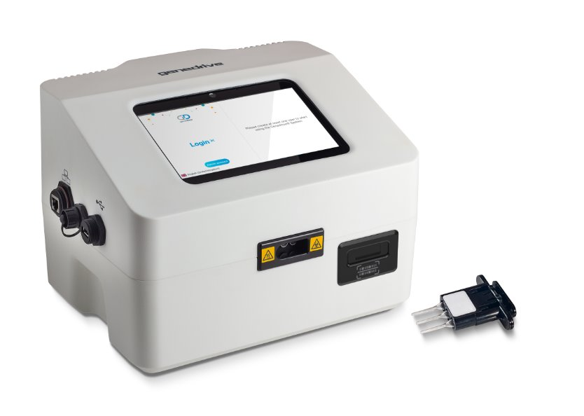
OUR SOLUTION
The Genedrive® System
Using the Genedrive MT-RNR1 ID Kit is a point-of-care in vitro diagnostic device, designed for professional use
World’s first point-of-care genetic test used to guide neonatal management in time critical settings and reduce the risk of aminoglycoside induced hearing loss (AIHL)

Slide 27




OUR SOLUTION
The Genedrive® System
Provides rapid automated
results in approximately 26 minutes
Seamless connectivity to export results via ethernet or Wi-Fi to SFTP
Flexible connectivity to external systems via middleware
RFID enabled reagent lock out to prevent use of expired tests

Slide 28
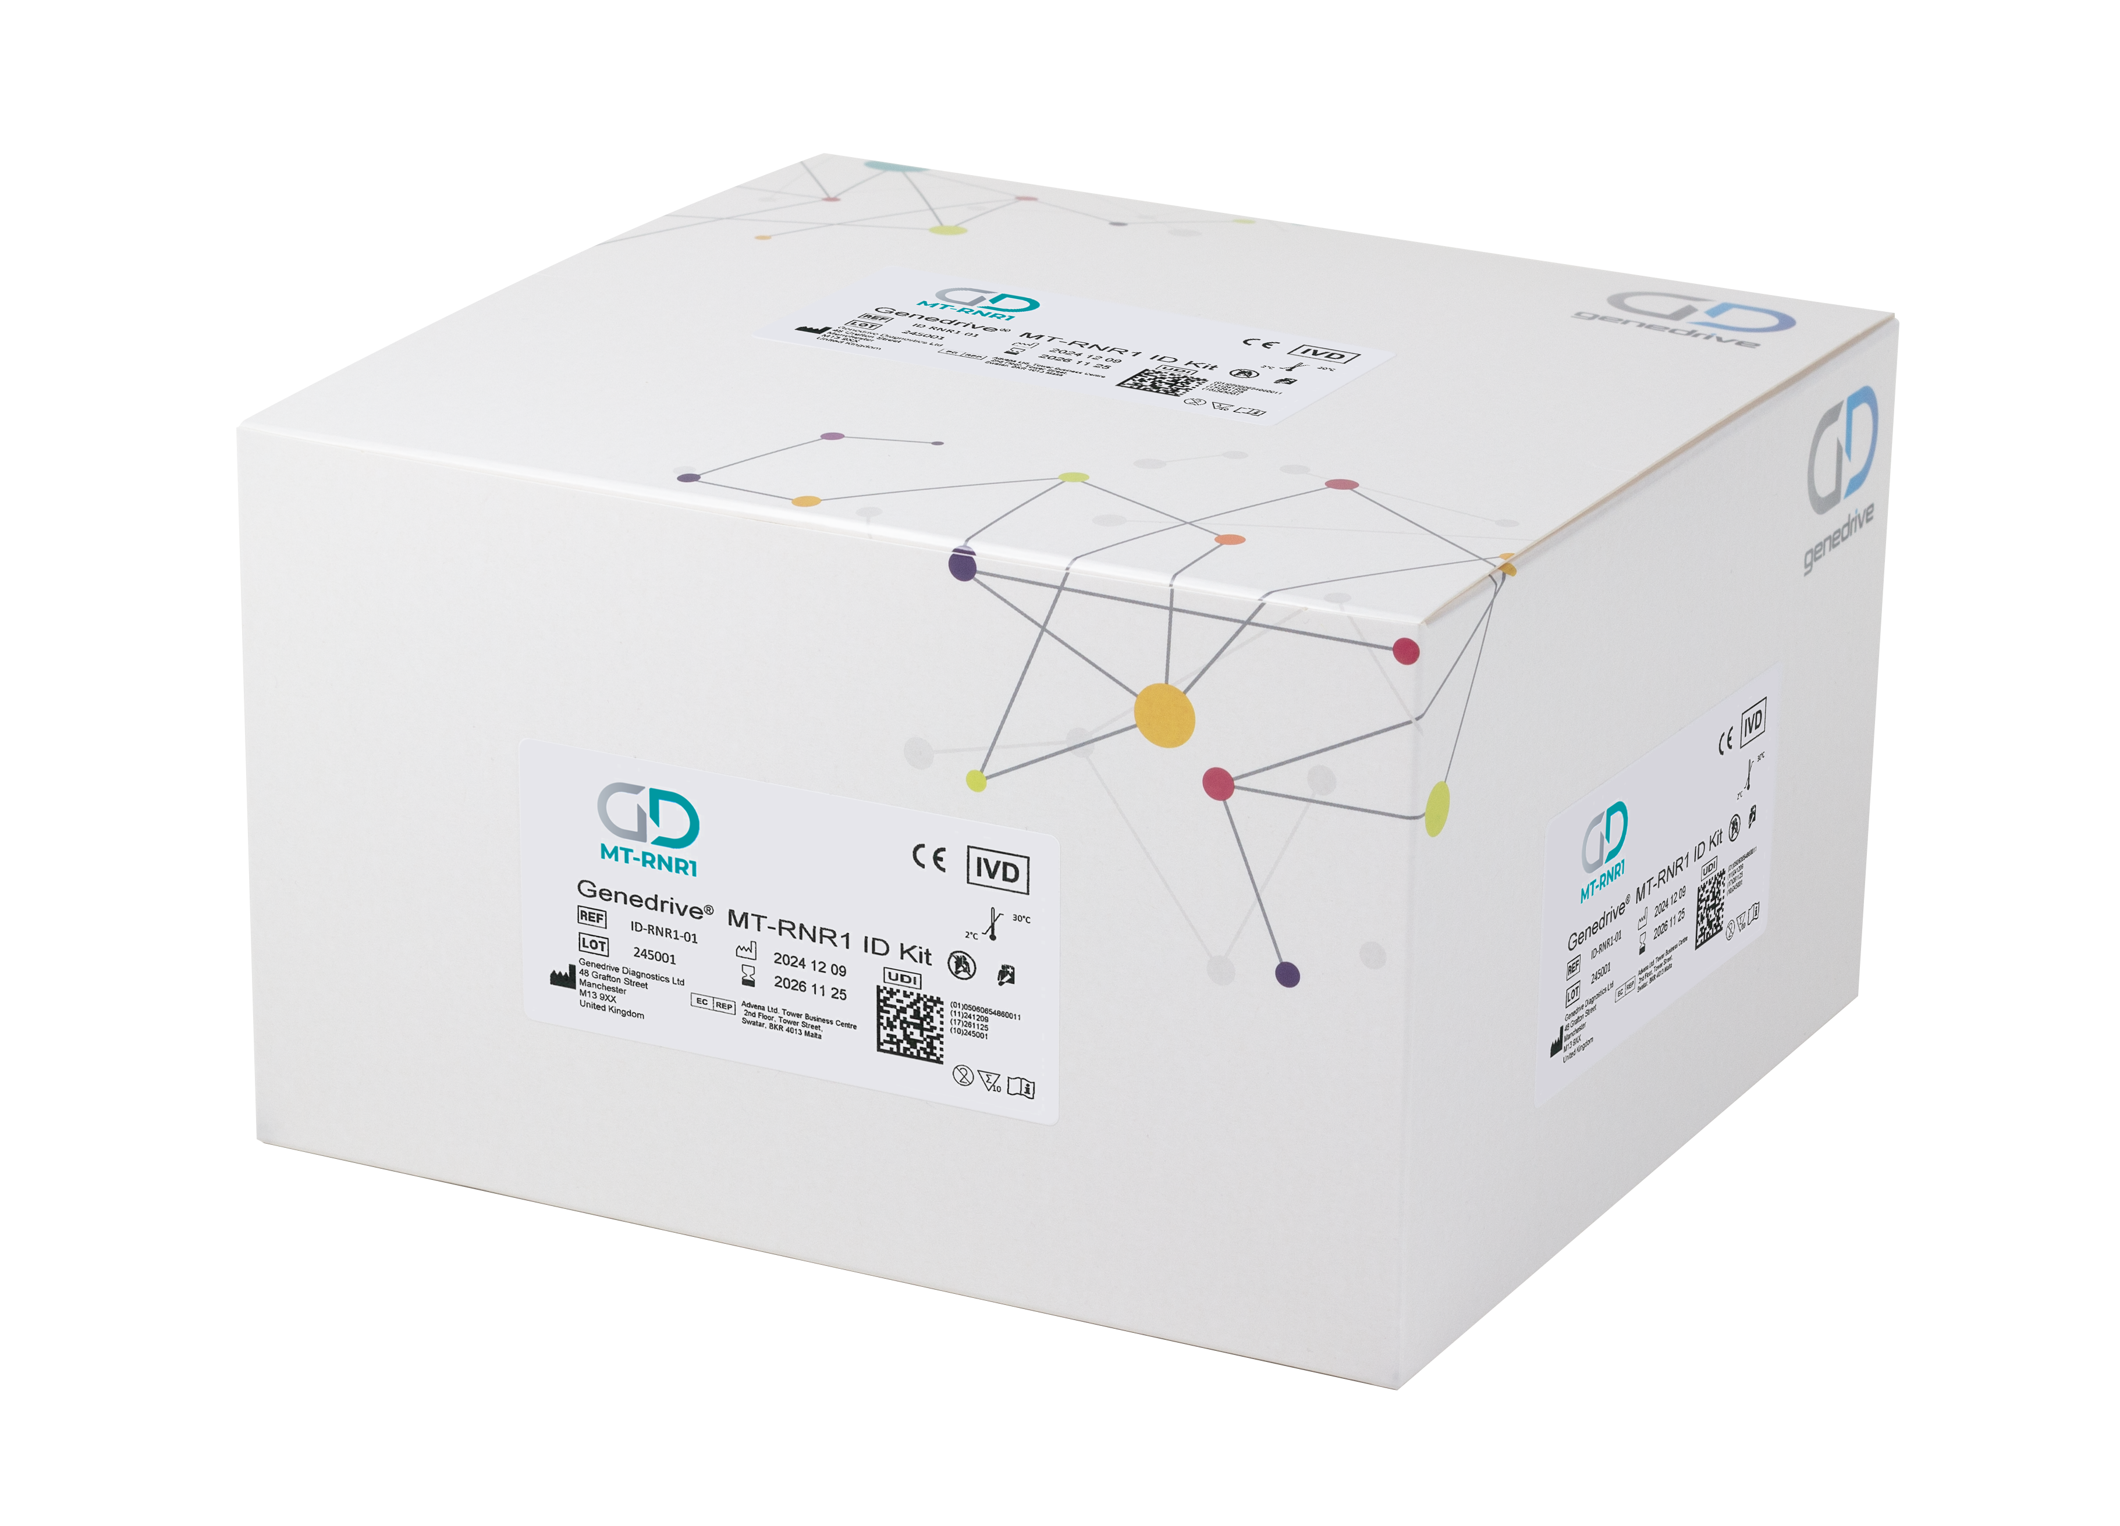
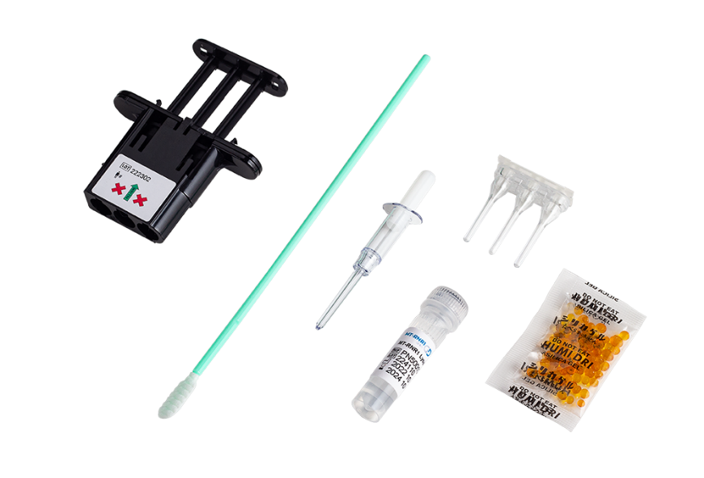
OUR SOLUTION
Genedrive® MT-RNR1 ID Kit
Point of care genetic test to be used in time critical situations, to guide antibiotic treatment prescription​
Reduces the risk of aminoglycoside induced hearing loss (AIHL) by detecting a variant in the MT-RNR1 gene (m.1555A>G)​​
Non-invasive test, using a single buccal swab
Simple to use test kits​
Rapid point of care genetic test that delivers results within the ‘golden hour’​
Easy adoption into existing neonatal workflows​

Slide 29
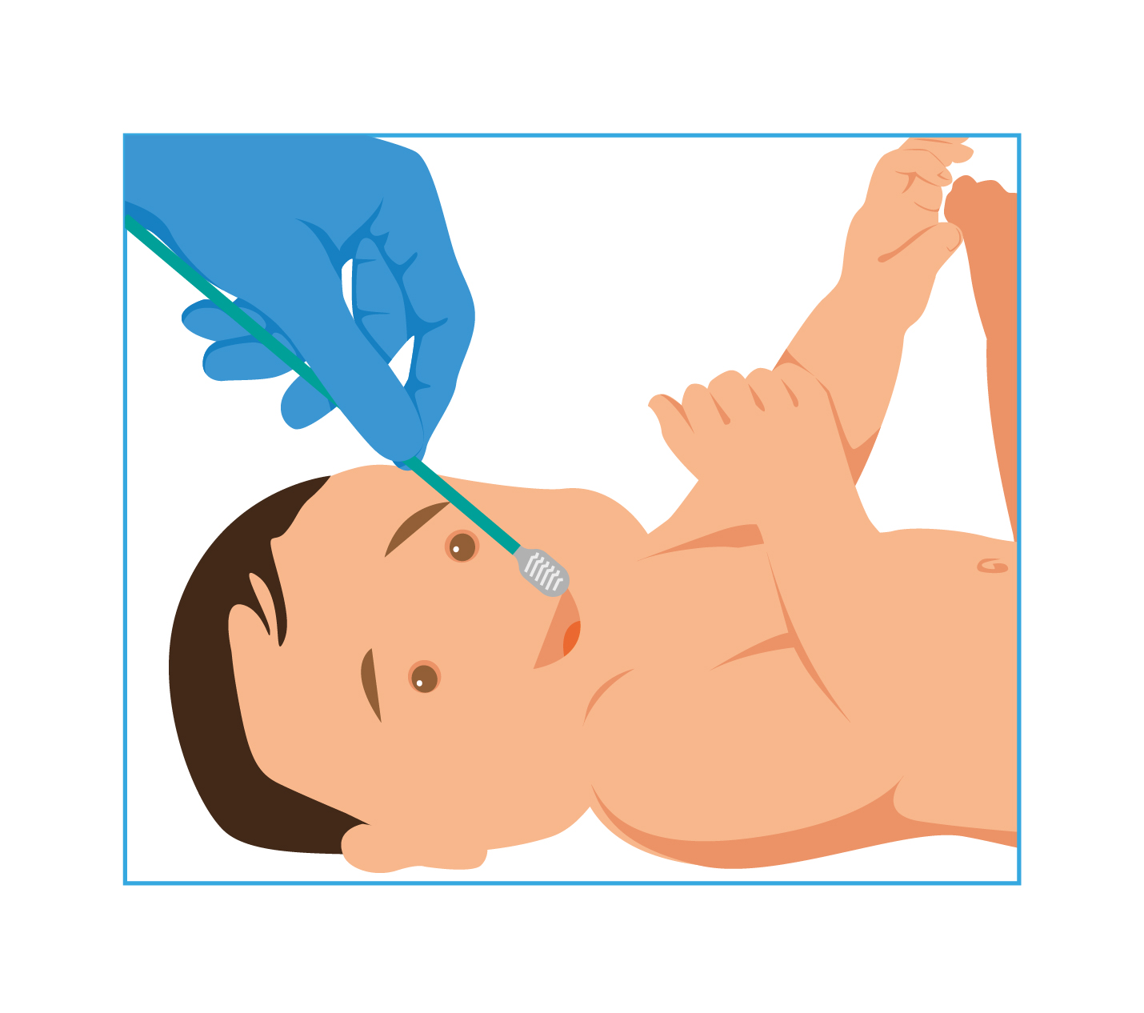
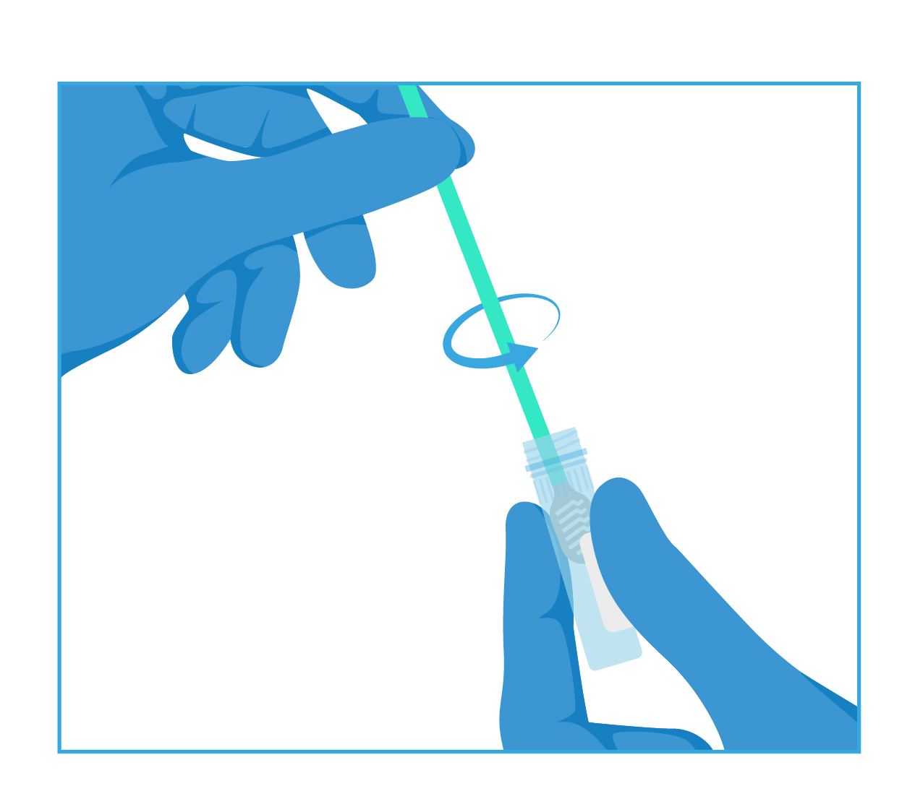
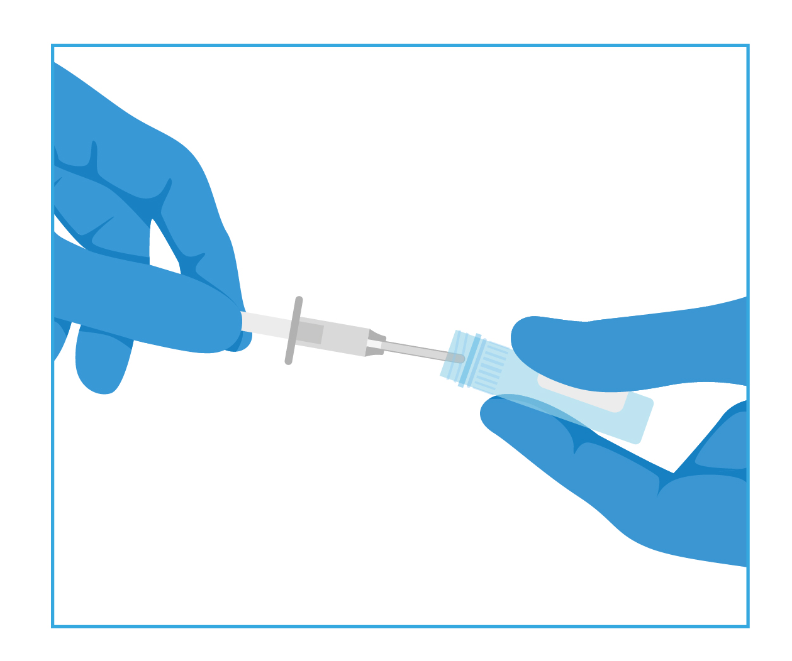
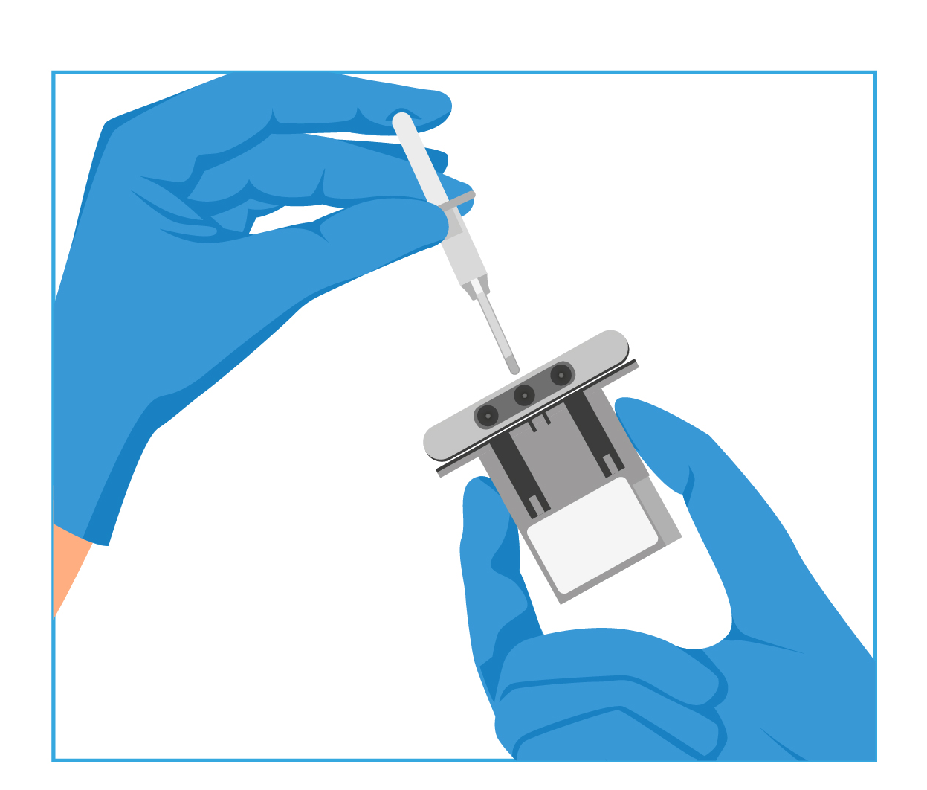
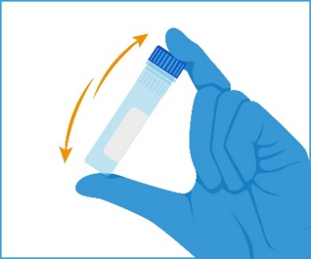
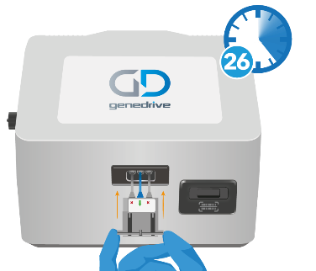
OUR SOLUTION
The Simple Workflow
Designed with easy sample collection and assay reconstitution in mind
Firmly swab the patient
Vigorously rotate the swab to release the DNA
Invert to mix the sample
Transfer the sample
Reconstitute assay
Start test

Slide 30
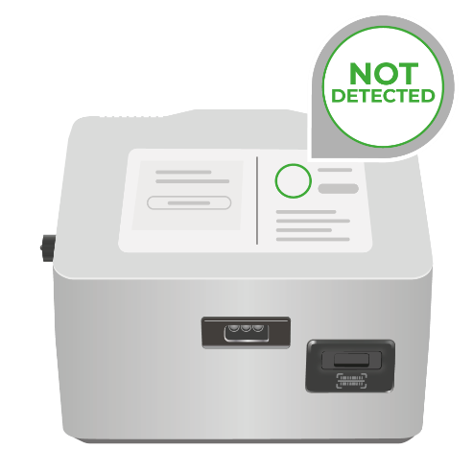
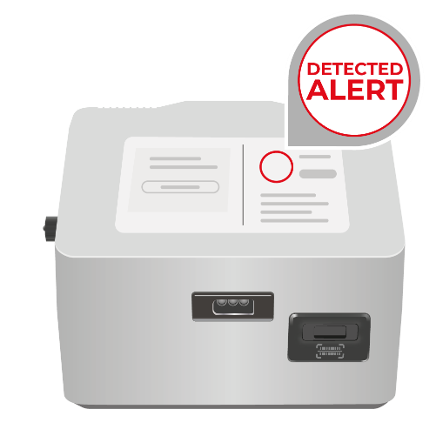
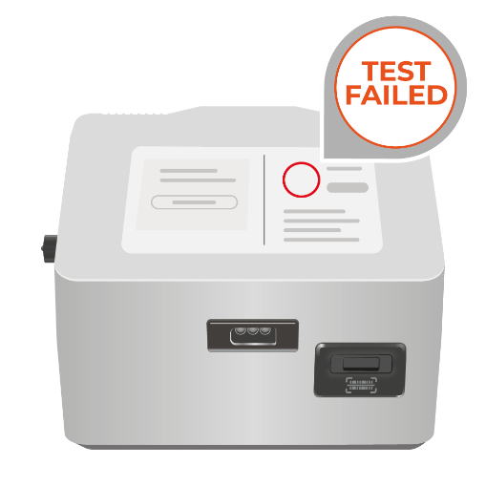
OUR SOLUTION
Easy to Interpret Actionable Results
MT-RNR1
m.1555A
Consider aminoglycoside antibiotics*
MT-RNR1
m.1555G
Consider alternative antibiotics*
Test Fail
Consider alternative antibiotics* and repeat test
Notes:
test fail that pathway is to avoid gent on test fail if no time to repeat test

Slide 31
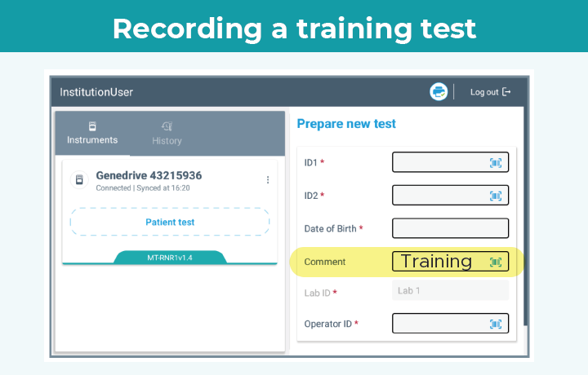
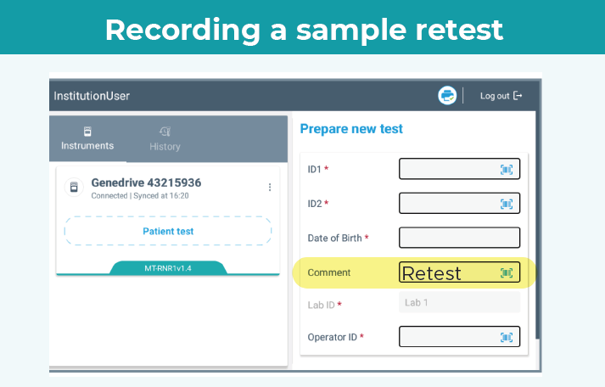
Important for Genedrive support and troubleshooting. As we cannot see personal identifiers (ID1 & ID2), your comments give us valuable context to resolve queries effectively.
Information to add to the comments section of the Genedrive® System
‘Training’
‘Retest’
Sample collection location e.g. ‘NICU’ ‘DS’
If the swab was taken by another user e.g. ‘Dr KH’
See GPM-175 (for MT-RNR1 PALOH UK)

Slide 32



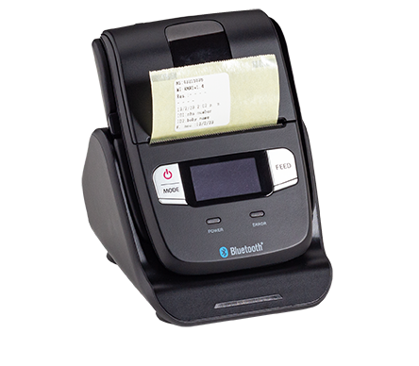
32 | OUR SOLUTION
The Genedrive® System – Export results
Results are automatically displayed with no need for interpretation
Secure Server on hospital network
Electronic Patient Record
Files are exported by SFTP
Automatically transfer results via Middleware
Results can be printed using the compatible label printer
Patient Record
Manual transfer of results
Notes:
SFTP (Secure file transfer procedure)

Slide 33



OUR SOLUTION
The Genedrive® System – Export results
Siemens POCcelerator & Attelica Connect
Radiometer AQURE
Roche Infinity POC
EKF-Link
Notes:
The Genedrive System Automatically Displays Results on Screen with no need for interpretation
You can use the label printer to print results
You can also manually export results as a excel file (CSV) via Bluetooth to an Android Device
It is also possible to setup automatic export of results:
Either via SFTP (Secure File Transfer Protocol) to a server on the customer site
Or through middleware into the EHR/EPR (electronic health/patient record).
We are compatible with multiple middleware providers and Genedrive can provide instructions, specifications and support to help get you connected.

Slide 34
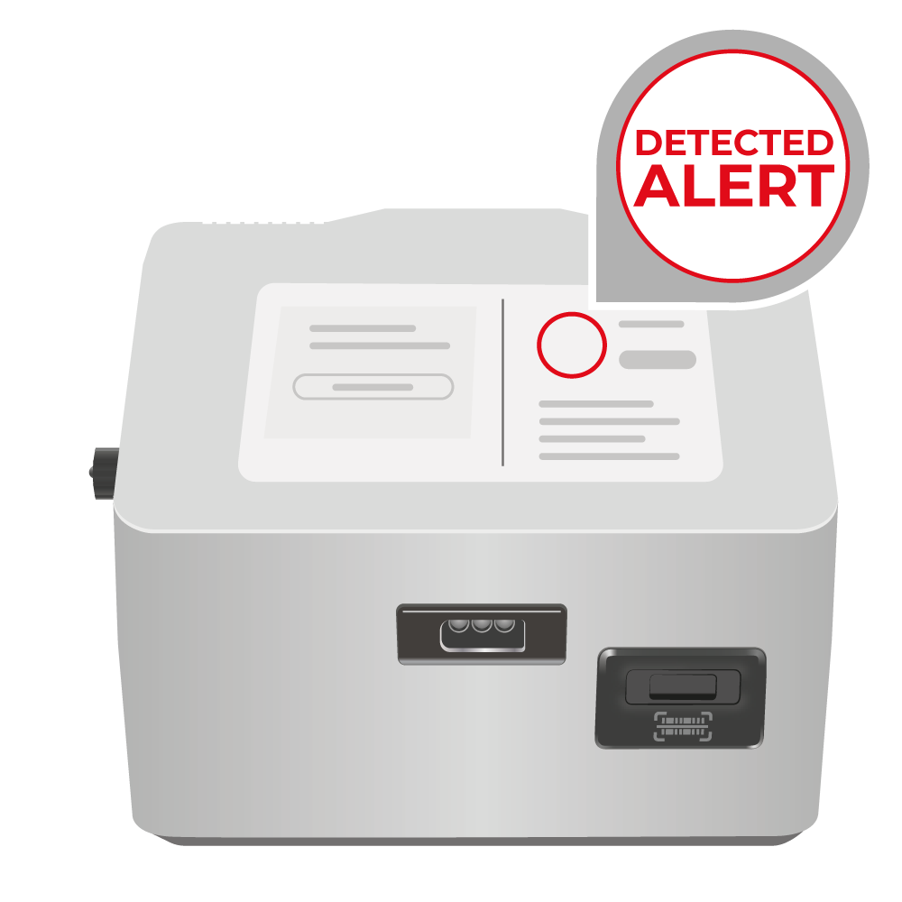

OUR SOLUTION
Genedrive® Technology
The Genedrive® System is a rapid thermocycling point of care platform that is programmed to perform loop-mediated isothermal amplification (LAMP), using human buccal cell samples, combined with lyophilised test reagents, which are heated to a constant temperature, to allow rapid amplification of target genetic material
Following amplification of genetic material, fluorescent differences are detected and reported by the Genedrive® System
The fluorescence differences, identify whether the MT-RNR1 m.1555A>G gene variant is present or not, within a clinically actionable timeframe

Slide 35
OUR SOLUTION
Performance Data
Validation, using the Genedrive® MT-RNR1 ID Kit, correctly detected 60 positive samples and 244 negative samples
 | Positive (Has the MT-RNR1 gene variant) | False Positives | Negative (Does not have the MT-RNR1 gene variant) | False Negatives
Genedrive® System Detected | 60 | 0 | 244 | 0
Sanger Sequencing Detected | 60 | 0 | 244 | 0
Sensitivity = 100% (95% CI, 94% - 100%) Specificity = 100% (95% CI, 98.5% - 100%)
304 samples were tested and confirmed by sanger sequencing
All 60 known positive samples tested, detected a true positive result
All 244 known negative samples tested, detected a true negative result

Slide 36


OUR SOLUTION
Sensitivity in Rare Variant Testing
Sensitivity = 100% (95% Confidence Interval: 94% - 100%)
The m.1555A>G variant is rare (~1 in 500 births)
To statistically demonstrate 100% sensitivity with >95% CI, you would need to test over 45,000 babies
How was performance validated?
An enriched cohort was used during development to include more positive cases
The test detected 100% of known positives
Confidence intervals reflect sample size – not test failure
One dose of gentamicin can cause irreversible hearing loss in babies with the variant.
Even low-level detection (heteroplasmy) is reported as "Detected“ as the risk is clinically significant
We can’t test 45,000 babies but we can help protect babies at risk.

Slide 37
GENEDRIVE EVOLUTION & P A L O H
Pharmacogenetic to Avoid Loss of Hearing pragmatic prospective implementation trial

Slide 38


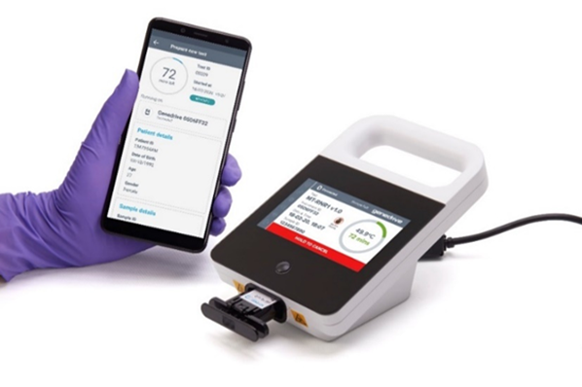


PALOH
Pharmacogenetics to Avoid Loss of Hearing pragmatic prospective implementation trial
Data shows a higher variant prevalence of 1 in 251⁶
patients
751
Can rapid, point-of-care genetic testing be implemented in an acute neonatal setting to avoid antibiotic induced hearing loss, without disrupting normal standards of care?⁶
Patients recruited
3
MT-RNR1 m.1555A>G positive participants avoided AIHL
NO
Significant change in time to antibiotic prescription
Notes:
6. McDermott JH, Mahaveer A, James RA, et al. Rapid Point-of-Care Genotyping to Avoid Aminoglycoside-Induced Ototoxicity in Neonatal Intensive Care. JAMA Pediatr. 2022;176(5):486–492. doi:10.1001/jamapediatrics.2022.0187

Slide 39
GENEDRIVE MT-RNR1
PRODUCT RANGE

Slide 40
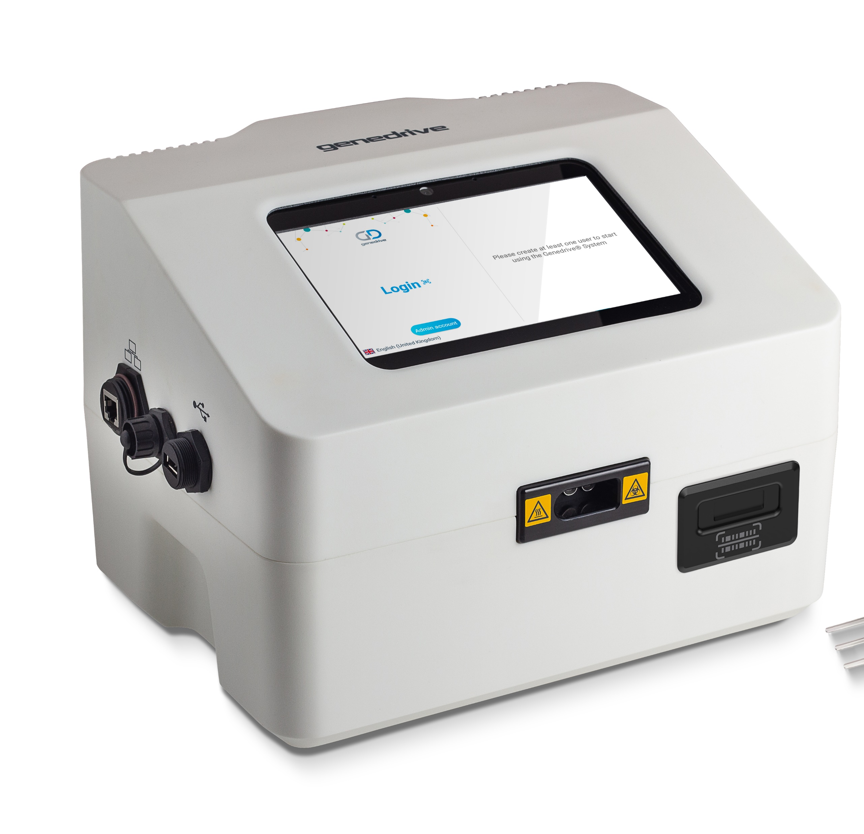
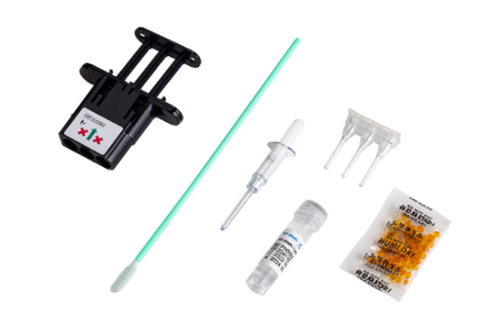
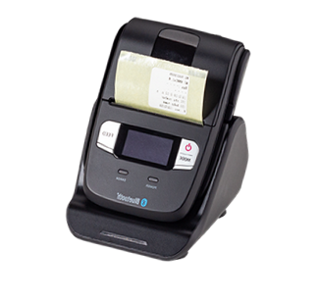
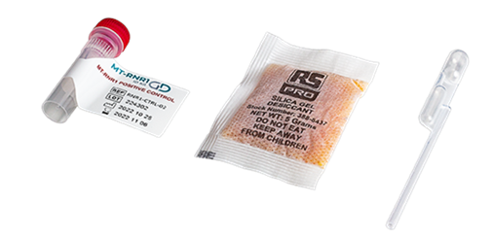
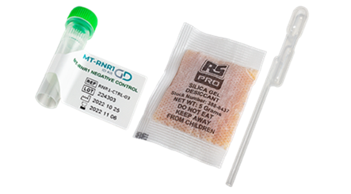
OUR SOLUTION
Genedrive® MT-RNR1 Product Range
Test requirements
Genedrive System
GS-002
Genedrive ID Kit
ID-RNR1-01
Genedrive Positive Control Kit
RNR1-CTRL-02
Genedrive Negative Control Kit
RNR1-CTRL-03
Label Printer and charging cradle
GS-PTR-01

Slide 41
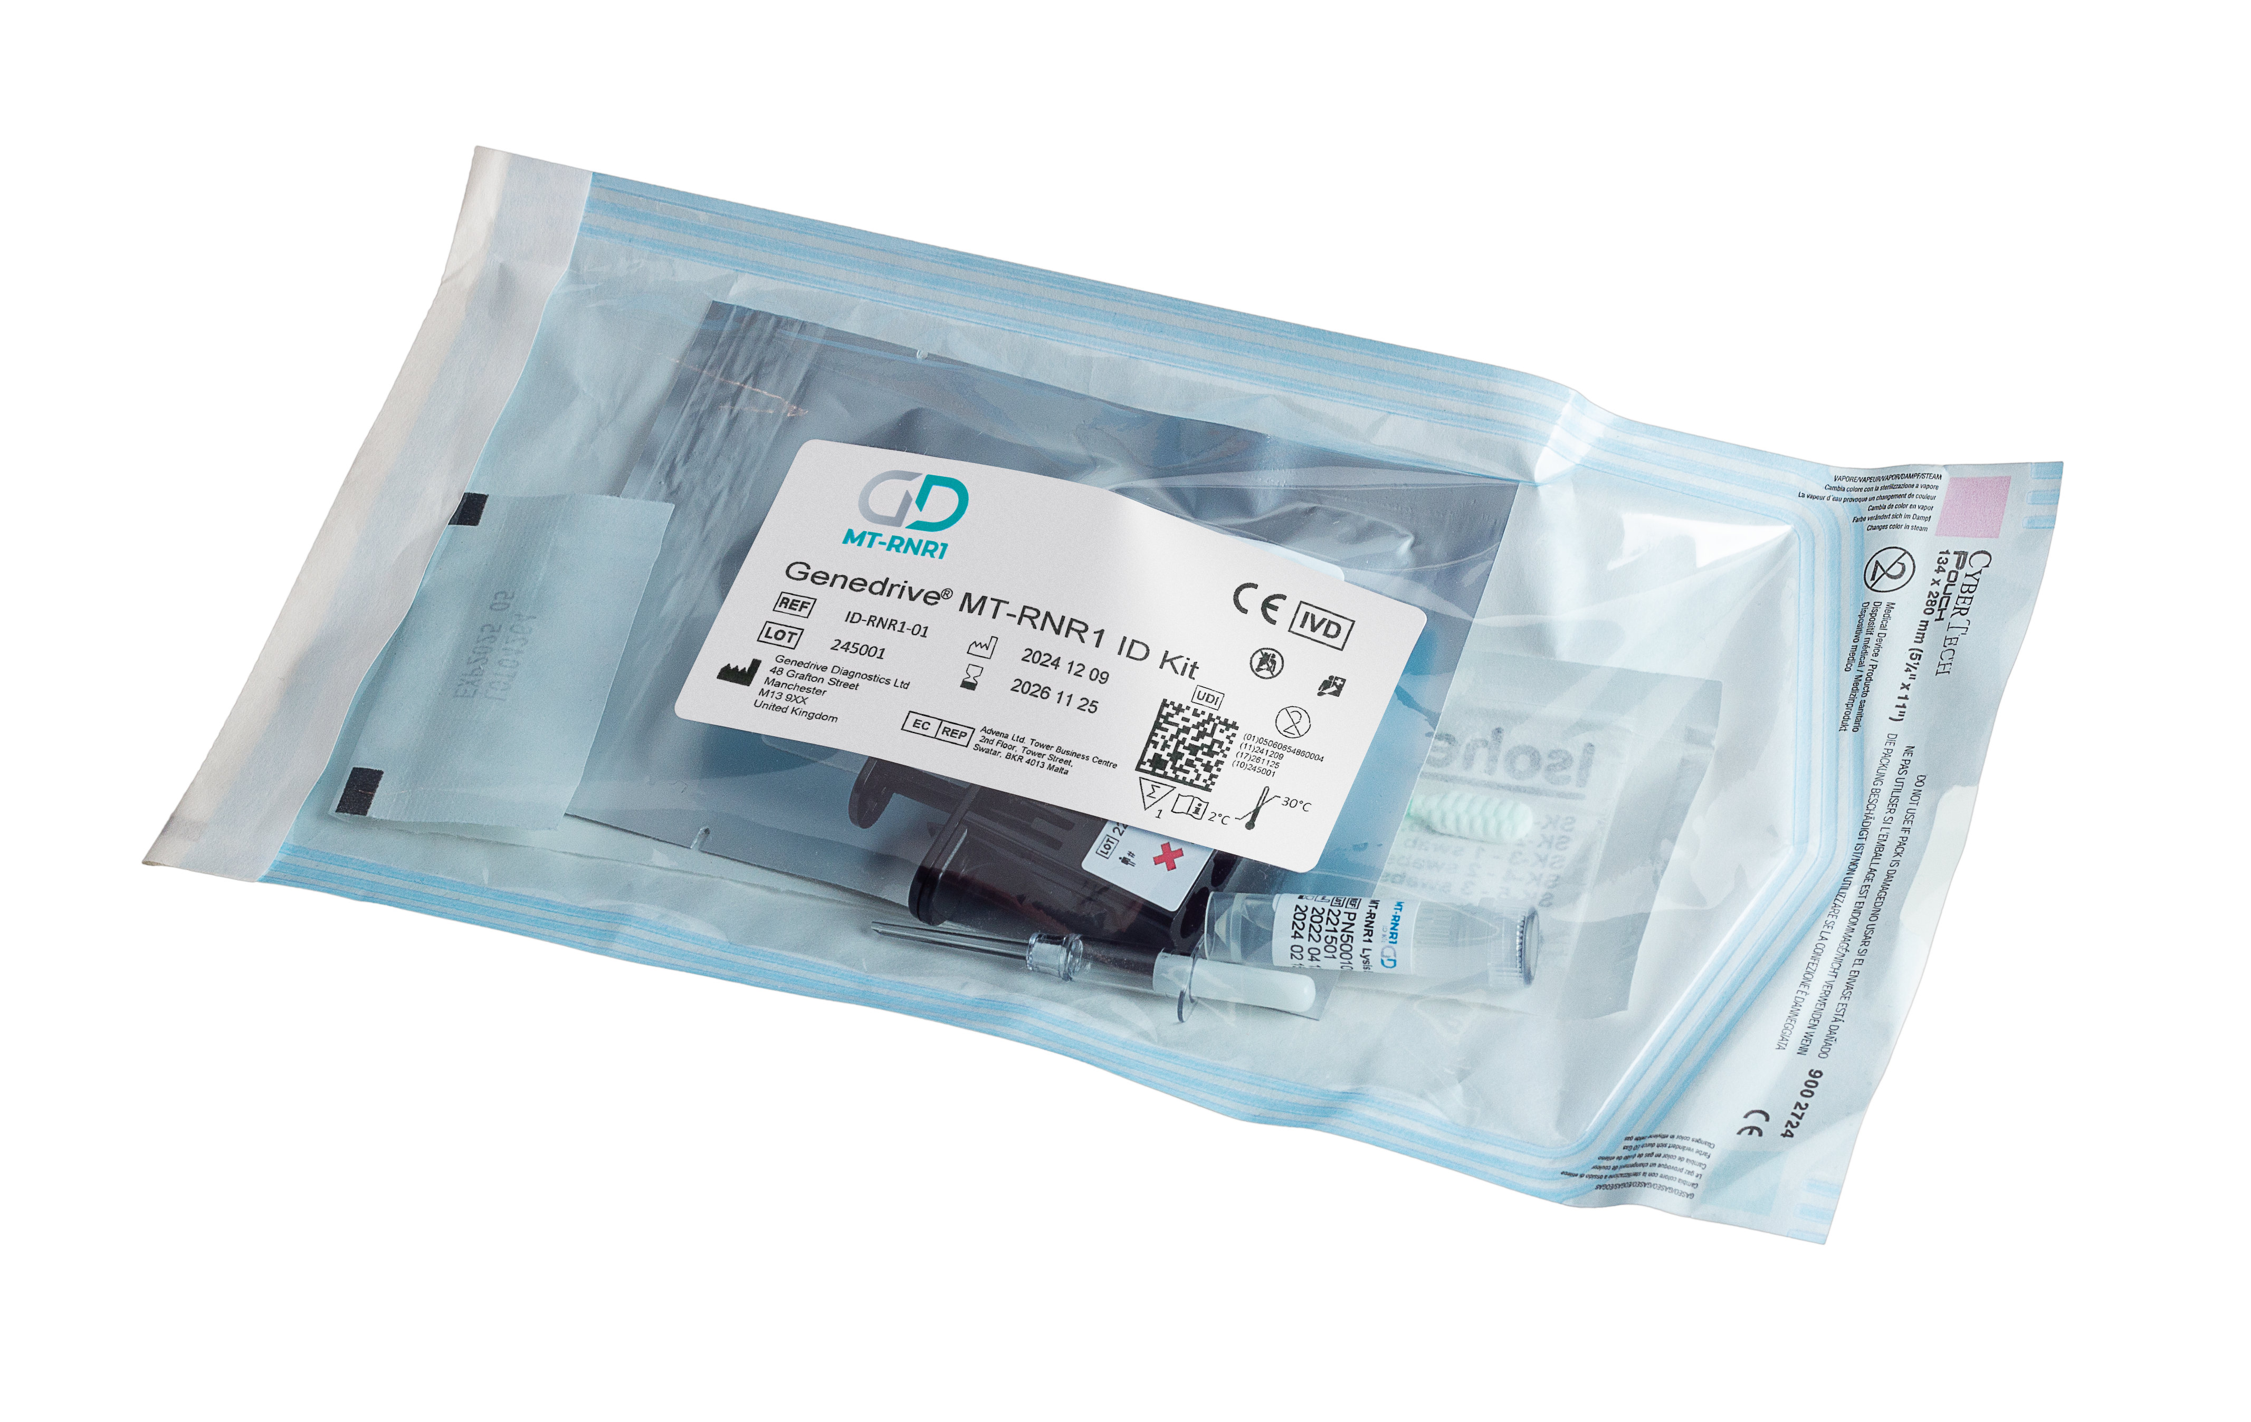

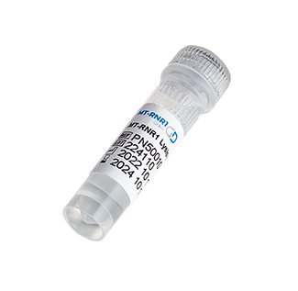
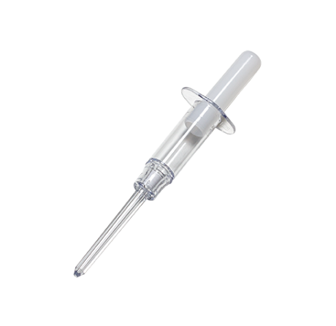
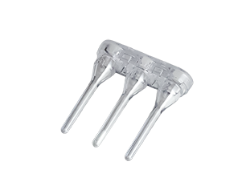
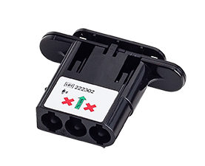
OUR SOLUTION
Genedrive® MT-RNR1 Product Range
Kit Components
Product Code | Product Description | Box Quantity
ID-RNR1-01 | Genedrive® MT-RNR1 ID Kit | 10 test kits
1 x Buccal Swab
1 x sample collection tube containing MT-RNR1 lysis buffer
1 x Minivette
1 x Genedrive assay cartridge containing lyophilised amplification reagents
1 x assay cartridge lid with RFID tag

Slide 42
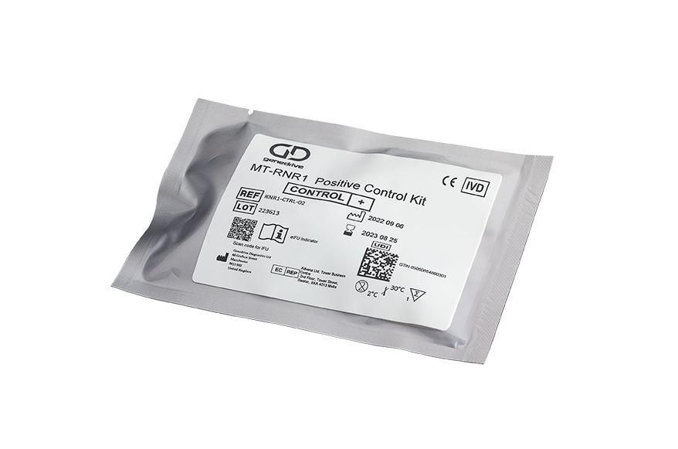
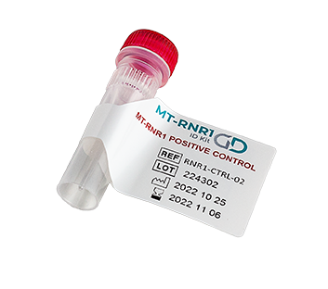
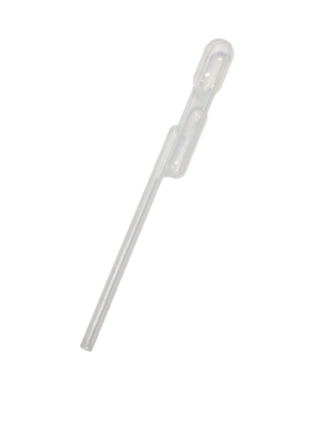

OUR SOLUTION
Genedrive® MT-RNR1 Positive Control Kit
Kit Components
Product Code | Product Description | Box Quantity
RNR1-CTRL-02 | Genedrive® MT-RNR1 Positive Control Kit | 4 test kits
1 x Lyophilised reagents in tube
with red screw cap
1 x Dual Bulb 200µL Pastette®
1 x Desiccant pouch

Slide 43
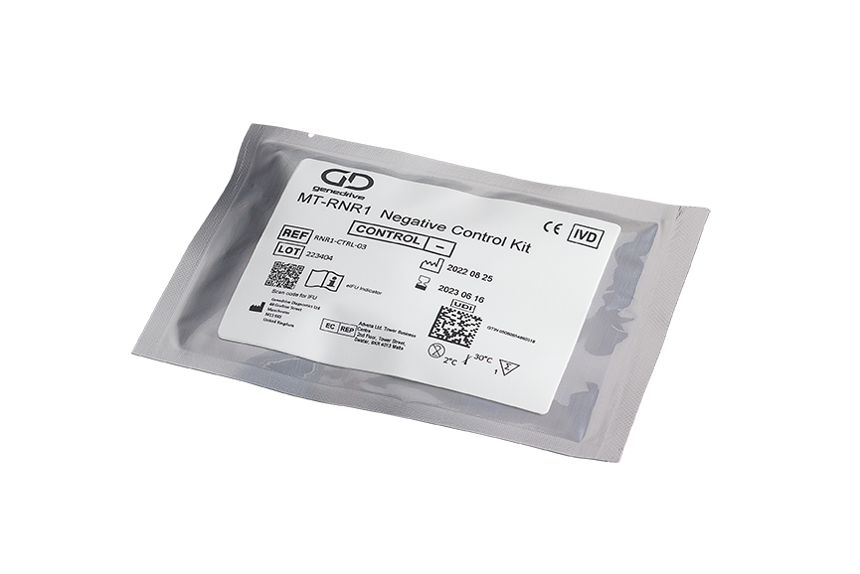
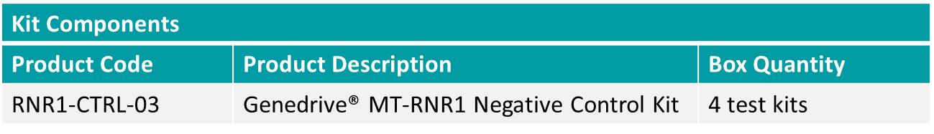
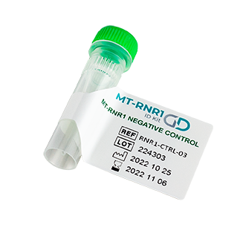
OUR SOLUTION
Genedrive® MT-RNR1 Negative Control Kit
1 x Lyophilised reagents in tube with green screw cap
1 x Dual Bulb 200µL Pastette®
1 x Desiccant pouch

Slide 44
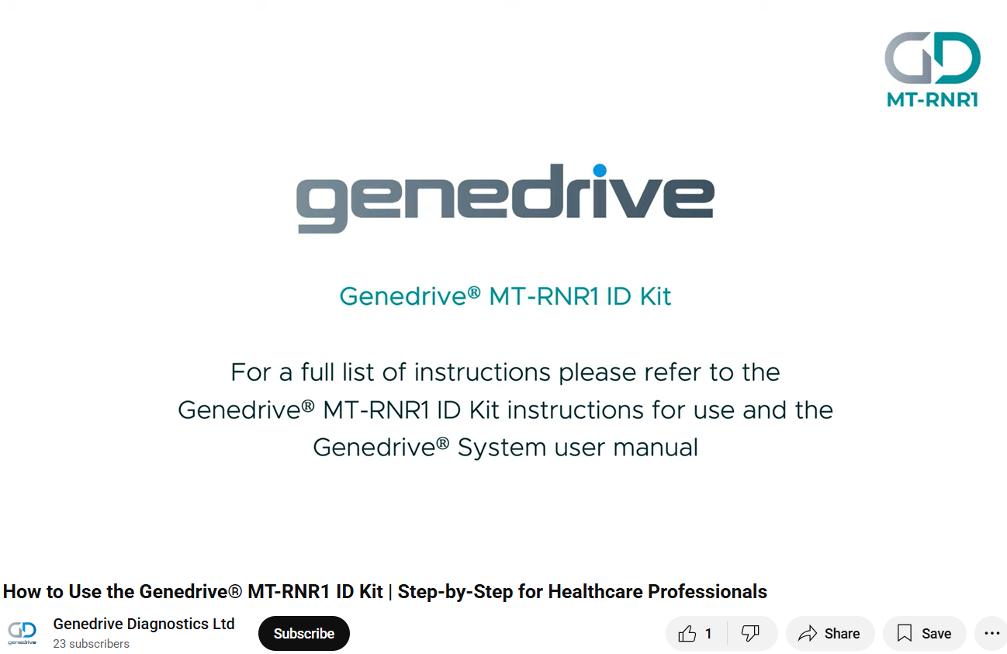
Technical Training Video
Notes:
https://youtu.be/KKHNxIe5jsc?feature=shared

Slide 45
PRODUCT DEMONSTRATION
See GPM-162 procedure slides/video

Slide 46
Guidance & Recommendations

Slide 47

Reference number: NG195 I Published: 20 April 2021 I Last updated: 19 March 2024
NICE Guideline
Neonatal infection: antibiotics for prevention and treatment
Management for babies at increased risk of infection
1.3.9
If a baby needs antibiotic treatment, give this as soon as possible and always within 1 hour of the decision to treat. [2021]
Notes:
Recommendations | Neonatal infection: antibiotics for prevention and treatment | Guidance | NICE

Slide 48
Reference number:NG51 I Published: 13 July 2016 I Last updated: 19 March 2024
NICE Guideline
Suspected sepsis: recognition, diagnosis and early management
Newborn babies under 28 days
1.14.5
Treat newborn babies under 28 days presenting in hospital with suspected sepsis in their first 72 hours with intravenous benzylpenicillin and gentamicin. [2016]
Notes:
Antibiotic therapy, intravenous fluid and oxygen | Suspected sepsis: recognition, diagnosis and early management | Guidance | NICE

Slide 49


GUIDANCE
CPIC Guidance
Clinical Pharmacogenetics Implementation Consortium
Use of aminoglycosides should be avoided in individuals with an MT-RNR1 variant associated with an increased risk of aminoglycoside-induced hearing loss, unless the high risk of permanent hearing loss is outweighed by the severity of infection and safe or effective alternative therapies are not available.”⁷
Notes:
Clinical Pharmacogenetics Implementation Consortium Guideline for the Use of Aminoglycosides Based on MT-RNR1 Genotype – PMC

Slide 50
GUIDANCE
NICE Early Value Assessment
Genedrive MT-RNR1 ID Kit for detecting a genetic variant to guide antibiotic use and prevent hearing loss in babies: early value assessment
Health technology evaluation I Reference number: HTE6 I Published: 30 March 2023 I Last updated: 10 August 2023
The Genedrive® MT‑RNR1 ID Kit can be used while further evidence is generated as an option for detecting the genetic variant m.1555A>G to guide antibiotic (aminoglycoside) use and prevent hearing loss in newborns.”⁷
Notes:
7. Overview | Genedrive MT-RNR1 ID Kit for detecting a genetic variant to guide antibiotic use and prevent hearing loss in babies: early value assessment | Guidance | NICE
NICE is a UK organisation with a remit to balance the best care with value for money across the NHS and social care, to deliver for both individuals and society as a whole.
Key recommendations:
The Genedrive® MT-RNR1 ID Kit can be used in the NHS, while further evidence is generated, as an option for detecting the genetic variant m.1555A>G to guide antibiotic (aminoglycoside) use and prevent hearing loss in newborns who are being considered for treatment with aminoglycosides.
Healthcare professionals should tell parents about the possible implications of positive test results for their baby and their family at an appropriate time and give support and information.
Positive results should be confirmed by laboratory testing.
The recommendation is conditional on further evidence being generated.

Slide 51
PALOH UK
Addressing the real-world Evidence Gap
The NIHR/OLS Real World Evidence Programme
PALOH (2020)
Programme Launch: PALOH UK, launched on 1st November 2024
Duration: 18 months maximum
Leadership: Clinician consortia led by Professor Bill Newman and Dr. John McDermott (University of Manchester / Manchester University NHS Foundation Trust)
Collaborating sites: 14 Neonatal Intensive Care Units across the UK
Structure:
  Group 1: 9 sites using the Genedrive MT-RNR1 ID Kits as part of clinical routine use
  Group 2: 5 additional sites to go live
Goals:
  Address evidence gap for full NICE recommendation
  Generate clinical data for FDA De Novo submission process and commercial entry into the U.S.
PALOH UK (2024)
Notes:
8. gdr_-_nihr_(21.11.24).pdf

Slide 52


European Guidance
The European Medicines Agency (EMA), CMDh, and PRAC have issued safety-related updates to the product information for systemic aminoglycosides.
there is sufficient evidence to reflect a warning between gentamicin (systemic use) and increased risk of aminoglycoside-associated ototoxicity in patients with mitochondrial mutations in the product information.
Patients with mitochondrial DNA mutations, particularly the nucleotide 1555 A to G substitution in the 12S rRNA gene may be at higher risk for ototoxicity, even if the patient’s aminoglycoside serum levels were within the recommended range.
In case of family history of aminoglycoside-induced deafness or known mitochondrial DNA mutations in the 12S rRNA gene, alternative treatments other than aminoglycosides may need to be considered.
Notes:
Gentamicin: CMDh scientific conclusions and grounds for the variation, amendments to the product information and timetable for the implementation - PSUSA/00009159/202303
European Medicines Agency (EMA),
Coordination Group for Mutual Recognition and Decentralised Procedures – Human (CMDh)
Pharmacovigilance Risk Assessment Committee (PRAC)
CMDh Scientific Conclusions
Gentamicin (systemic use) - PSUSA/00009159/202303
Tobramycin (systemic use) - PSUSA/00009318/202009
Amikacin (systemic use) - PSUSA/00000143/202206

Slide 53
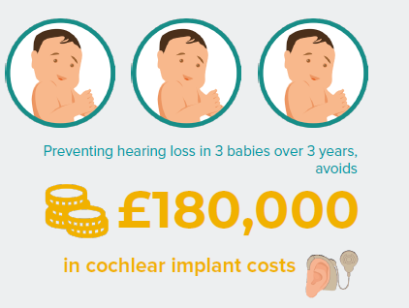

Scottish Health Technologies Group (SHTG) Technical Assessment Summary
SHTG provides impartial, evidence-based advice to NHSScotland on the use of health technologies.
Key Findings:
Newborns with the MT-RNR1 gene variant, m.1555A>G, have an increased risk of permanent hearing loss if treated with aminoglycoside antibiotics.
The Genedrive® MT-RNR1 ID Kit is a point-of-care genetic test providing results in approximately 26 minutes, without delaying antibiotic treatment.
Implementation in Scottish NICUs could prevent hearing loss in three babies over three years, avoiding approximately £180,000 in cochlear implant costs.
Notes:
Reference: Harbour J, Heggeland M, Bates E, Chappell J, Herbert P, Lakha F, Lee A, Nicol T. (2024). Genotype testing to guide antibiotic
use and prevent hearing loss in neonates. Glasgow/Edinburgh; NHS Healthcare Improvement Scotland.
Available at: https://shtg.scot/our-advice/genotype-testing-to-guide-antibiotic-use-and-prevent-hearing-loss-in-babies/

Slide 54

Scottish National Roll Out
£800,000 funding secured for phased national rollout
MT-RNR1 testing of newborn babies to begin October 2025
18-month phased implementation across all
regional health boards
3000+ babies per year to benefit from MT-RNR1 pharmacogenetic testing
Supported through the Accelerated National Innovation Adoption (ANIA) pathway, following technology assessments by the Scottish Health Technologies Group (SHTG)
Notes:
The Scottish Government has announced funding to support a national rollout of the Genedrive MT-RNR1 ID Kit across all regional health boards in Scotland, starting Q3 2025.

Slide 55
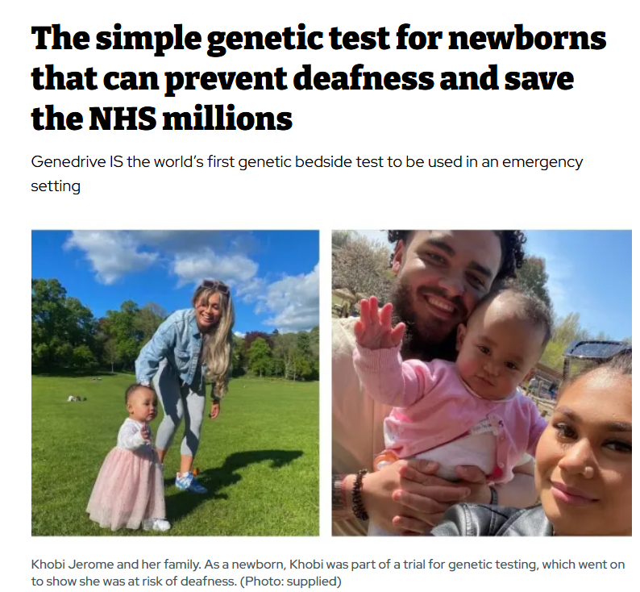
Notes:
The simple genetic test for newborns that can prevent deafness and save the NHS millions

Slide 56
Competitive Landscape

Slide 57
National Genomic Test Directory For rare and inherited diseases
Testing in England is available through one of seven NHS Genomic Medicine Services but its usually conducted retrospectively and can days or weeks for the result
Clinical Indication ID: R65
Test ID: R65.1
Clinical Indication: Aminoglycoside exposure posing risk to hearing
Target Genes: MT-RNR1 1555A>G; m.1095T>C; m.1494C>T
Clinical indication and testing criteria
We offer a test prior to aminoglycoside therapy for individuals, and also for those who have been exposed to aminoglycosides in whom the target gene (MT-RNR1 1555A>G) status needs to be determined because of concern regarding hearing loss
Notes:
8. gdr_-_nihr_(21.11.24).pdf

Slide 58
Credo Diagnostics

Slide 59

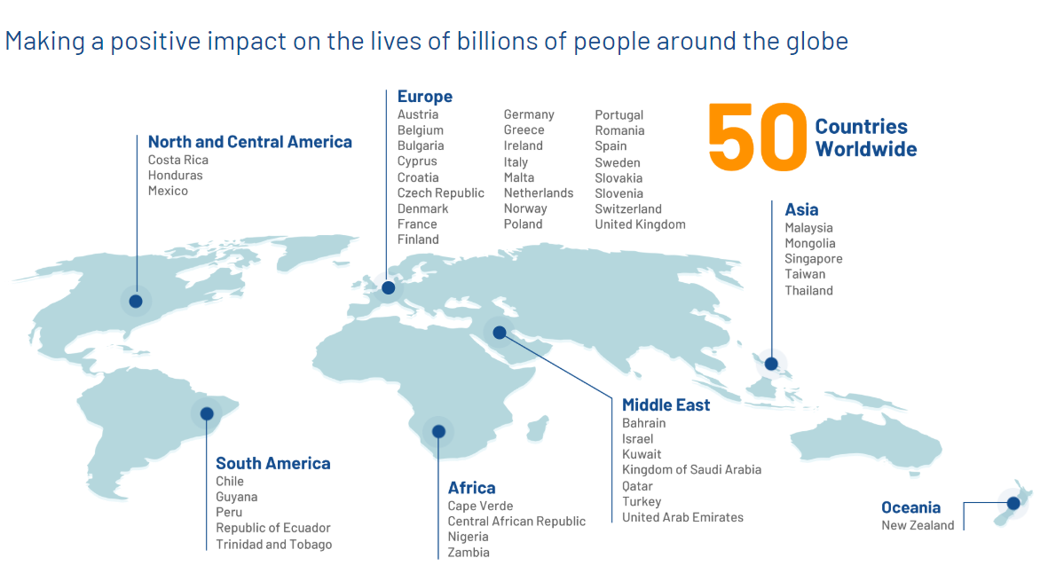
Credo Diagnostics
Established in 2011
Based in Singapore
Global presence in 50 countries
Their vision is to provide advanced medical technology for all
Their mission is to pioneer accessible diagnostic solutions to improve lives, creating knowledge that empowers people to make the right decisions about their health.
Notes:
8. gdr_-_nihr_(21.11.24).pdf

Slide 60


Integrating a full workflow of nucleic acid extraction and real-time PCR testing in a cartridge-based design.
Media - Credo Diagnostics (credodxbiomed.com)
VitaSIRA Solo™
VitaSIRA Solo
27cm by 23cm by 20cm
3.6 kg
CE Marked
Barcode scanner above screen
Notes:
GD is 30 by 23 by 20.5cm
And 3.6kg
These are located in many different areas including hospitals, labs, cruise ships and military ships

Slide 61

POCT1A compatible
Time to result dependent on the assay running. Generally, they claim results in 40 minutes
With four Assay
1)MT-RNR1 SNP Assay
2)SARA-CoV-2 / Flu / RSV Assay
3)HPV Assay
4)CT/NG/TV/MG Assay
VitaSIRA Solo™

Slide 62

VitaSIRA Solo™
Notes:
Diagnostic menus

Slide 63


VitaSIRA Solo
Notes:
Fluorescence Detection
450 to 750 nm
Fluorescence Channel
6+1 (Internal Control)

Slide 64


VitaSIRA Solo

Slide 65


Results
Print results using a connected printer
Export results to a USB
Connect via POCT1A

Slide 66


MT-RNR1 SNP Assay
VitaSIRO Solo
Registration status is research use only
Requires a pipette and filter tip

Slide 67



MT-RNR1 SNP Assay
VitaSIRO Solo
Notes:
Similar simple workflow
Similar easy to interpret results
Time to results quicker 20mins
Similar kit storage
Larger box quantity 20 per box. GD 10 per box
Hands-on-time has changed from <30 seconds to <1 minute
Kit storage has changed from 4-30 to 5-25

Slide 68
Kelliop

Slide 69

Kelliop
http://www.kelliop.com/
Kelliop is based in San Francisco Bay Area and Singapore
“Our focus has increasingly moved to emergency medicine, where the delivery of genetic information more quickly with than competitor's systems is a strength of our technology.”
Kelliop is deploying multiple commercial genetic tests
Into emergency care settings

Slide 70

RapidSeq126
lab-on-chip molecular diagnostic
Sample-to-answer in 25-45 min
CE Approved
External barcode reader
15kg, 434mm (L) x 212mm (W) x 288mm (H)
The device is compatible with various types of samples, such as blood, saliva, urine, and swabs.
The device also has a user-friendly interface and a cloud-based data management system.
can identify up to 114 alleles in under an hour
There is a 4 x version

Slide 71


Run
User Interphase

Slide 72


Results
User Interphase

Slide 73


Hearing loss assay
LOD: 5X10^2 copy/μl

Slide 74

Automatic steps using pneumatic pressure to transfer sample:
Hearing loss assay
Internal control resuspended
Cell lysis by mechanical and/or chemical mean
Membrane-based nucleic acid purification
Mixing the purified nucleic acid with the lyophilized main mixing reagent
Transfer aliquots of the defined elution/premix solution to different reaction chambers
Real-time multiplex PCR tests were performed in each reaction chamber.
If the target analyte is present, an increase in fluorescence is detected

Slide 75
Support

Slide 76
SUPPORT
Support Materials
Available on the document portal
Technical
ID-RNR1-IFU: Genedrive MT-RNR1 ID Kit Instructions For Use
GPM-15: Genedrive MT-RNR1 ID Kit Quick Reference Guide
RNR1-CTRL-IFU: Genedrive MT-RNR1 Control Kit Instructions For Use
GPM-101: Genedrive MT-RNR1 Control Kit Quick Reference Guide
GUM-4: Genedrive System User Manual
Sales Aids include:
GPM-114: Sales Flyer
GPM-132: Sales Flyer
GPM-100: Sales brochure
GPM-113: FAQ’s
GPM-109: PALOH Study summary
GPM-110: CIPIC Guideline summary
GPM-112: Key Publications
GPM-118 NICE EVA summary
GPM-151 Nurse PALOH summary
GPM-168 SHTG summary
GPM-173 Russian Prevalence summary
Training
GPM-29: eLearning Product Training Module
GPM-28: Genedrive MT-RNR1 Product Training video
GPM-149 Critical steps training aid
GPM-161 Introduction presentation
GPM-162 Test procedure slides
GPM-99 Product overview training presentation
Notes:
9. https://www.itv.com/news/granada/2024-11-21/new-test-to-prevent-newborn-babies-going-deaf-to-be-trialled-across-the-uk
The MT-RNR1 ID Kit is now in use at eight Greater Manchester neonatal units and has prevented the hearing loss of 11 babies across the region, with 4,000 babies tested as of October 2024.

Slide 77
SUPPORT
Press Release Log
PR Log.xlsx

Slide 78





Genedrive Commercial Team
Patrick Breen
Chief Commercial Officer
p.breen@genedrive.com
Stacey Gardiner
UK Business
Development Manager
s.gardiner@genedrive.com
Shadi Dehlaghi
UK North Business
Development Executive
s.dehlaghi@genedrive.com
Claire Newton
Marketing Manager
c.newton@genedrive.com
Kimberly Howard
Product Manager​
k.howard@genedrive.com

Slide 79
Any Questions
?
Demonstration

Slide 80
PRESS RELEASES
References
https://medregs.blog.gov.uk/2023/10/02/the-role-of-genetics-in-medicine-safety/
J. M. Barbarino, T. L. McGregor, R. B. Altman, and T. E. Klein, PharmGKB summary: very important pharmacogene information for MT-RNR1. Pharmacogene Genomics, 2016. 26(12): p. 558-567.
National Institute for Health and Care Excellence (NICE). 2021. Neonatal infection: antibiotics for prevention and treatment.
Bliss on hospital admissions to Neonatal Units https://www.bliss.org.uk/research-campaigns/neonatal-care-statistics/statistics-about-neonatal-care
Causes | Background information | Sepsis | CKS | NICE
McDermott JH, Mahaveer A, James RA, et al. Rapid Point-of-Care Genotyping to Avoid Aminoglycoside-Induced Ototoxicity in Neonatal Intensive Care. JAMA Pediatr. 2022;176(5):486–492. doi:10.1001/jamapediatrics.2022.0187
Clinical Pharmacogenetics Implementation Consortium Guideline for the Use of Aminoglycosides Based on MT-RNR1 Genotype - PMC (nih.gov)
Overview | Genedrive MT-RNR1 ID Kit for detecting a genetic variant to guide antibiotic use and prevent hearing loss in babies: early value assessment | Guidance | NICE

Slide 81
PRESS RELEASES
Press Releases
JAMA Pediatrics
https://jamanetwork.com/journals/jamapediatrics/fullarticle/2790066
New Scientist
https://www.newscientist.com/article/2314445-genetic-test-for-mutation-that-leads-to-antibiotic-induced-deafness/
Medscape
https://www.medscape.com/viewarticle/971355?src=soc_lk_shar
NHS England
https://www.england.nhs.uk/2022/04/nhs-develops-world-first-bedside-genetic-test-to-prevent-babies-going-deaf/
NICE
Genedrive MT-RNR1 ID Kit for detecting a genetic variant to guide antibiotic use and prevent hearing loss in babies: early value assessment (nice.org.uk)
ITV News
NHS develops world-first bedside genetic test to prevent babies going deaf | ITV News - YouTube

