Slide 1
Genedrive® CYP2C19 ID Kit
Product Introduction

Slide 2
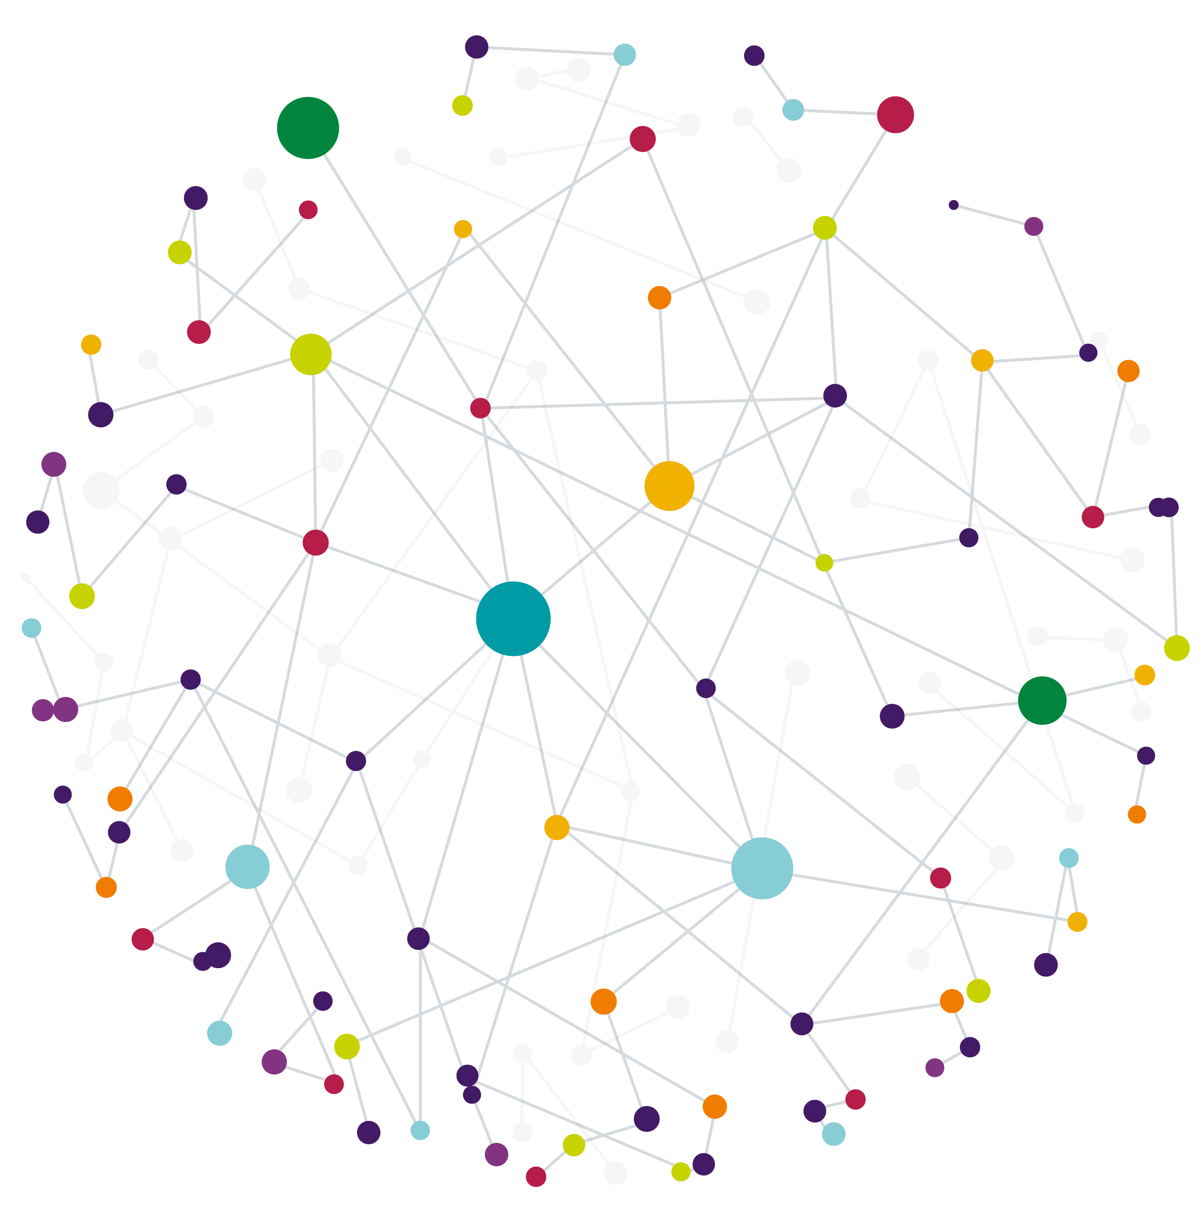

Our Vision
Our Mission
Our Vision is to become the leading company globally in point-of-care, pharmacogenetic testing
Our Mission is to design and develop easy-to-use, point-of-care pharmacogenetic tests that can be used in time critical settings that directly improve clinical outcomes
Advancing Diagnostics to the point-of-care
Notes:
Merge Vision & Mission

Slide 3

Our Core Competencies
Proven Track Record of achieving CE-IVD status on several products
Regulatory Expertise ISO 13485 certification
Flexible
technology uses different methods, for a broad assay portfolio
Unique
position in POC PGx*
testing and a world’s first product
Experienced hardware, software and reagent development teams
Growing Network of accredited distributors and partners

Slide 4
Our Network
Health Innovation Networks
Manchester
NICE
NIHR
OLS
BIVDA
NHS Partnerships
Manchester Foundation Trust
NHS Scotland
Genomic Laboratory Hubs
7 in England
1 in Wales
4 in Scotland
Academic Partnerships
University of Manchester
POCT
Innovators
POCT for Scotland
Notes:
Strong Partnerships with academic institutions and healthcare providers and clinical governance organisations
England
Central and South Genomic Laboratory Hub led by Birmingham Women’s and Children NHS Foundation Trust
East Genomic Laboratory Hub led by Cambridge University Hospitals NHS Foundation Trust
North West Genomic Laboratory Hub led by Manchester University NHS Foundation Trust
North Thames Genomic Laboratory Hub led by Great Ormond Street Hospital for Children NHS Foundation Trust
South East Genomic Laboratory Hub led by Guy’s and St Thomas’ NHS Foundation Trust
South West Genomic Laboratory Hub led by North Bristol NHS Trust
North East and Yorkshire Genomic Laboratory Hub led by The Newcastle upon Tyne Hospitals NHS Foundation Trust
Scotland
Scottish Strategic Network for Genomic Medicine (SSNGM) Aberdeen, Dundee, Edinburgh and Glasgow

Slide 5
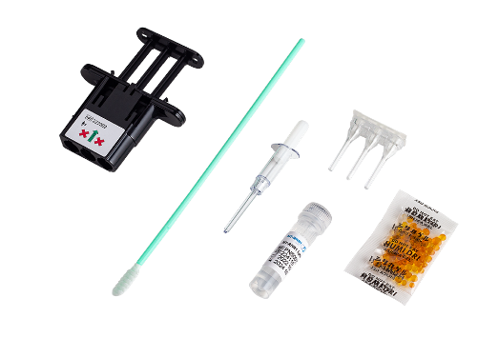
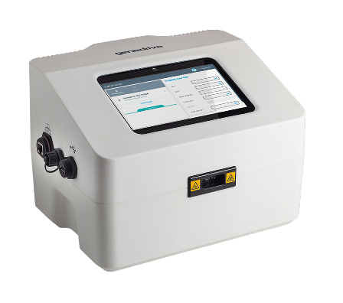
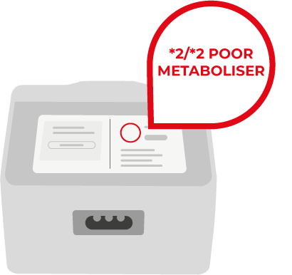
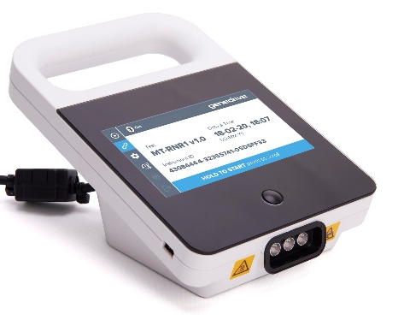

Our Company Product Timeline
2012
Sept
2019
Sept
2021
July
2022
Sept
2023
Genedrive
Instrument
CE-IVD marked
Genedrive
MT-RNR1 ID Kit
CE marked
1st POC PGx test of its kind, to reduce AHIL
Genedrive
System
CE-IVD marked
Strategic Direction
Shift away from infectious diseases to PGx testing
Genedrive
CYP2C19 ID Kit
UKCA marked
CYP2C19 genotyping & metaboliser status
Notes:
Genedrive are based in Manchester, UK in a building shared with the University of Manchester
Genedrive Diagnostics Ltd is part of genedrive plc; formed in 2016, previously part of Epistem Holdings
We are a molecular diagnostic company Over 12 Years of experience in point-of-care molecular diagnostics
Initially focused on infectious diseases, now primarily focused on rapid, point-of-care tests used to stratify patients to guide treatment decisions in time-critical situations
An ISO 13485 accredited company

Slide 6







Why Pharmacogenetics
ADRs are responsible for 6.5% of hospital admissions ²
Some patients may experience reduced effectiveness of the drug. ​
Or an unexpected harmful response, known as an Adverse Drug Reaction (ADR)
Medications can work differently for everyone
PGx could prevent up to 30% ADRs ¹
8,000 beds occupied due to ADRs in the NHS ²
Genes can affect patient response to medication
Using pharmacogenetics can improve patient safety by quickly testing for genes known to cause ADRs
ADRs estimated to cost the NHS over £2 billion annually ²
Advancing Diagnostics to the point-of-care
Notes:
https://medregs.blog.gov.uk/2023/10/02/the-role-of-genetics-in-medicine-safety/
Osanlou R, Walker L, Hughes DA, et al Adverse drug reactions, multimorbidity and polypharmacy: a prospective analysis of 1 month of medical admissions BMJ Open 2022;12:e055551. doi: 10.1136/bmjopen-2021-055551

Slide 7
Why CYP2C19?
Clopidogrel is a recommended anti-platelet therapy
Around 1 in 3 people can carry LOF alleles depending on the patient cohort
PGx could prevent up to 30% ADRs ¹
Variants in the CYP2C19 gene can cause loss of function (LOF) affecting metaboliser status
Pharmacogenetic testing with the Genedrive® CYP2C19 ID Kit guide anti-platelet therapy in patients
Advancing Diagnostics to the point-of-care
Notes:
1. https://medregs.blog.gov.uk/2023/10/02/the-role-of-genetics-in-medicine-safety/

Slide 8
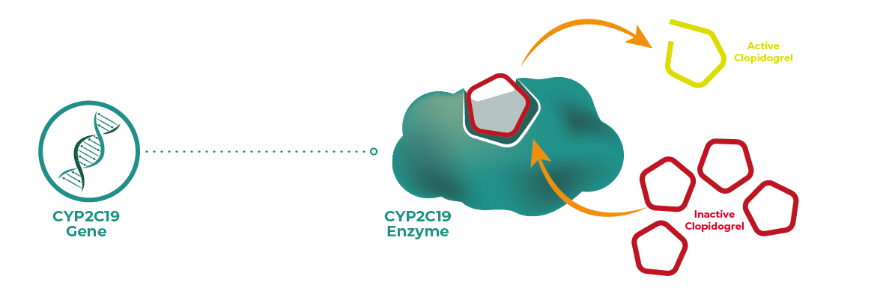
What is CYP2C19?
The CYP2C19 gene codes for the CYP2C19 enzyme
CYP2C19 is a liver enzyme thought to be involved in metabolising at least 10% of commonly prescribed drugs, including antidepressants, PPI's and the antiplatelet Clopidogrel (Plavix)
There are many variants of the CYP2C19 gene, and these variants determine an individual's metaboliser status, by influencing how effectively CYP2C19 functions
Notes:
In the liver the CYP2C19 enzyme catalyses the inactive prodrug to an active form
CYP2C19 codes for Cytochrome P450 Family 2 Subfamily C Member 19 (CYP2C19) enzyme
Many = 35+ variants according to CPIC
SSRIs = Selective Serotonin Reuptake Inhibitors are a newer class of antidepressants
TCAs = Tricyclic Antidepressants are an older class of antidepressants
PPIs = Proton pump inhibitors
CYP2C19 gene: MedlinePlus Genetics - 10% fact

Slide 9











CYP2C19 Metaboliser Status
Normal, Rapid or Ultrarapid metaboliser status
Genetic Variation of CYP2C19
Consider Clopidogrel
Clopidogrel activated
Intermediate metaboliser status (IM)
IM and PM are 46% more likely to have a recurrent stroke¹
Clopidogrel partially activated
Increased risk of major cardiovascular and cerebrovascular events
Poor metaboliser status (PM)
Clopidogrel not activated
Notes:
The importance of rapid and ultra-rapid metabolisers on clinical outcomes is a topic of ongoing research but current CPIC guidelines say give clopidogrel
Testing could help prevent further strokes in people with gene variant | NICE
In reality normal metabolizers don’t activate all the clopidogrel

Slide 10
The Clinical Need
Clopidogrel is an antiplatelet prescribed to manage transient ischemic attacks (TIA) and ischemic strokes
It helps prevent blood clots, reducing the risk of subsequent strokes and other cardiovascular events
There are over 100,000 strokes a year in the UK (one every 5 mins) 4
Strokes cause around 38,000 deaths a year with 2/3 survivors living with a disability
The UK Stroke Association estimated that annual NHS costs of stroke are set to treble from £3.4 billion in 2015 to £10.2 billion in 2035
Around 30%
of people are intermediate or
poor metabolisers
Notes:
Stroke statistics | Stroke Association

Slide 11







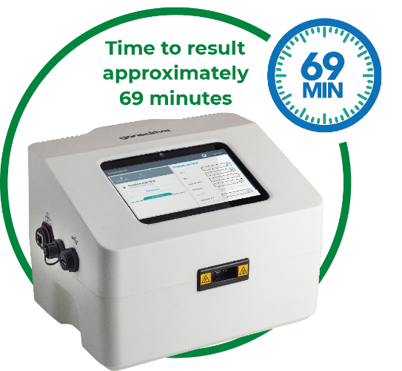



Current Clinical Pathway
Clinician to administer treatment within 24hrs
Metaboliser status not known
30% of patients do not
respond to clopidogrel
Stroke Patient Admitted
With Genedrive® System Implemented
Normal/Rapid/Ultrarapid Metaboliser status identified
Consider clopidogrel
Clinician to administer treatment within 24hrs
Consider alternative treatment
Intermediate/Poor Metaboliser status identified

Slide 12


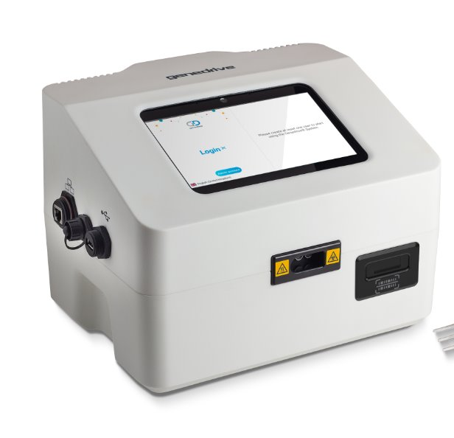


12 | GENEDRIVE FEATURES
The Genedrive® System
Provides rapid automated
results in approximately 69 minutes
Seamless connectivity
to export results via ethernet or Wi-Fi to SFTP
RFID enabled reagent
lock out to prevent
use of expired tests
Flexible connectivity to external systems via middleware

Slide 13
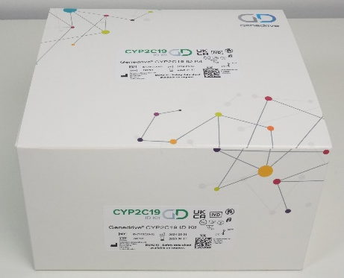
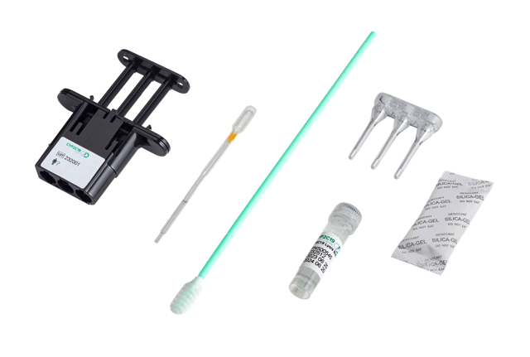
Genedrive® CYP2C19 ID KIT
Point of care genetic test to be used in time critical situations, to guide therapeutics that are metabolised by Cytochrome P450 2C19 (CYP2C19)
Allows personalised treatment for drugs metabolised by CYP2C19, including the antiplatelet Clopidogrel
Non-invasive test, using a single buccal swab
Simple workflow
Rapid actionable results in approximately 69 minutes including diplotype and metaboliser status
Easy adoption into existing workflows
No cold storage required for reagents
Comprehensive variant coverage identifying clinically relevant alleles of CYP2C19 Loss of Function (*2, *3, *4, *8, *35) and gain of function (*17)

Slide 14
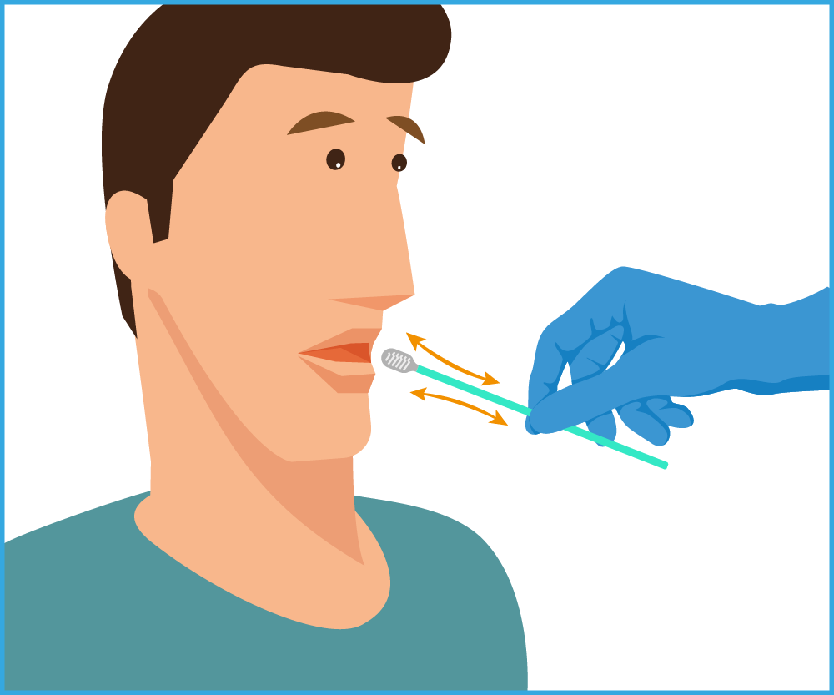
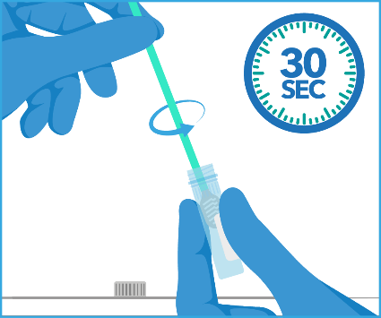
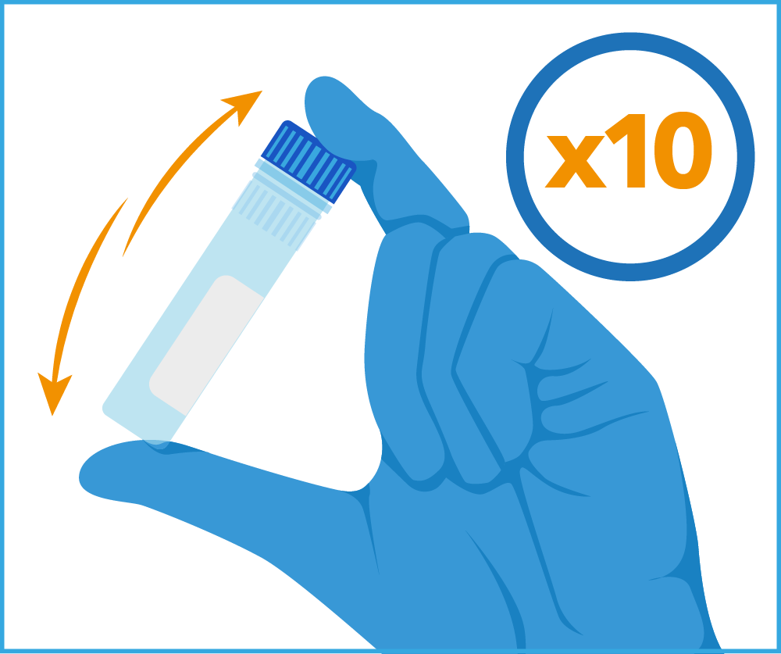
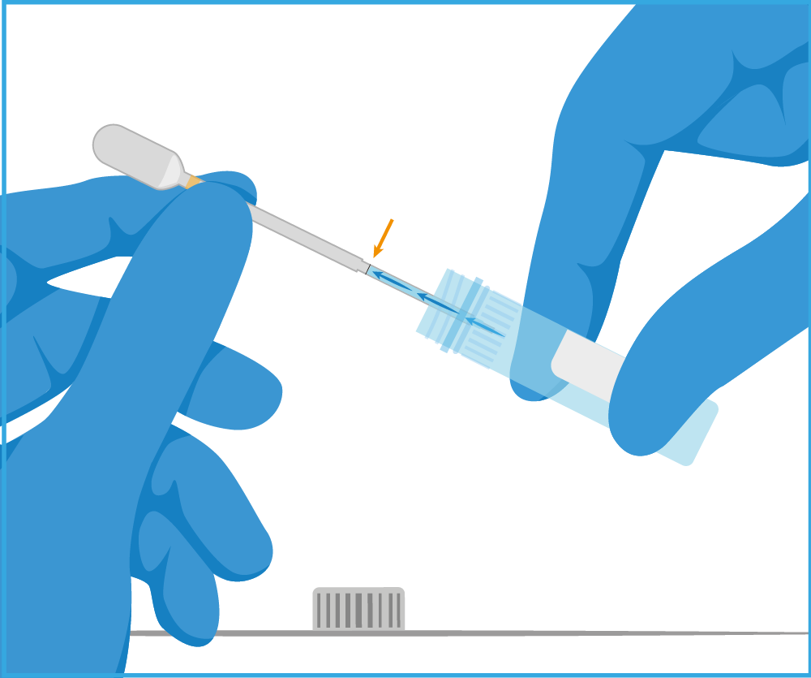
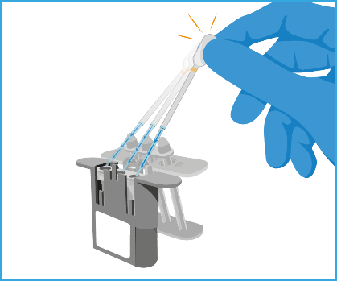
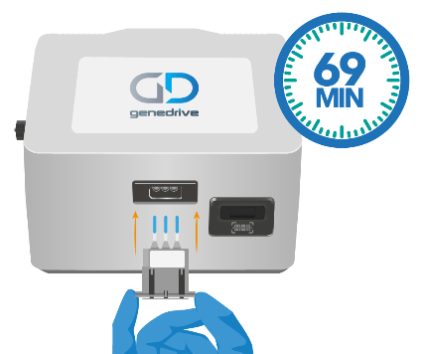
Genedrive CYP2C19 ID Kit Workflow
Simple workflow
Firmly swab
the patient
Vigorously rotate to release the DNA
Invert to mix the sample
Transfer the sample
Reconstitute the reagents
Insert cartridge to Start test
Notes:
Technical training version

Slide 15
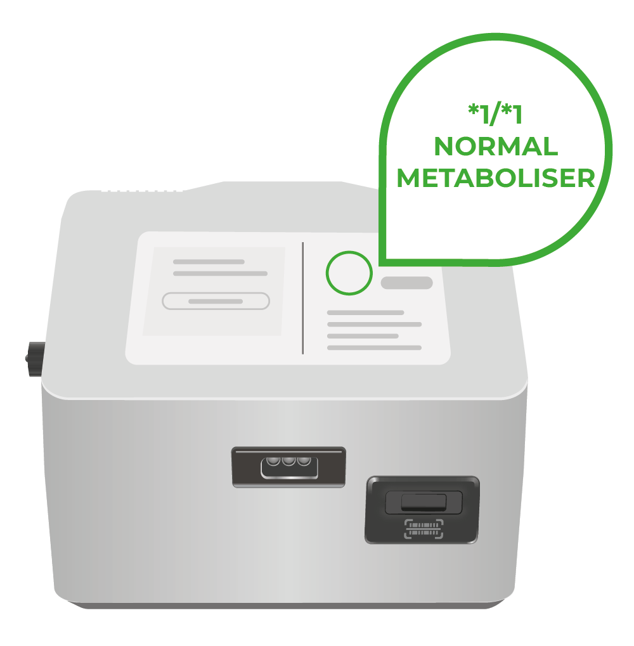


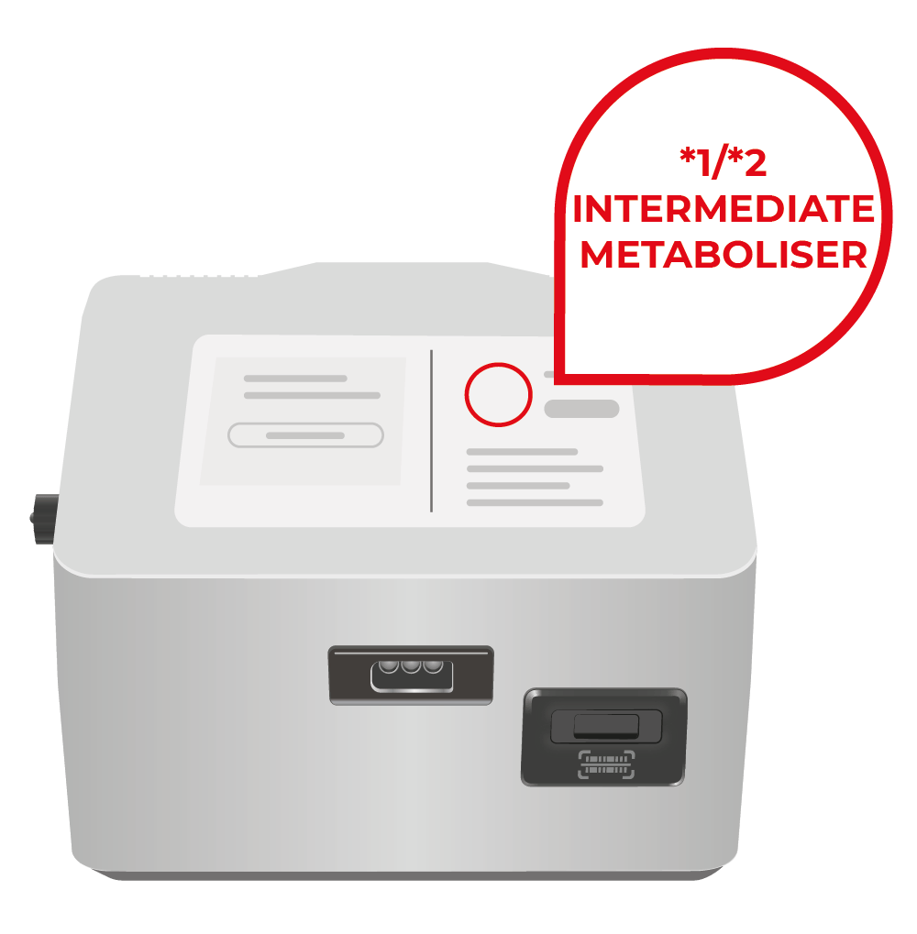
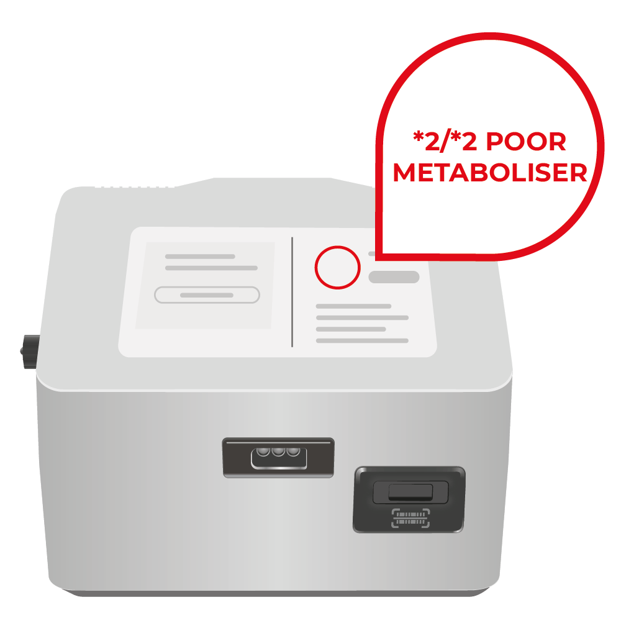
Results
Clear actionable results screens showing the diplotype identified and CPIC-coded metaboliser status
Consider clopidogrel
Consider clopidogrel
Consider clopidogrel
Consider alternative treatment
Consider alternative treatment

Slide 16

CPIC Guidance
CYP2C19 intermediate and poor metabolisers who receive clopidogrel experience reduced platelet inhibition and increased risk for major adverse cardiovascular and cerebrovascular events.
Metabolizer Status | Implications | Therapeutic Recommendation
CYP2C19 intermediate metabolisers | Reduced clopidogrel active metabolite formation; increased on-treatment platelet reactivity; increased risk for adverse cardiac and cerebrovascular events | Avoid standard dose (75 mg) clopidogrel if possible. Use prasugrel or ticagrelor at standard dose if no contraindication
CYP2C19 poor metabolisers | Reduced clopidogrel active metabolite formation; increased on-treatment platelet reactivity; increased risk for adverse cardiac and cerebrovascular events | Avoid standard dose (75 mg) clopidogrel if possible. Use prasugrel or ticagrelor at standard dose if no contraindication
Notes:
Clinical Pharmacogenetics Implementation Consortium Guideline for CYP2C19 Genotype and Clopidogrel Therapy: 2022 Update (cpicpgx.org)

Slide 17

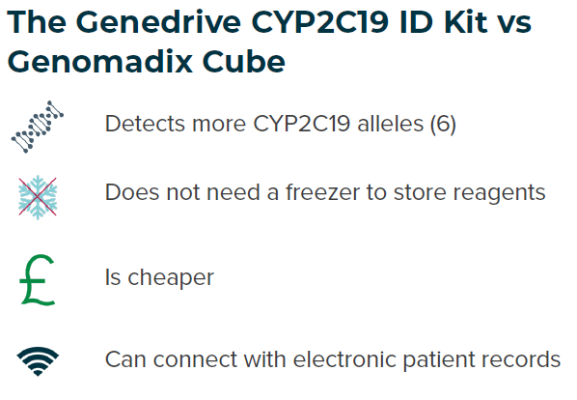
CYP2C19 Genotype Testing to Guide Clopidogrel Use After Ischaemic Stroke or Transient Ischaemic Attack
NICE recommend
Laboratory based testing and point-of-care testing (POCT) are recommended.
The Genedrive CYP2C19 ID Kit should be used when laboratory-based testing is not available.
What it Means in Practice:
UK National Stroke clinical guideline recommends that dual antiplatelet therapies (such as Clopidogrel and aspirin) are administered in <24 hours of the event.
Conventional laboratory testing workflows are unlikely to turnaround actionable results in this time.
The Genedrive CYP2C19 ID Kit should be used when laboratory-based testing is not available.
Notes:
https://cks.nice.org.uk/topics/antiplatelet-treatment/

Slide 18

GPM-146
About Us
CYP2C19
Genedrive are experienced developers of POC PGx tests
Strong partnerships with academic institutions and healthcare providers
CYP2C19 is responsible for metabolising many drugs
Genetic variations in CYP2C19 are common
Poor and intermediate metabolisers experience worse outcomes when treated with clopidogrel
Summary
The Genedrive® CYP2C19 ID kit
Allows personalised treatment for drugs metabolised by CYP2C19, including the antiplatelet Clopidogrel
Our Solution
The Guidance
Non-invasive test
Broad variant coverage
Simple workflow
Rapid actionable results in approximately 69 minutes
CPIC – Define metaboliser status
NICE – Recommend CYPC2C19 genetic testing
National stroke Guidelines – recommend clopidogrel administered with 24hrs

Slide 19
Any Questions
?
Demonstration

Slide 20
References:
https://medregs.blog.gov.uk/2023/10/02/the-role-of-genetics-in-medicine-safety/
Clinical Pharmacogenetics Implementation Consortium Guideline for CYP2C19 Genotype and Clopidogrel Therapy: 2022 Update (cpicpgx.org)
https://cks.nice.org.uk/topics/antiplatelet-treatment/
Stroke statistics | Stroke Association
*PGx = Pharmacogenetics

Slide 21



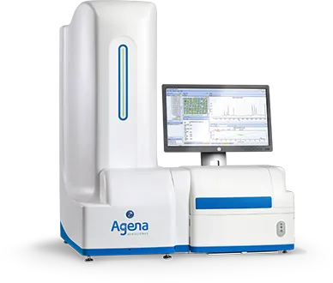

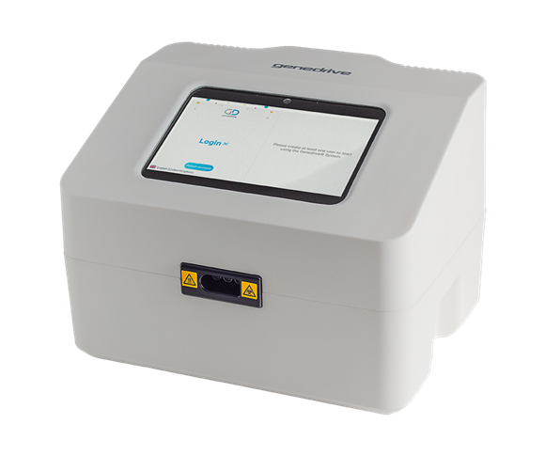
Competitive Landscape
Genedrive® System
Point-of-Care
Genomadix Cube
Point-of-Care
The MassARRAY® System
Laboratory

Slide 22
CYP2C19 Genotyping Comparision
Feature | Genedrive POC | Genomadix POC | Laboratory (Agena Bioscience MassARRAY)
Alleles | *2, *3, *4, *8, *17, *35 Increased ethnicity | *2, *3, *17 Includes two LoF alleles | *2, *3, *4, *5, *6, *7, *8, *17,
Reagent storage temperature | 2°C to 30°C | -15°C to -80°C (freezer storage) Used within 15 mins of removal
Result transfer to patient records | Electronic transfer and connectivity via middleware | Not available – manual result data entry required | Export CSV files
Time to result | 69 minutes | Approx. 1 hour | Approx. 1 week (96 plate run time 100mins. 384 plate run time 150mins)
Format | Integrated system | System plus laptop
Specimen collection | 1 buccal swab | 3 buccal swabs | Blood sample
Number of samples run at a time | 1 | 1 | 96 or 384
Results | Easy to interpret metaboliser status as per CPIC | Diplotype detected | Requires interpretation by a trained healthcare professional
Cost | £150. per test kit | £197. per test kit | £15 to £250

