Slide 1
Genedrive® CYP2C19 ID Kit
Product Overview Training
GPM-146

Slide 2

GPM-146
About Us
Clinical Need
Who are Genedrive?
Our Vision & Mission
Why Pharmacogenetics?
What is CYP2C19?
Metaboliser Status
The Clinical Impact
Contents
Our Solution
The Guidance
Simple workflow
Rapid actionable results
CPIC
NICE

Slide 3
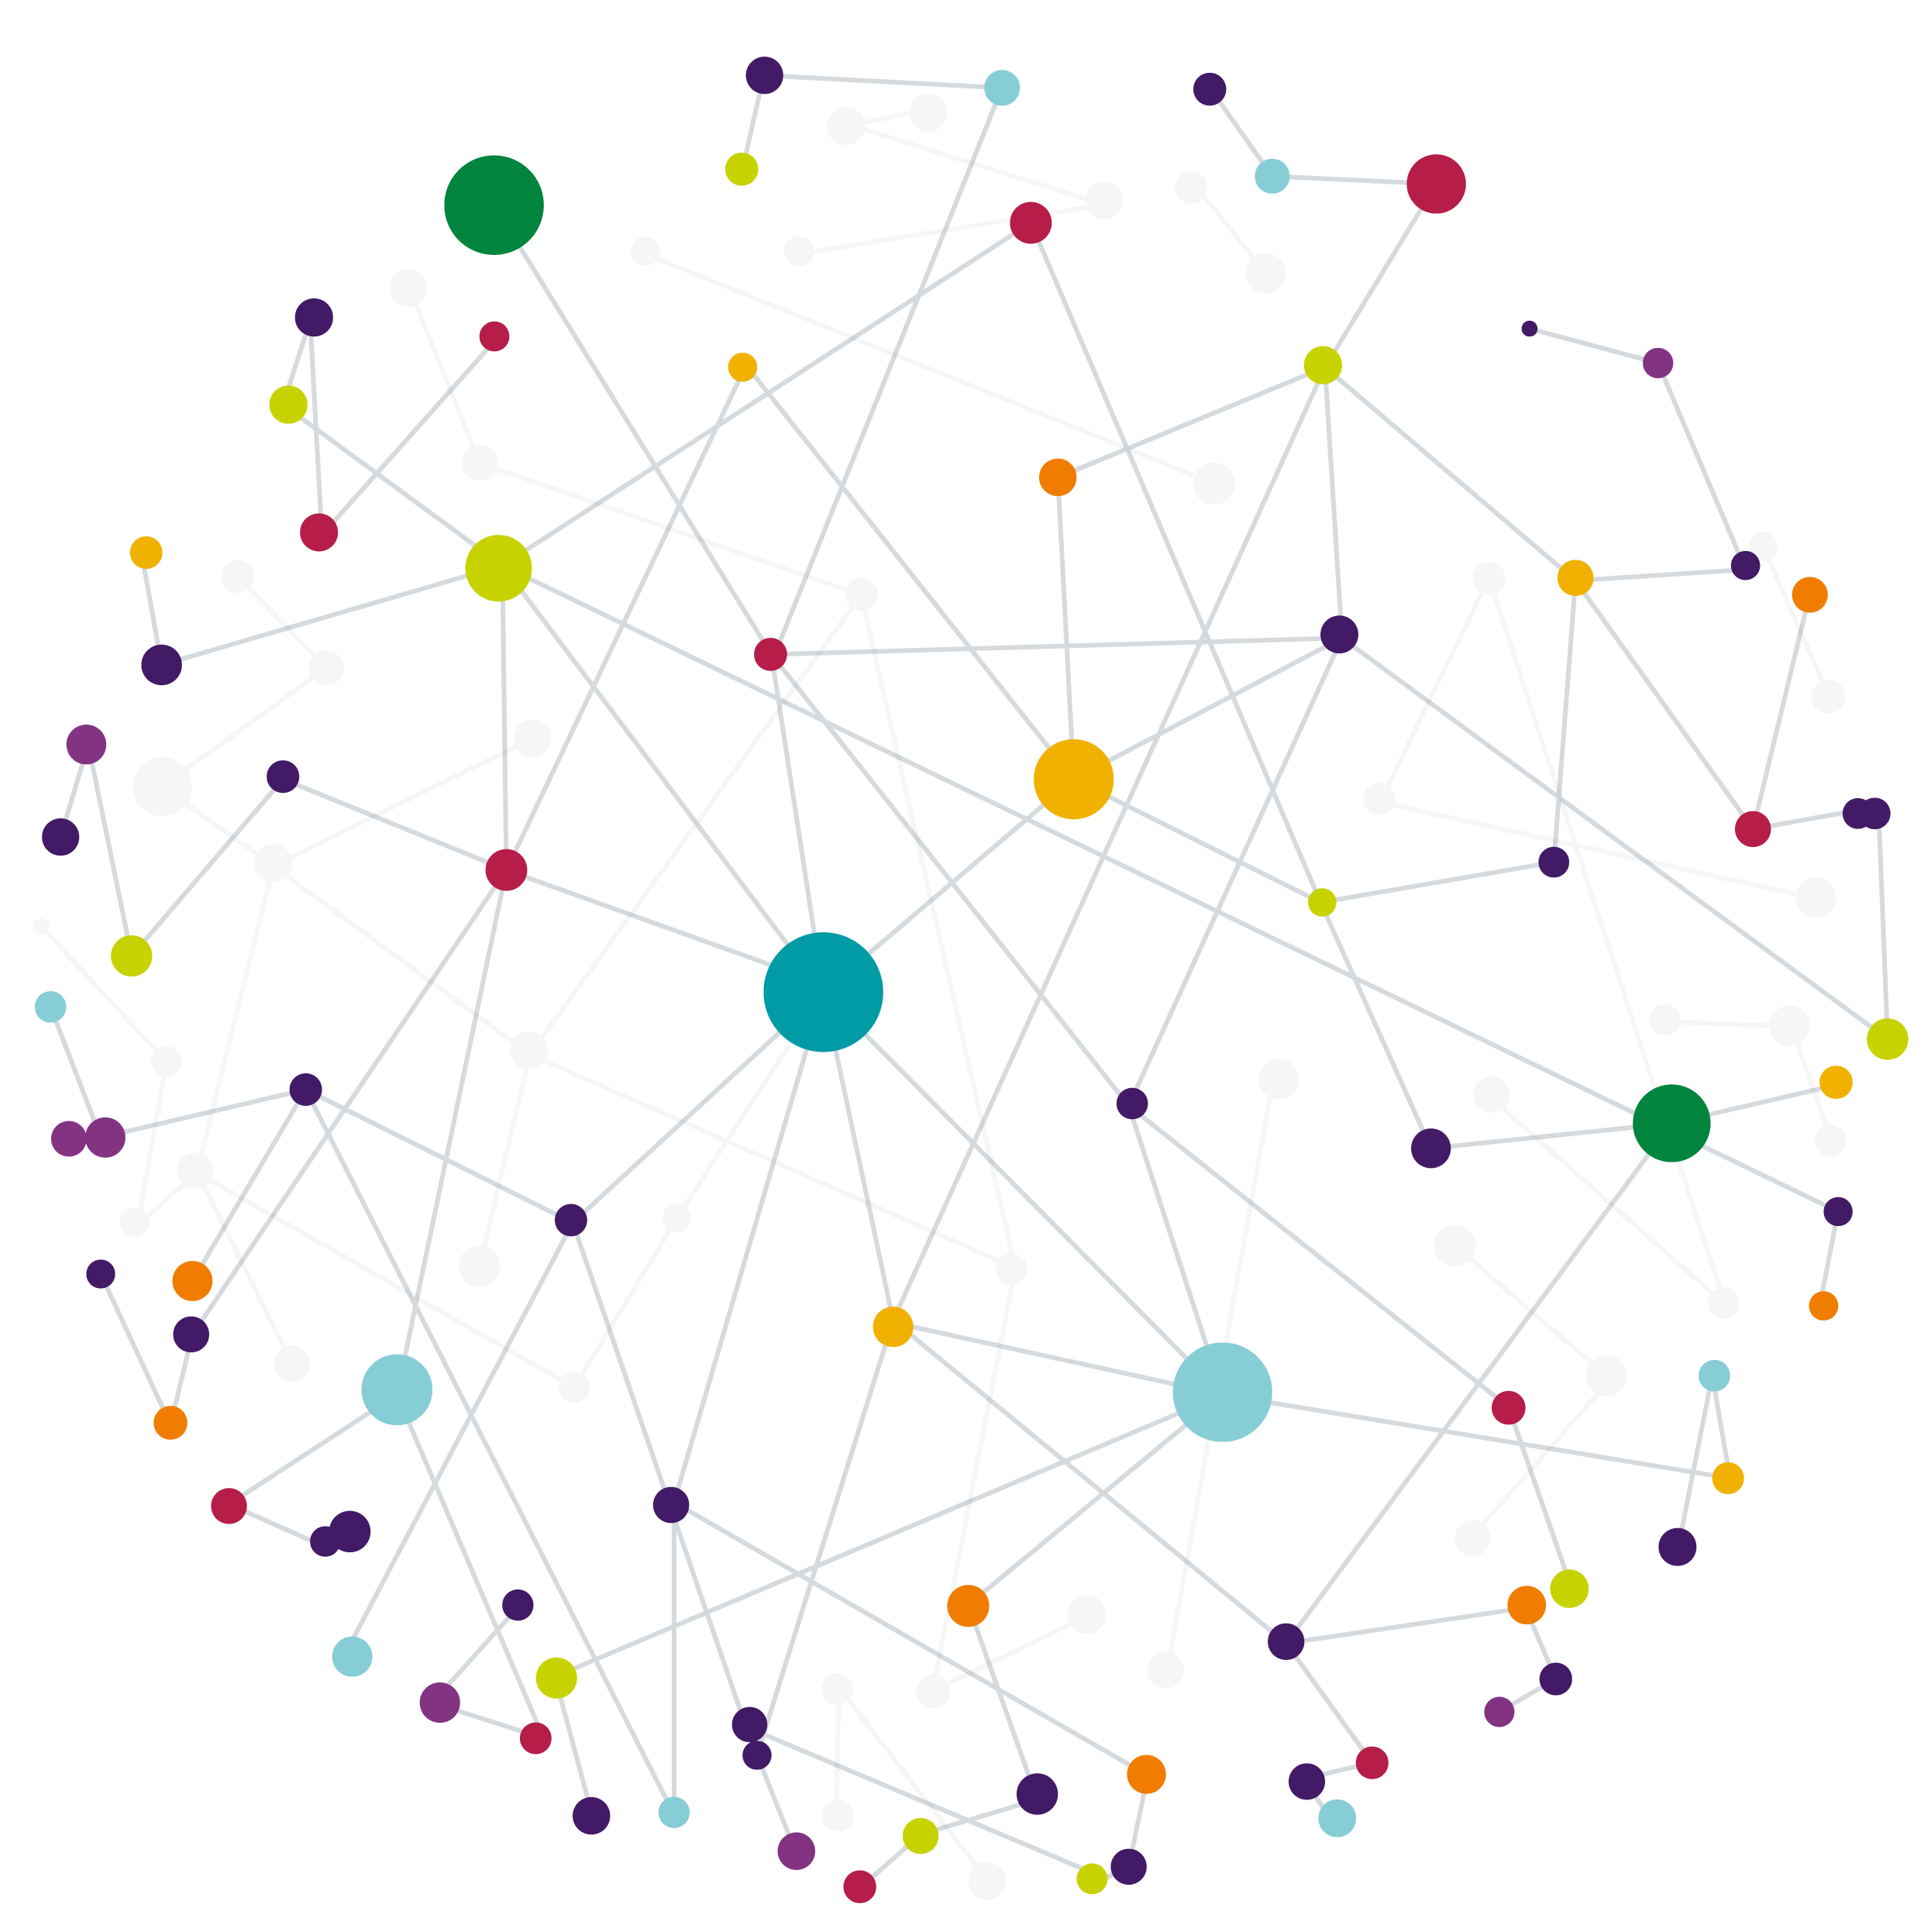

Our Vision
Our Mission
Our Vision is to become the leading company globally in point-of-care, pharmacogenetic testing
Our Mission is to design and develop easy-to-use, point-of-care pharmacogenetic tests that can be used in time critical settings that directly improve clinical outcomes

Slide 4
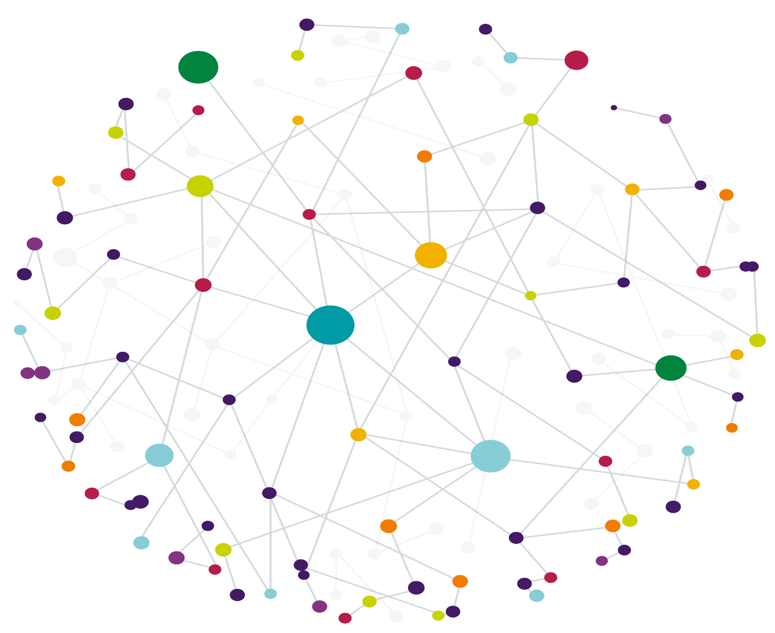
Our Core Competencies
Proven Track Record
of achieving
CE-IVD status on several products
Regulatory Expertise
ISO 13485 certification
Flexible
technology uses different methods, for a broad assay portfolio
Unique
position in POC PGx*
testing and a world’s first product
Experienced hardware, software and reagent development teams
Growing Network
of accredited distributors and partners

Slide 5
Our Network
Health Innovation Networks
Manchester
NICE
NIHR
OLS
BIVDA
NHS Partnerships
Manchester Foundation Trust
NHS Scotland
Genomic Laboratory Hubs
7 in England
1 in Wales
4 in Scotland
Academic Partnerships
University of Manchester
POCT
Innovators
POCT for Scotland
Notes:
Strong Partnerships with academic institutions and healthcare providers and clinical governance organisations
England
Central and South Genomic Laboratory Hub led by Birmingham Women’s and Children NHS Foundation Trust
East Genomic Laboratory Hub led by Cambridge University Hospitals NHS Foundation Trust
North West Genomic Laboratory Hub led by Manchester University NHS Foundation Trust
North Thames Genomic Laboratory Hub led by Great Ormond Street Hospital for Children NHS Foundation Trust
South East Genomic Laboratory Hub led by Guy’s and St Thomas’ NHS Foundation Trust
South West Genomic Laboratory Hub led by North Bristol NHS Trust
North East and Yorkshire Genomic Laboratory Hub led by The Newcastle upon Tyne Hospitals NHS Foundation Trust
Scotland
Scottish Strategic Network for Genomic Medicine (SSNGM) Aberdeen, Dundee, Edinburgh and Glasgow

Slide 6
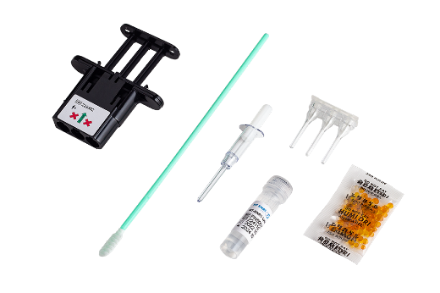
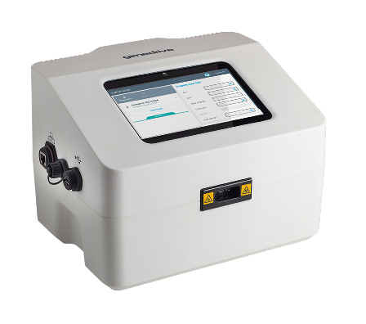
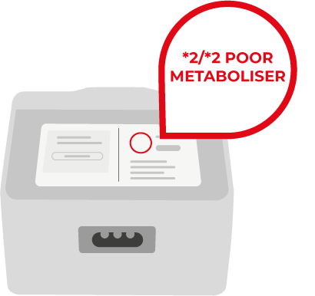
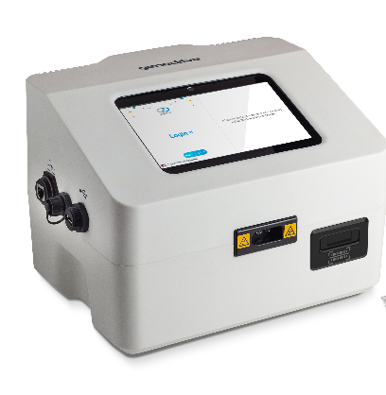
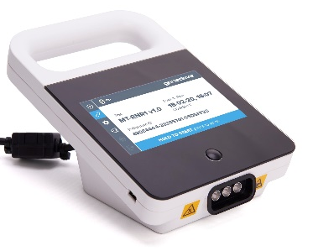

Our Company Product Timeline
April 2018
Nov
2019
Sept
2021
July
2022
Sept
2023
Sept
2024
Genedrive
MT-RNR1 ID Kit
CE-IVD marked
1st POC PGx test of its kind, to reduce AHIL
Genedrive
System
CE-IVD marked
Strategic Direction
Shift away from infectious diseases to PGx testing
Genedrive
CYP2C19 ID Kit
UKCA marked
CYP2C19 genotyping & metaboliser status
Genedrive
System
V6 launched
Genedrive
Instrument
CE-IVD marked
Notes:
Genedrive are based in Manchester, UK in a building shared with the University of Manchester
Genedrive Diagnostics Ltd is part of genedrive plc; formed in 2016, previously part of Epistem Holdings
We are a molecular diagnostic company Over 12 Years of experience in point-of-care molecular diagnostics
Initially focused on infectious diseases, now primarily focused on rapid, point-of-care tests used to stratify patients to guide treatment decisions in time-critical situations
An ISO 13485 accredited company

Slide 7







Why Pharmacogenetics
ADRs are responsible for 6.5% of hospital admissions ²
Some patients may experience reduced effectiveness of the drug. ​
Or an unexpected harmful response, known as an Adverse Drug Reaction (ADR)
Medications can work differently
for everyone
PGx could prevent up to
30% ADRs ¹
8,000 beds occupied due to ADRs in the NHS ²
Genes can affect patient response to medication
Using pharmacogenetics can improve patient safety by quickly testing for genes known to cause ADRs
ADRs estimated to cost the NHS over £2 billion annually ²
Notes:
https://medregs.blog.gov.uk/2023/10/02/the-role-of-genetics-in-medicine-safety/
Osanlou R, Walker L, Hughes DA, et al Adverse drug reactions, multimorbidity and polypharmacy: a prospective analysis of 1 month of medical admissions BMJ Open 2022;12:e055551. doi: 10.1136/bmjopen-2021-055551

Slide 8
Why CYP2C19?
Clopidogrel is a recommended anti-platelet therapy
Around 1 in 3 people can carry LOF alleles depending on the patient cohort
PGx could prevent up to
30% ADRs ¹
Variants in the CYP2C19 gene can cause loss of function (LOF) affecting metaboliser status
Pharmacogenetic testing with the Genedrive® CYP2C19 ID Kit guide anti-platelet therapy in patients
Notes:
1. https://medregs.blog.gov.uk/2023/10/02/the-role-of-genetics-in-medicine-safety/

Slide 9
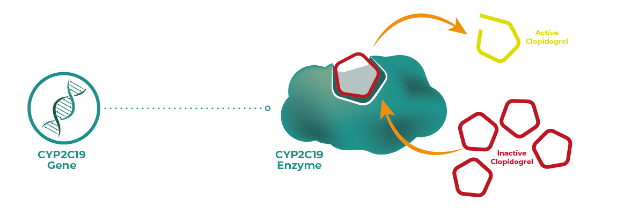
What is CYP2C19?
The CYP2C19 gene codes for the CYP2C19 enzyme
CYP2C19 is a liver enzyme thought to be involved in metabolising at least 10% of commonly prescribed drugs, including antidepressants, PPI's and the antiplatelet Clopidogrel (Plavix)
There are many variants of the CYP2C19 gene, and these variants determine an individual's metaboliser status, by influencing how effectively CYP2C19 functions
Notes:
In the liver the CYP2C19 enzyme catalyses the inactive prodrug to an active form
CYP2C19 codes for Cytochrome P450 Family 2 Subfamily C Member 19 (CYP2C19) enzyme
Many = 35+ variants according to CPIC
SSRIs = Selective Serotonin Reuptake Inhibitors are a newer class of antidepressants
TCAs = Tricyclic Antidepressants are an older class of antidepressants
PPIs = Proton pump inhibitors
CYP2C19 gene: MedlinePlus Genetics - 10% fact
In reality multiple enzymes are responsible for this process

Slide 10
Alleles
Variation throughout gene categorised as *alleles
Metaboliser
Ultrarapid
Rapid
Normal
Intermediate
Poor
Majority have no impact, but some result in a gain or loss of function of the CYP2C19 enzyme.
The Genedrive® CYP2C19 ID KIT detects the loss of function alleles *2, *3 ,*4, *8 and *35
The Genedrive® CYP2C19 ID KIT detects the gain of function allele *17
Combination of these alleles leads to classification of metaboliser status
Notes:
CPIC® Guideline for Clopidogrel and CYP2C19 – CPIC

Slide 11











CYP2C19 Metaboliser Status
Normal, Rapid or Ultrarapid metaboliser status
Genetic Variation of CYP2C19
Consider Clopidogrel
Clopidogrel activated
Intermediate metaboliser status (IM)
IM and PM are 46% more likely to have a recurrent stroke¹
Clopidogrel partially activated
Increased risk of major cardiovascular and cerebrovascular events
Poor metaboliser status (PM)
Clopidogrel not activated
Notes:
The importance of rapid and ultra-rapid metabolisers on clinical outcomes is a topic of ongoing research but current CPIC guidelines say give clopidogrel
Testing could help prevent further strokes in people with gene variant | NICE
In reality normal metabolizers don’t activate all the clopidogrel

Slide 12
The Clinical Need

Slide 13




What is clopidogrel?
Clopidogrel is an antiplatelet drug that works by blocking the platelet P2Y12 receptor thereby blocking platelet activation and aggregation.
National guidelines from NICE and Royal College of Physicians recommend that for ischaemic stroke or TIA (transient ischaemic attack) clopidogrel is administered with aspirin within 24hrs for secondary prevention of cardiovascular disease.
Where Clopidogrel isn't suitable another P2Y12 inhibitor is recommended (e.g. Ticagrelor) or a different class of antiplatelet e.g. Dipyridamole.

Slide 14
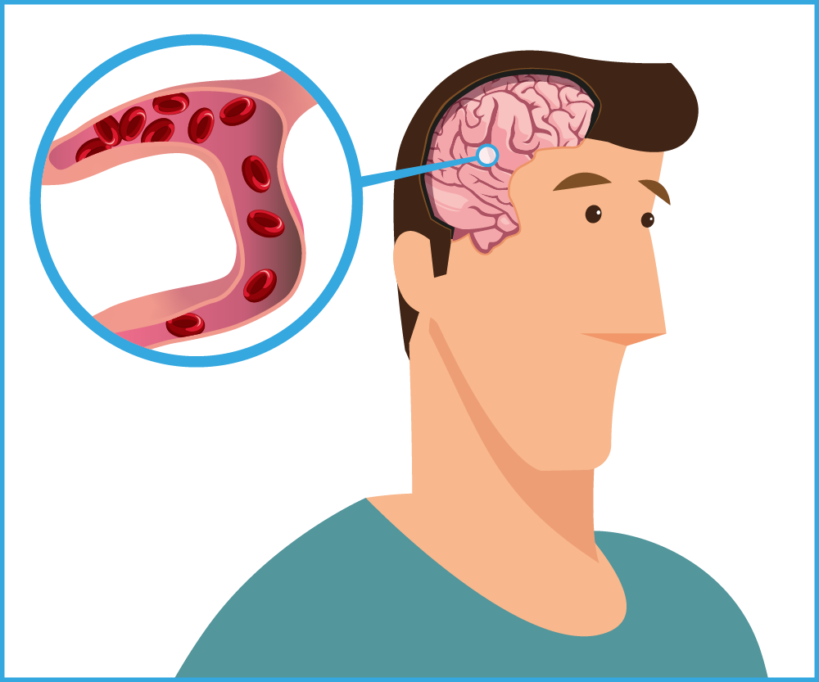
There are around 100,000 strokes a year
(1 every 5 mins)
The Clinical Need – Stroke
85% Ischaemic stroke
  Caused by a blockage in a blood vessel that supplies blood to the brain. Killing brain cells
  1/4 of people go on to have another stroke within 5 years of the first stroke
15% Haemorrhagic stroke
  Caused by a bleeding in or around the brain
Transient ischaemic attack (TIA)
  Also known as a mini-stroke, symptoms only last for a short amount of time (24hrs)
  Stroke is the fourth single leading cause of death in the UK, and causes 34,000 deaths annually, 1 every 15 minutes
  25% of strokes are recurrent
Notes:
https://www.stroke.org.uk/stroke/types
Stroke Association (2021) Stroke statistics.
3. Oza, R., Rundell, K., & Garcellano, M. (2017). Recurrent ischemic stroke: Strategies for prevention. American Family Physician, 96(7), 436-440. Retrieved from https://www.aafp.org/pubs/afp/issues/2017/1001/p436.html
TIA – not classed as a stroke in the data

Slide 15
The Clinical Need - Stroke Disability
Strokes Cause damage to the brain
  Damage to the brain can affect how the body works and how you think or feel and leave you with life-changing effects.
  Two-thirds of people who survive a stroke find themselves living with a disability.
Loss of livelihood
  A stroke can occur at any age, the median age in UK is 77 years and is as low as 45 in countries such as the UAE.
  There are 1.3 million stroke survivors in the UK.
  Communication problems affect more than 350,000 people in the UK following a stroke. Problems may include aphasia, dysarthria or apraxia. A person's ability to understand speech, speak, read, write and use numbers might be affected.
  6% of patients were working full-time 6 months after stroke compared with 15% prior to stroke.
Notes:
Stroke Association (2021) Stroke statistics. National Clinical Guidelines for Stroke - Communication and language
NICE Stroke and transient ischaemic attack in over 16s: diagnosis and initial management
Stroke Association (2021) Stroke statistics. Sentinel Stroke National Audit Programme
Stroke Association (2021) Stroke statistics.
Sentinel Stroke National Audit Programme
https://gulfnews.com/uae/health/world-stroke-day-why-are-young-uae-residents-getting-strokes-1.99059135#:~:text=In%20the%20UAE%2C%20where%20strokes%20affect%20around%2010%2C000,is%2020%20years%20younger%20than%20the%20global%20average.

Slide 16
Cost Impact - Stroke
Stroke costs the UK economy £26 billion per year, including a cost of £3.4 billion to the NHS, £5.3 billion to social care and £15.8 billion to informal care¹
This is forecast to rise to £91 billion by 2035. The average cost of somebody having a stroke is >£45,000 over the following 12 months¹
The NHS spends £78 million on Antiplatelet treatments a year²
Analysis suggests that POCT would generate a net benefit of 0.130 QALYs and a monetary benefit of £2,595 per patient. ³
Using a rapid POCT test was £512 less expensive compared with no testing per patient, due to the prevention of secondary strokes and reduced hospital admissions.³
When you factor in the potential improvements in patient's quality of life, the model estimates that the potential value of the test to the NHS is over £160 million each year. ³
Notes:
1 Stroke Association - Current, future and avoidable costs of stroke in the UK Report
2 NHS business services authority Prescription Cost Analysis
3 Wright, S., McDermott, J., Sen, D., Smith, C., Newman, W., & Payne, K. (n.d.). Development of a point-of-care genetic test for effective treatment of ischaemic stroke: An early model-based cost-effectiveness analysis [version 1; peer review: awaiting peer review]. Wellcome Open Research. Retrieved from https://wellcomeopenresearch.org/articles/8-183

Slide 17
Tier 1 panels test for *2 *3 (LOF) *17 (GOF)
GD test for *2, 3, 4, 8, 35 (LOF) *17 (GOF)
The estimated combined prevalence of the *4, *8 and *35 alleles in the UK stroke population would be around 0.6% ¹
However:
The *4 allele is more common in the Ashkenazi Jewish population (1.8%)²
The *35 allele has a prevalence of up to 3% in people with sub-Saharan African family background
Morbidity from ischaemic heart disease and stroke is significantly worse for South Asian, Black Caribbean and Black African Ethnic groups. These groups also suffer higher incidence of important risk factors such as diabetes mellitus and hypertension making coronary therapeutics increasingly important.
~30% of Europeans have at least one LOF allele compared to >50% of individuals in east Asian populations. ⁴
Prevalence and Ethnicity
Notes:
NICE
Scott, S. A., Edelmann, L., Kornreich, R., Erazo, M., & Desnick, R. J. (2008). CYP2C9, CYP2C19, and CYP2D6 allele frequencies in the Ashkenazi Jewish population. Pharmacogenomics, 9(5), 595–608. https://doi.org/10.2217/14622416.9.5.595
The UK Commission on Race and Ethnic Disparities
CYP2C19 — Knowledge Hub

Slide 18







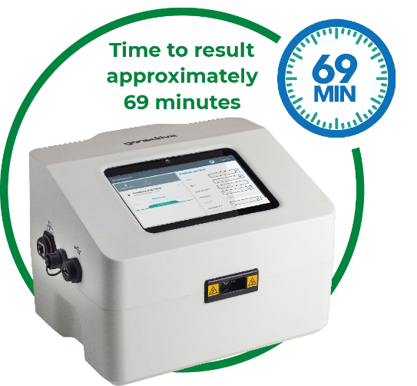



Current Clinical Pathway
Clinician to administer treatment within 24hrs
Metaboliser status not known
30% of patients do not respond to clopidogrel
Stroke Patient Admitted
With Genedrive® System Implemented
Normal/Rapid/Ultrarapid Metaboliser status identified
Consider clopidogrel
Clinician to administer treatment within 24hrs
Intermediate/Poor Metaboliser status identified
Consider alternative treatment

Slide 19
Our Solution

Slide 20
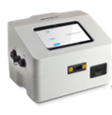
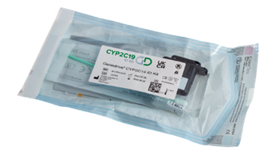
Pharmacogenetic test to inform clinicians on an individual's CYP2C19 genotype and metaboliser status
Genedrive System using the CYP2C19 ID Kit
The only point-of-care genetic test to aid clinicians' therapeutic treatment decisions, for drugs that are metabolised by CYP2C19, and that are specifically affected by DNA variant alleles *2, *3, *4, *8, *17 and *35

Slide 21









Genedrive® System
Provides rapid automated
results in approximately 69 minutes
Designed to be used in time critical situations,
prior to antibiotic treatment prescription
Results export via
Ethernet or WiFi to SFTP
Uses multiplex PCR amplification and fluorescent probe-based target discrimination
Easy to operate touch screen
with barcode scanning ability
RFID enabled reagent lock out
to prevent use of expired tests
Compact benchtop design allowing it to be placed at the point-of-care or laboratory setting
Flexible connectivity to
external systems/middleware providers
Optional Bluetooth printer
for instant results recording

Slide 22

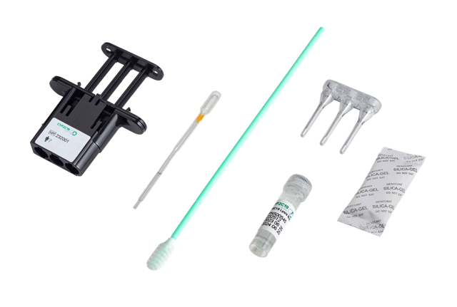
Genedrive® CYP2C19 ID KIT
Point of care genetic test to be used in time critical situations, to guide therapeutics that are metabolised by Cytochrome P450 2C19 (CYP2C19)
Allows personalised treatment for drugs metabolised by CYP2C19, including the antiplatelet Clopidogrel
Non-invasive test, using single buccal swab
Simple workflow
Rapid actionable results in approximately 69 minutes including diplotype and metaboliser status
Easy adoption into existing workflows
No cold storage required for reagents
Comprehensive variant coverage identifying clinically relevant alleles of CYP2C19 Loss of Function (*2, *3, *4, *8, *35) and gain of function (*17)

Slide 23
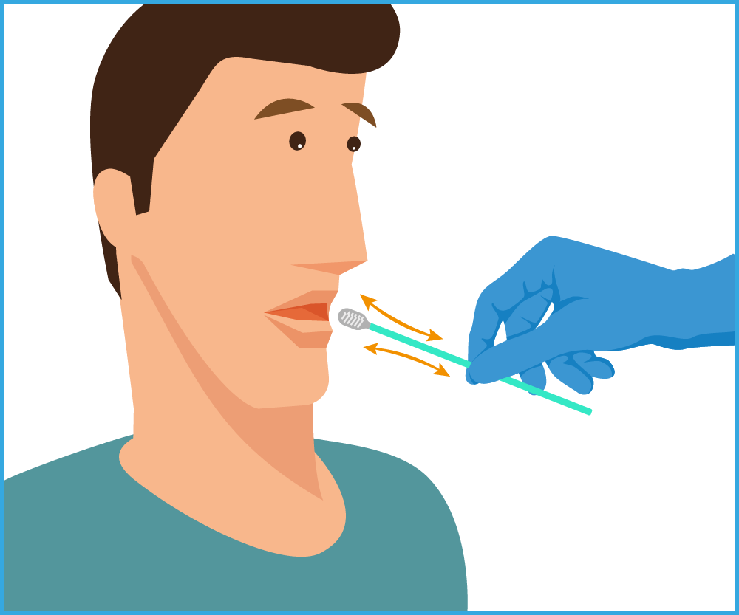
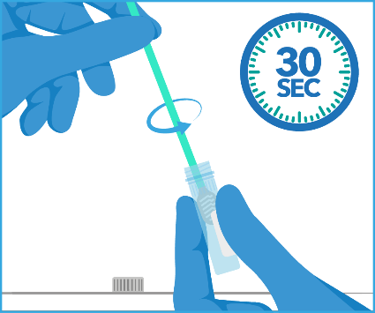
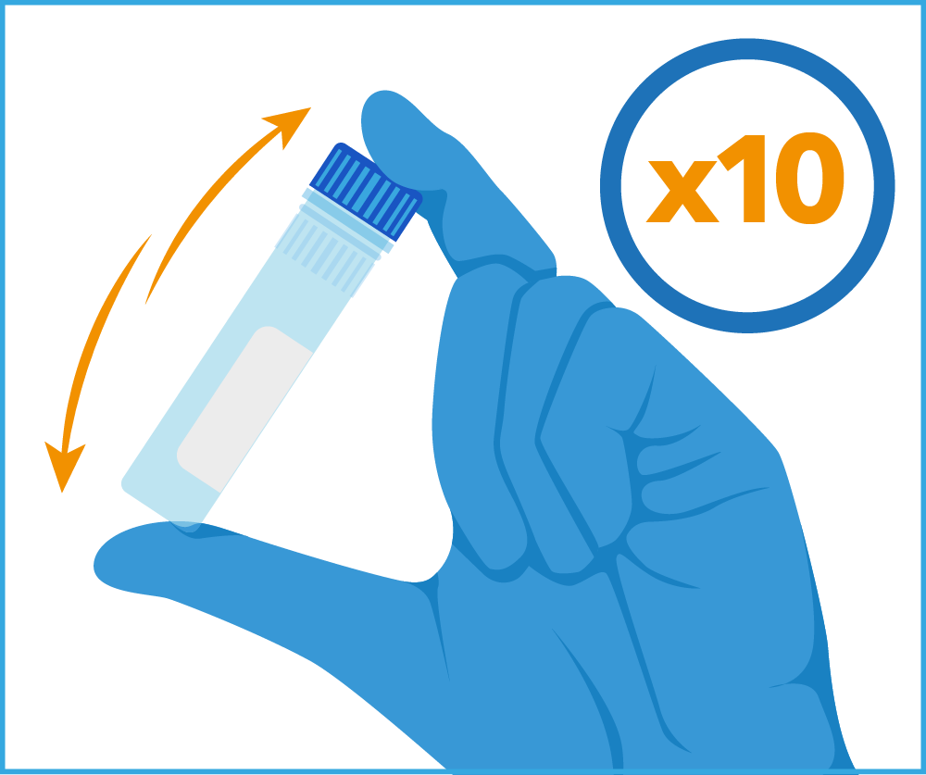
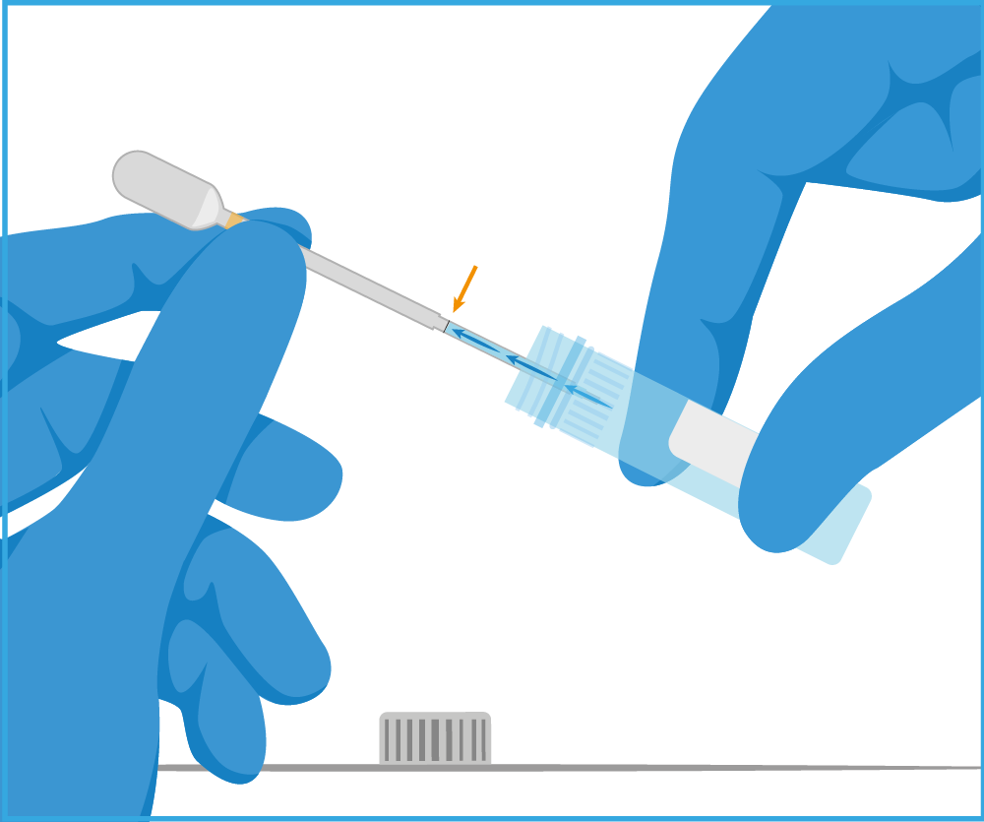
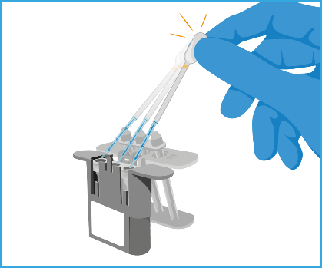
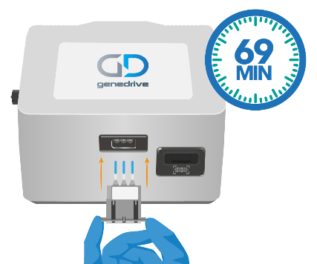
Genedrive CYP2C19 ID Kit Workflow
Simple workflow
Swab
Mix
Invert
Transfer
Reconstitute
Start test

Slide 24
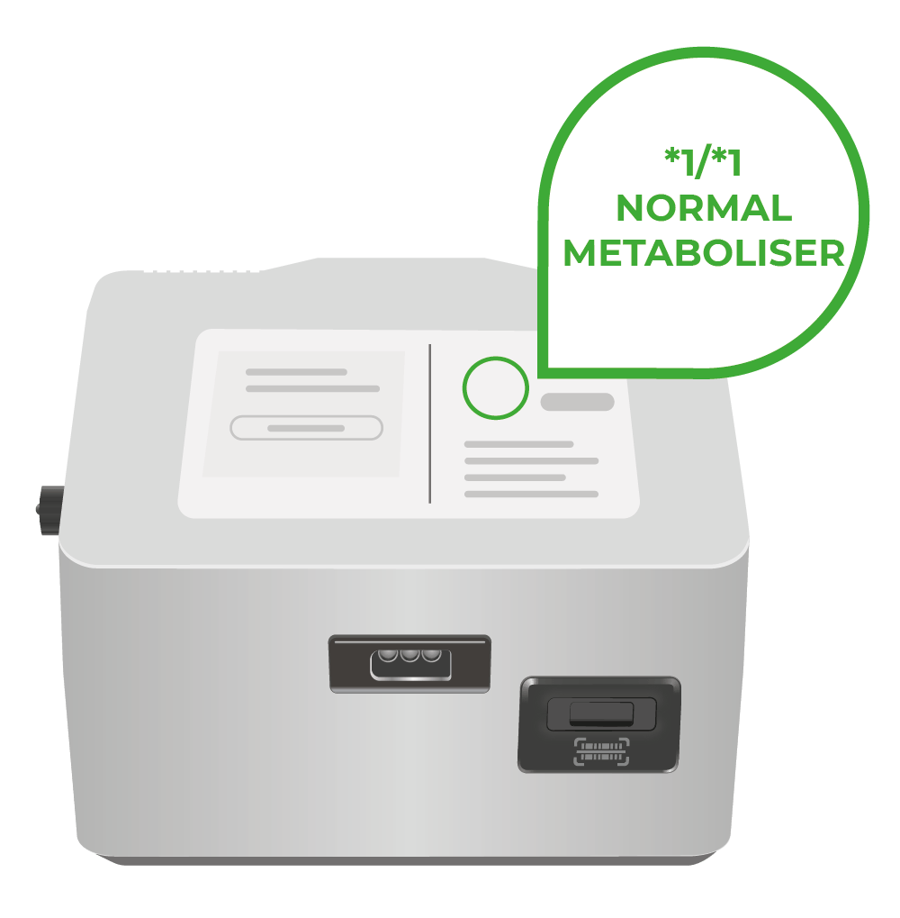

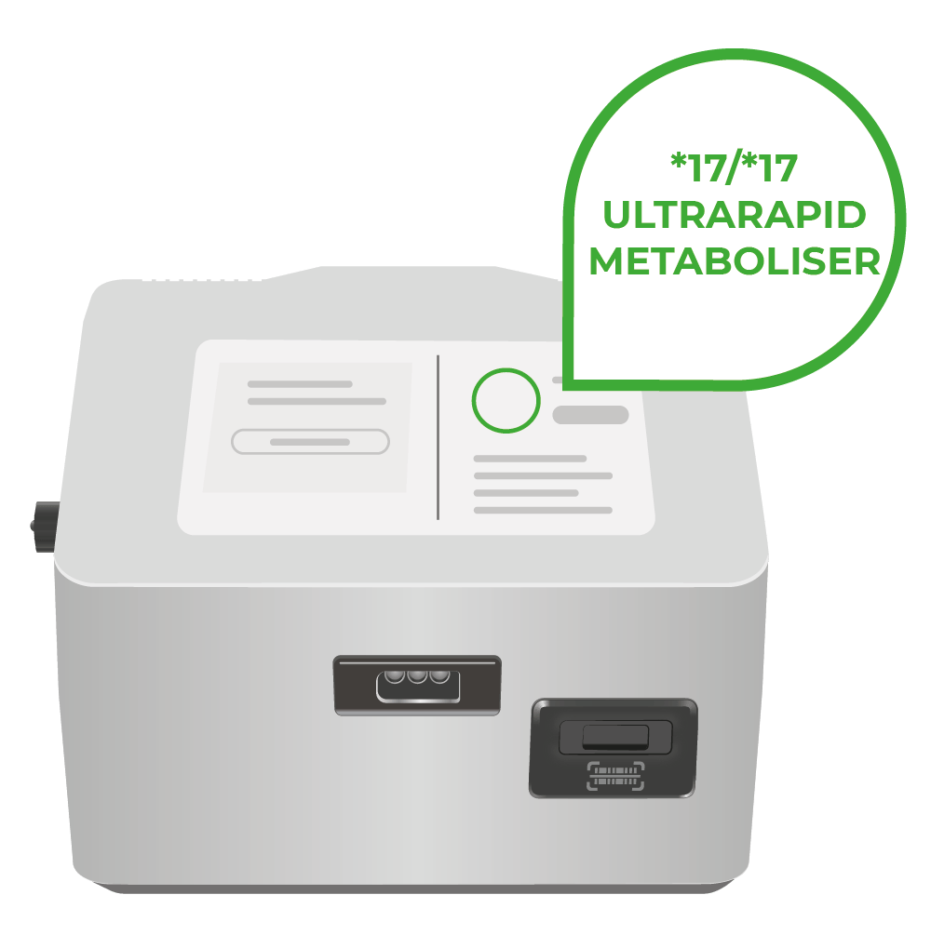
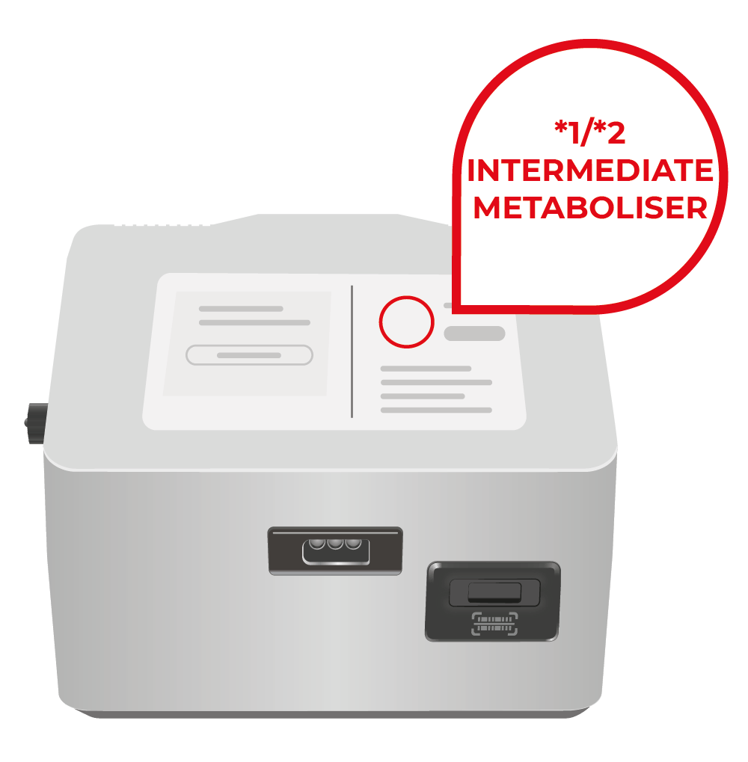
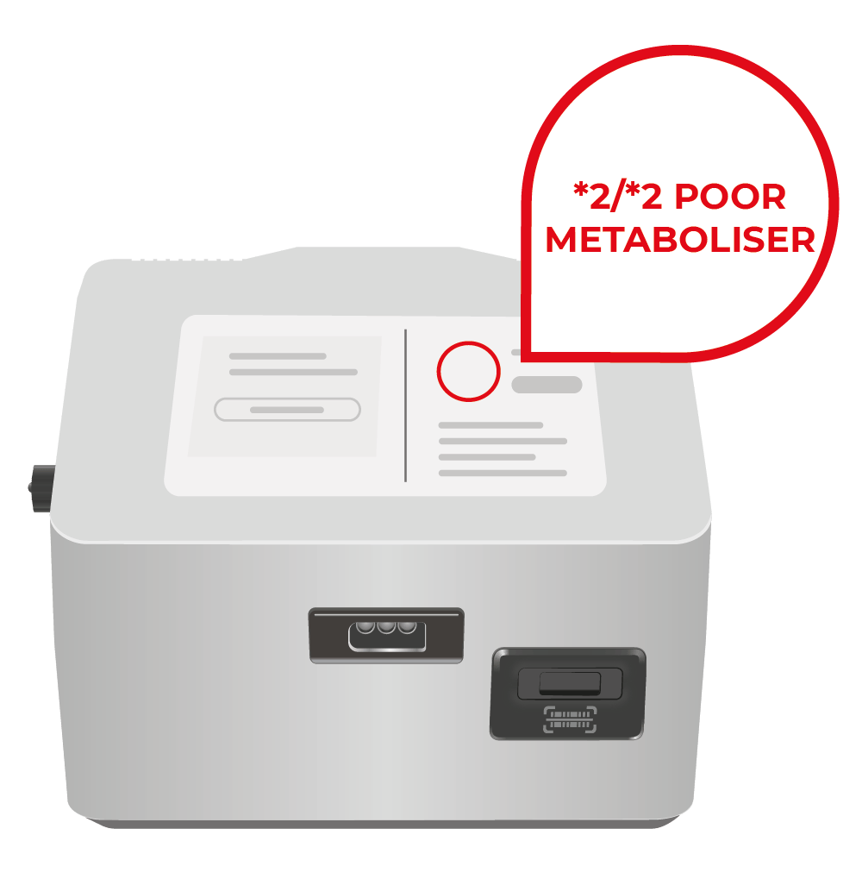
Results
Clear actionable results screens showing the diplotype identified and CPIC-coded metaboliser status
Consider clopidogrel
Consider clopidogrel
Consider clopidogrel
Consider alternative treatment
Consider alternative treatment

Slide 25
Product Range

Slide 26

Genedrive® CYP2C19 Product Range
Genedrive System
GS-003
Genedrive® CYP2C19 ID Kit (ID-CYP2C19-01)
Genedrive® CYP2C19 Control Kit (CYP2C19-CTRL-01)
Label Printer and charging cradle
GS-PTR-01
Images are intended as representations

Slide 27

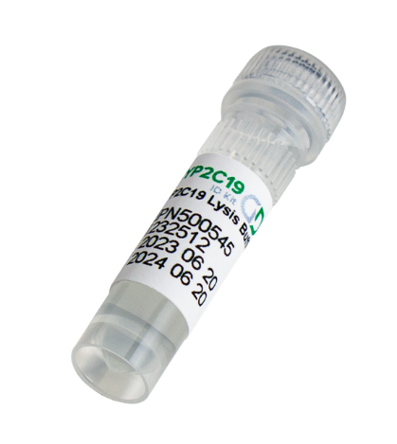
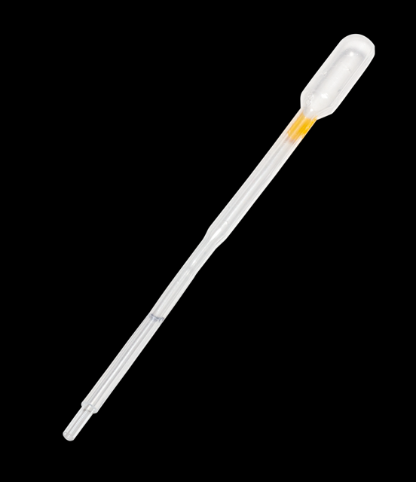
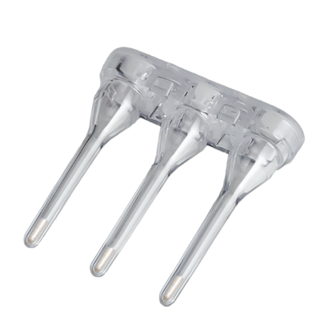
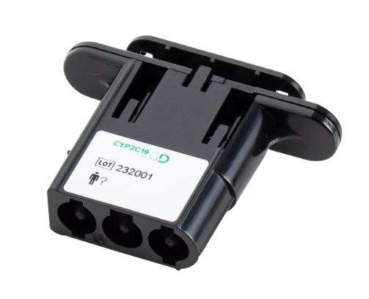
Genedrive® CYP2C19 ID Kit
Kit Components
Product Code | Product Description | Box Quantity
ID-CYP2C19-01 | Genedrive® CYP2C19 ID Kit | 10 test kits
1 x buccal swab
1 x CYP2C19
lysis buffer
1 x Transfer Capillary Pipette (20ul)
1 x Genedrive assay cartridge containing lyophilised amplification reagents
1 x assay cartridge lid with RFID tag
Images are intended as representations

Slide 28
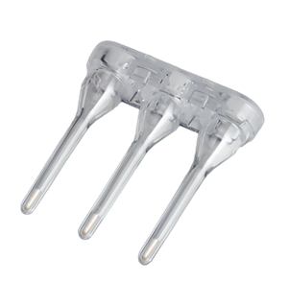
Genedrive® CYP2C19 Control Kit
Kit Components
Product Code | Product Description | Box Quantity
CYP2C19-CTRL-01 | Genedrive® CYP2C19 Control Kit | 10 test kits
1 x Control lysis buffer
1 x Transfer Capillary Pipette (20ul)
1 x CYP2C19 Positive assay cartridge containing lyophilised control reagents
1 x assay cartridge lid with RFID tag
Images are intended as representations

Slide 29
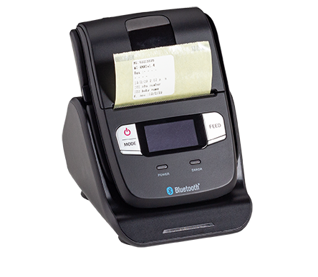
Bluetooth Label Printer
Kit Components
Product Code | Product Description | Box Quantity
GS-PTR-01 | Bluetooth label printer | 1
GS-PTR-02 | Replacement label | 2 rolls of 200
The Bluetooth label printer and charging cradle is an optional accessory, with custom labels, available from Genedrive
A handheld label printer with charging cradle
The charging cradle connects to the Genedrive® System via the USB cable provided and slots into USB 2.0 port
The label printer connects via Bluetooth enabling printing of labels containing test details and patient information

Slide 30

Genedrive CYP2C19 Stability & Storage Conditions
Operating conditions:
Genedrive® CYP2C19 ID Kit must be operated on the
Genedrive® System under the following conditions:
Operating temperature 18°C – 30°C
Operating humidity: up to 75% RH
Storage and Shelf Life
Genedrive® CYP2C19 ID Kit must be stored between
2°C and 30°C.
Once the Genedrive assay cartridge has been removed from the foil pouch and the strip cap has been removed it is stable up to 30°C for 2 hours.
Collected Specimens are stable in the Lysis buffer for 70 days

Slide 31
Product Demonstration
See GPM-159 for test procedure

Slide 32
Genedrive
Performance Data

Slide 33
Clinical Performance
An external clinical performance study was conducted on behalf of GDL at Manchester University NHS Foundation Trust (MFT) in a near-patient setting. CYP2C19 diplotype alleles were genotyped in 204 adult specimens.
Accuracy was assessed by comparing results to validated reference methods, including the Agena™ iPLEX PGx 74 assay (MassARRAY) and Sanger Sequencing.
Efficiency & Test Fail Rate
Valid results were obtained from 202 clinical specimens, resulting in
efficiency of 99.02% (valid result on first run) and test fail rate of 0.98%
For loss of function and gain of function the overall results were as follows:
Notes:
Source IFU

Slide 34
Repeatability and Reproducibility
Precision (Intra-laboratory Repeatability)
The performance of the Genedrive® CYP2C19 ID Kit was evaluated at a single internal site across five days.
A total of 80 tests were performed, with 100% repeatability observed with respect to GoF and LoF, and 98.75% for * allele, diplotype and metaboliser status.
Precision (Inter-laboratory Reproducibility)
The performance of the Genedrive® CYP2C19 ID Kit was evaluated at three sites (one
internal, two clinical) across five days per site.
100% accuracy was observed across 180 tests (* allele, diplotype, metaboliser status and phenotype (GoF, LoF).
Notes:
Source IFU

Slide 35
Analytical Sensitivity (Limit Of Detection)
The analytical sensitivity, or Limit of detection (LoD) is defined as the lowest concentration which >95% of the tested specimens generate a positive result.
The clinical LoD of the Genedrive® CYP2C19 ID Kit is 71.5 cells per reaction, which equates to <5% of an average buccal swab.
Analytical specificity (cross reactivity) and interference
The effect of potential cross reactive commensal organisms was evaluated with pools of Oral, Skin, Gut and Mycobiome pooled target genomic DNA.
100% exclusivity was observed
Interference of all targeted * alleles at 3 x LoD was assessed by challenge of pooled genomic DNA at copies per test as indicated in the Kit IFU.
No interference at 3X LoD was observed with Oral, Skin, Mycobiome or Gut genomic DNA.
Notes:
Source IFU

Slide 36
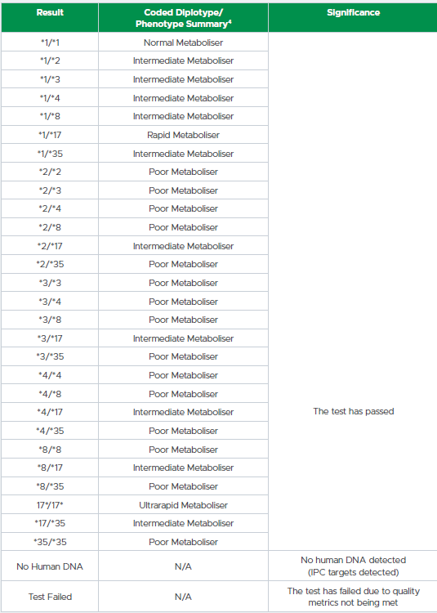
Results
Upon completion the test results are displayed on the screen.
The results are presented as diplotype identified and CPIC-coded metaboliser status.
In the event of a ‘Test Failed’ result, the same patient specimen should be retested.
In the event of a repeated ‘Test Failed’ result or ‘No Human DNA’ result, take a fresh buccal swab from the same patient and repeat the procedure.
Result history can be searched and filtered on the Genedrive System.
Notes:
Source IFU

Slide 37
The Guidance

Slide 38

CPIC Guidance
CYP2C19 intermediate and poor metabolisers who receive clopidogrel experience reduced platelet inhibition and increased risk for major adverse cardiovascular and cerebrovascular events.
Metabolizer Status | Implications | Therapeutic Recommendation
CYP2C19 intermediate metabolisers | Reduced clopidogrel active metabolite formation; increased on-treatment platelet reactivity; increased risk for adverse cardiac and cerebrovascular events | Avoid standard dose (75 mg) clopidogrel if possible. Use prasugrel or ticagrelor at standard dose if no contraindication
CYP2C19 poor metabolisers | Reduced clopidogrel active metabolite formation; increased on-treatment platelet reactivity; increased risk for adverse cardiac and cerebrovascular events | Avoid standard dose (75 mg) clopidogrel if possible. Use prasugrel or ticagrelor at standard dose if no contraindication
Notes:
Clinical Pharmacogenetics Implementation Consortium Guideline for CYP2C19 Genotype and Clopidogrel Therapy: 2022 Update (cpicpgx.org)

Slide 39
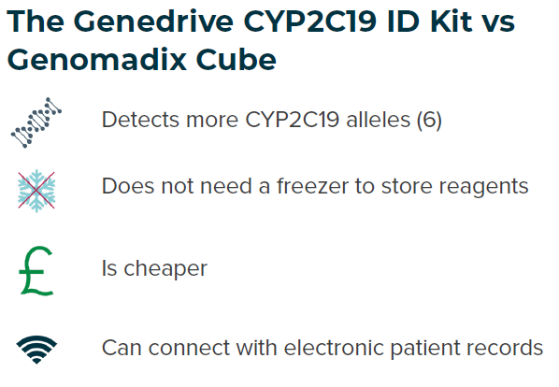
CYP2C19 Genotype Testing to Guide Clopidogrel Use After Ischaemic Stroke or Transient Ischaemic Attack
NICE Recommendation
Laboratory based testing and point-of-care testing (POCT) are recommended.
The Genedrive CYP2C19 ID Kit should be used when laboratory-based testing is not available.
What it Means in Practice:
UK National Stroke clinical guideline recommends that dual antiplatelet therapies (such as Clopidogrel and aspirin) are administered in <24 hours of the event.
Conventional laboratory testing workflows are unlikely to turnaround actionable results in this time.
The Genedrive CYP2C19 ID Kit should be used when laboratory-based testing is not available.
Notes:
8. https://cks.nice.org.uk/topics/antiplatelet-treatment/

Slide 40
Research Studies
& Publications

Slide 41
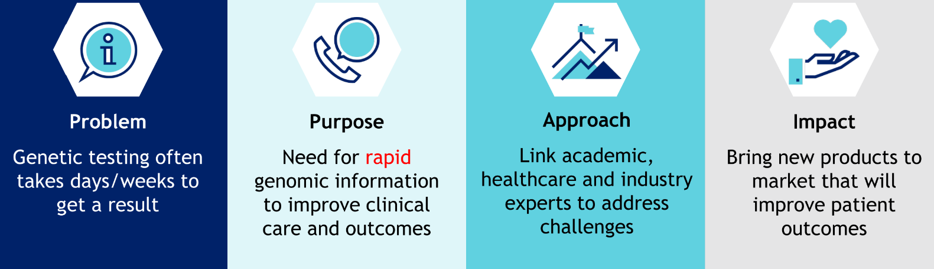
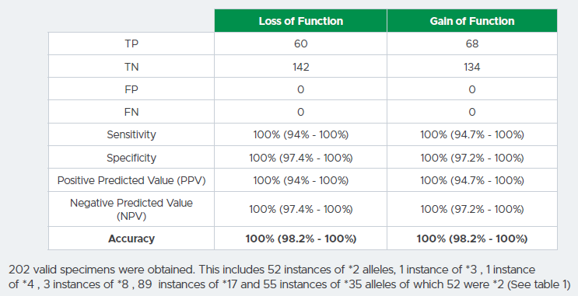
DEvelopment and Validation Of Technology for time critical genomic testing (DEVOTe) program
2024 study compared Genedrive to the MassARRAY:
Genedrive had fewer test fails
Was more accurate
Valid results were obtained from 202 clinical specimens, resulting in
efficiency of 99.02% (valid result on first run) and test fail rate of 0.98%
Notes:
Method Comparison (2024) - Genedrive CYP2C19 ID Kit vs Agena MassARRAY
204 individuals
Genedrive CYP2C19 ID Kit was more accurate (Agena misclassifying some individuals)
Genedrive CYP2C19 ID Kit included *35
In cohort, 7 LOF individuals outside *2 and *3
Clinical Performance
Loss of Function Gain of Function
TP 60 68
TN 142 134
FP 0 0
FN 0 0
Sensitivity 100% (94% - 100%) 100% (94.7% - 100%)
Specificity 100% (97.4% - 100%) 100% (97.2% - 100%)
(PPV) 100% (94% - 100%) 100% (94.7% - 100%)
(NPV) 100% (97.4% - 100%) 100% (97.2% - 100%)
Accuracy 100% (98.2% - 100%) 100% (98.2% - 100%)
202 valid specimens were obtained. This includes 52 instances of *2 alleles, 1 instance of *3 , 1 instance
of *4 , 3 instances of *8 , 89 instances of *17 and 55 instances of *35 alleles of which 52 were *2 (See table 1)
Efficiency & Test Fail Rate
Valid results were obtained from 202 clinical specimens, resulting in
efficiency of 99.02% (valid result on first run) and test fail rate of 0.98%

Slide 42
NICE CYP2C19 Implementation Assessment
Project led by Network of Excellence, supported by NHS Stroke Programme and NHS Genomics Unit
Designed to test a "minimal viable service" and share learnings with the rest of NHS
7-month project (October 2024 – May 2025)
Four varied sites across England – ST Georges, Exeter, Doncaster, Salford
One lab testing site – Liverpool – 1000 tests
One Genedrive POC site – Salford – 1000 tests
Continuous feedback
  Mapping process to generate additional information for commissioning decision
  Generate Implementation guidance
Hospitals can act now, with the project guaranteeing improved support and guidance down the line.

Slide 43
NICE CYP2C19 Implementation Assessment
Early Challenges and Considerations:
Early findings/Challenges
Patient Selection: Requesting tests. Who to test and how to rollout.
Taking Samples: Packaging and Posting Samples
Turnaround time: The expected turnaround time poses significant logistical and operational challenges.
Receiving Results: Logging them onto internal systems
Actioning Results: Altering Prescriptions and Communicating with Patients
Clear at this point that POC testing will play a crucial part in meeting these challenges

Slide 44
Competitive Landscape

Slide 45



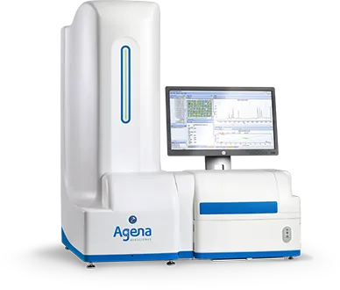
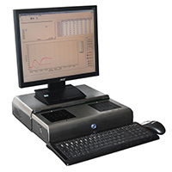

Competitive Landscape
Laboratory Genotyping
Platelet Function Testing
Point-of-Care Genotyping
Genedrive System
Genomadix Cube
The MassARRAY® System
Stago TA - 4V

Slide 46


Point Of Care Genotyping
NICE’s POC System of choice
More inclusive allele coverage *2, *3, *4, *8, *17, *35
Approximately 69 minutes
Single Buccal Swab
No cold storage required
Cheaper
Connects with electronic patient record
Results including metabolizer status
Alleles *2, *3, *17,
Approximately 60 minutes
Three Buccal Swabs
Notably in a 2024 study. In a cohort of only 204 patients the Genedrive test identified 7 loss of function alleles other than *2 & *3, ultimately increasing ethnic coverage of testing.
Notes:
Additional benefits: Genedrive use Softer Swab

Slide 47



Genedrive® VS Genomadix
https://mft.nhs.uk/2024/07/31/manchester-leads-implementation-of-lifesaving-genetic-bedside-stroke-test/
UK based Company
Designed by the NHS for the NHS
Systems and Reagents manufactured in UK
UK based sales and support teams
Does not require cold chain shipping
https://mft.nhs.uk/2024/11/21/genetic-test-developed-by-manchester-researchers-to-prevent-newborn-babies-going-deaf-to-be-trialled-across-the-uk/

Slide 48
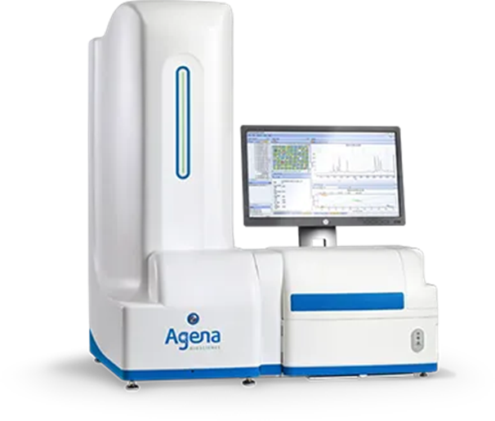

Laboratory Genotyping
2024 study compared Genedrive to the MassARRAY:
Genedrive had fewer test fails
Was more accurate
Alleles *2, *3, *4, *8, *17, *35
Single Buccal Swab
Results in ~69 minutes:
Treatment decision made on the same day and is not pushed to primary care
Research shows POC users receive much faster actionable results and incur significant saving on medication costs.¹
National guideline recommends that dual antiplatelet therapies are administered in <24 hours of the event.
Alleles *2, *3, *4, *5, *6, *7, *8, *17, *35
Blood Samples
Results in a week or more
Results exported as CSV and require interpretation
Complexity on how to return and act on results as patient likely discharged
Notes:
Genomic hubs in England and Wales don't currently offer CYP2C19 testing outside the implementation assessment
Single point of contact for the test
Sending a test out and transport incurs costs
Nice raise concerns on ability for lab testing to handle volume
1. A recent real-world study including 1,530 patients compared central lab testing to point-of-care (POC) genotyping. The POC group received much faster actionable results and there was also a significant saving on medication costs.²
1. Levens AD, den Haan MC, Jukema JW, Heringa M, van den Hout WB, Moes DJAR, Swen JJ. Feasibility of Community Pharmacist-Initiated and Point-of-Care CYP2C19 Genotype-Guided De-Escalation of Oral P2Y12 Inhibitors. Genes (Basel). 2023 Feb 25;14(3):578. doi: 10.3390/genes14030578. PMID: 36980851; PMCID: PMC10048116.

Slide 49
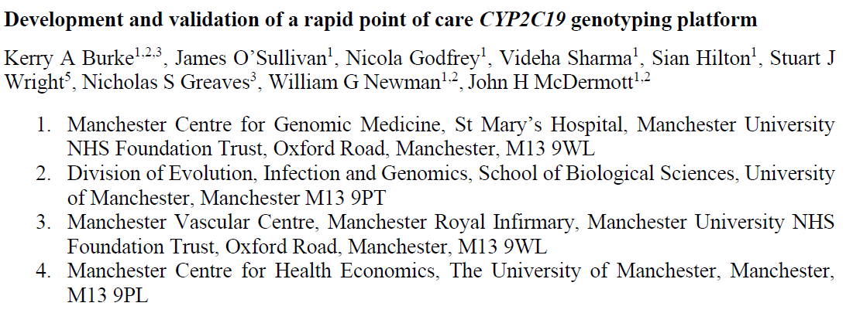
Comparison of Genedrive® vs Lab Testing
204 individuals
The Genedrive had less test fails than laboratory testing
The Genedrive CYP2C19 ID Kit was more accurate (Agena misclassifying some patients) and also covered *35 (which Agena doesn’t currently).
It was notable in this cohort of only 200 patients that 7 of these were loss of function alleles other than *2 & *3, ultimately increasing ethnic coverage of LoF variants.

Slide 50
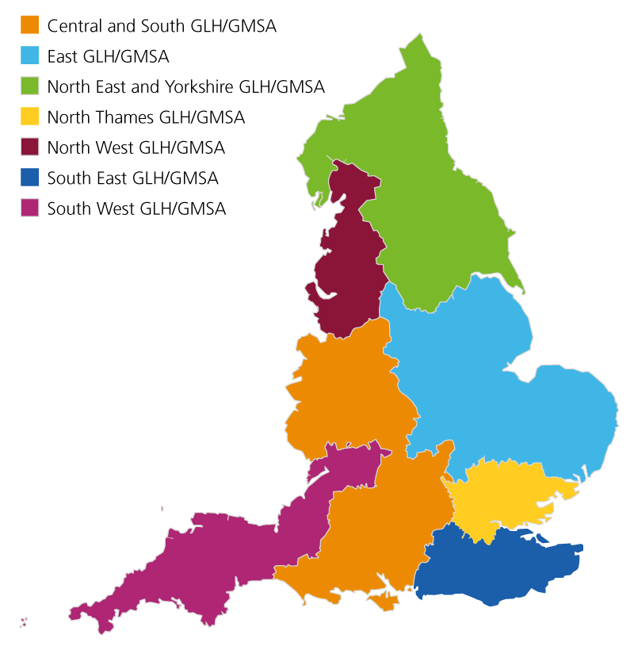
Laboratory Testing Pathways VS POC testing Pathways
Blood Sample Taken
Sample Posted to GLH
Patient Admitted
DNA Extracted
Testing Performed
Report Written
Report Sent Back to HCP
~2-3 Weeks Turnaround Time (TAT)
Significant System Complexity
Prescription Adjusted
POCT
Patient Admitted
Testing Performed
Prescription Adjusted

Slide 51
Platelet Function Testing
Consistent results unaffected by medication, diet or illness.
Results in approximately 69 mins
Once in a lifetime testing
Evidence based standardized guidance
No requirement for individual to be on anti-platelet therapy
Direct measure of response
Includes genetic and non-genetic factors
Non-Standardized guidance
May need to be repeated multiple times
Patient must be on anti-platelet therapy
Notes:
Testing techniques, agonist choice, protocols, reagents used, sample handling and patient condition (copharmacies, comorbidities) can change results.
Lack of a universal reference range for results.
Rapid or long lead time depending on platform

Slide 52
GPM-146
About Us
CYP2C19
Genedrive are experienced developers of POC PGx tests
Strong partnerships with academic institutions and healthcare providers
CYP2C19 is responsible for metabolising many drugs
Genetic variations in CYP2C19 are common
Poor and intermediate metabolisers experience worse outcomes when treated with clopidogrel
Conclusion
The Genedrive® CYP2C19 ID kit
Allows personalised treatment for drugs metabolised by CYP2C19, including the antiplatelet Clopidogrel
Our Solution
The Guidance
Non-invasive test
Broad variant coverage
Simple workflow
Rapid actionable results in approximately 69 minutes
CPIC – Define metaboliser status
NICE – Recommend CYPC2C19 genetic testing
National stroke Guidelines – recommend clopidogrel administered within 24hrs

Slide 53

Thank you

Slide 54
Technical Documents
Supporting Materials
Sales Aids
Training Documents
ID-CYP2C19-IFU:
Genedrive CYP2C19 ID Kit Instructions For Use
CYP2C19-CTRL-IFU: Genedrive Control Kit Instructions For Use
GUM-7: Genedrive System User Manual
GPM-136: Genedrive CYP2C19 ID Kit Sales Flyer
GPM-152: Genedrive CYP2C19 NICE DAP Summary sheet
GPM-135: ID Kit Quick Reference Guide
GPM-160: Control Kit Quick Reference Guide
GPM-157: Critical Steps
GPM-158: Product Introduction Presentation
GPM-159: Test Procedure Presentation
GPM-146 Product Overview Presentation

